Slide 1
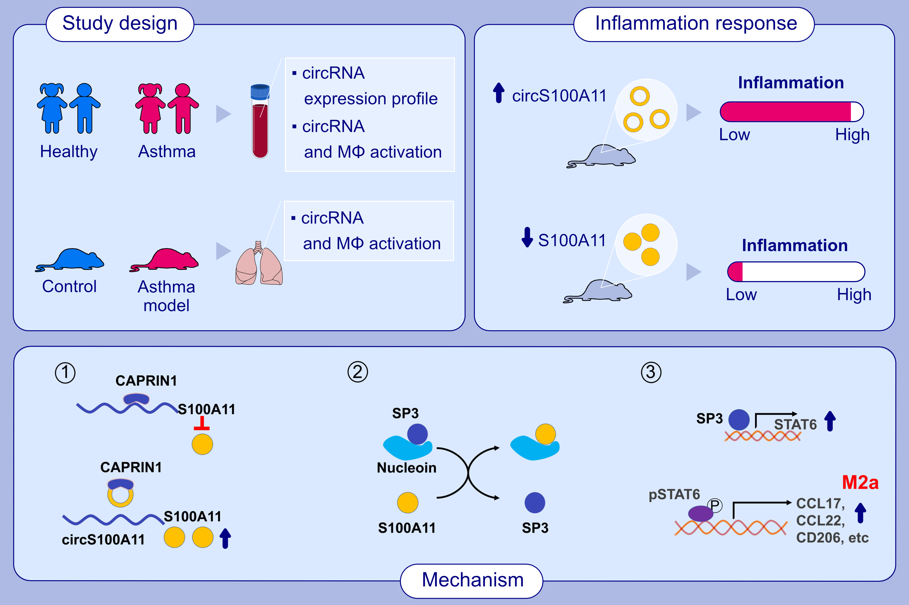
circS100A11 enhances M2a macrophage activation and lung inflammation in children with asthma
Qiuyan Liang, Jinrong Fu, Xiang Wang, Lijuan Liu, Wenfeng Xiao , et al.
Allergy. 2023; pages:1020-1035
https://doi.org/10.1111/all.15515
© 2019 EAACI and John Wiley and Sons A/S. Published by John Wiley and Sons Ltd.
Notes:
HIGHLIGHTS
circS100A11 was screened out by microarray analysis. circS100A11 facilitated M2a macrophage activation by enhancing S100A11 translation through competitively binding to CAPRIN1.
S100A11 liberated SP3 from nucleolin and promoted SP3 binding to the STAT6 promoter to enhance STAT6 expression and M2a macrophage activation.
circS100A11 overexpression enhanced while S100A11 knockdown attenuated lung inflammation in asthmatic murine model.
Abbreviations: CAPRIN1, cell cycle associated protein 1; CCL, CC chemokine ligand; circRNA, circular RNA; MΦ, macrophage; S100A11, S100 calcium binding protein A11; SP3, specificity protein 3; STAT6, signal transducer and activator of transcription 6.

