Slide 1
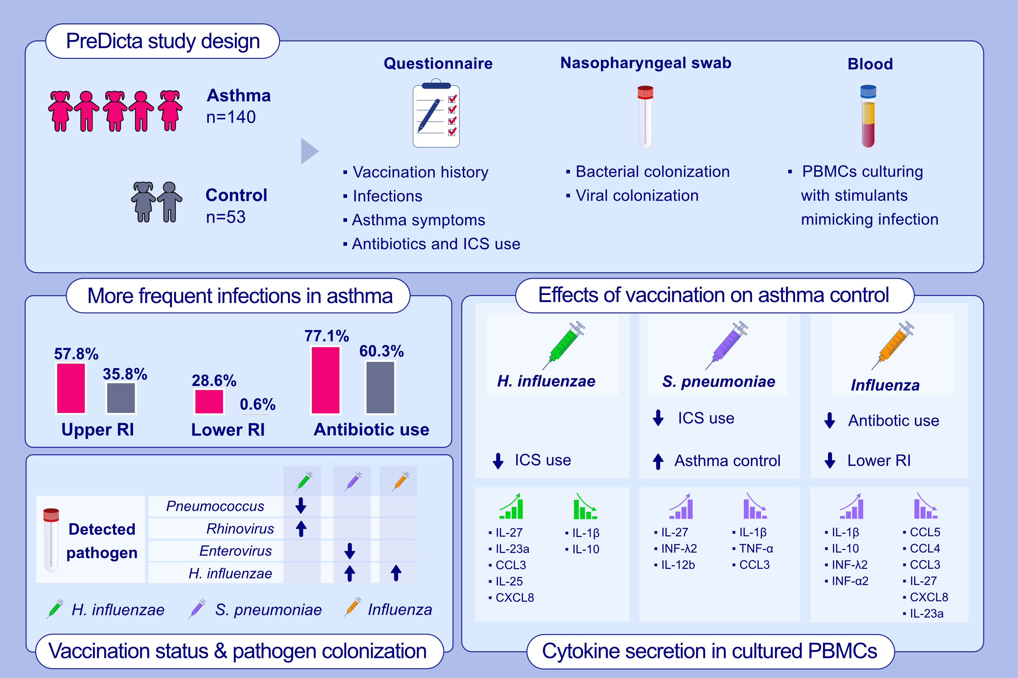
Effect of Haemophilus influenzae, Streptococcus pneumoniae and influenza vaccinations
on infections, immune response, and asthma control in preschool children with asthma
Ya-dong Gao, Paraskevi Xepapadaki, Yan-wen Cui, Barbara Stanic, Debbie J. Maurer, et al.
Allergy. 2023; pages:1020-1035
https://doi.org/10.1111/all.15551
© 2019 EAACI and John Wiley and Sons A/S. Published by John Wiley and Sons Ltd.
Notes:
HIGHLIGHTS
In the PreDicta cohort, we found that pneumococcal vaccination was associated with a reduced ICS use and better asthma control. Haemophilus influenzae vaccination was associated with reduced ICS use and influenza vaccination was associated with reduced LRI and antibiotic use in asthmatic preschool children.
Pneumococcal vaccination was associated with a predominant anti-inflammatory immune response, whereas H. influenzae or influenza vaccinations were associated with both pro- and anti-inflammatory responses.
Our results indicate that common vaccinations in asthmatic children benefit to asthma control and modulate immune responses relevant to improving asthma pathogenesis.
Abbreviations: CCL, chemokine (C-C motif) ligand; CXCL, chemokine (C-X-C motif) ligand; ICS, inhaled corticosteroid; CCL, chemokine (C-C motif) ligand; CXCL, chemokine (C-X-C motif) ligand; PBMCs, peripheral blood mononuclear cells; PreDicta, post-infectious immune reprogramming and its association with persistence and chronicity of respiratory allergic diseases; RI, respiratory infection; TNF-α, tumor necrosis factor alpha.

