Slide 1
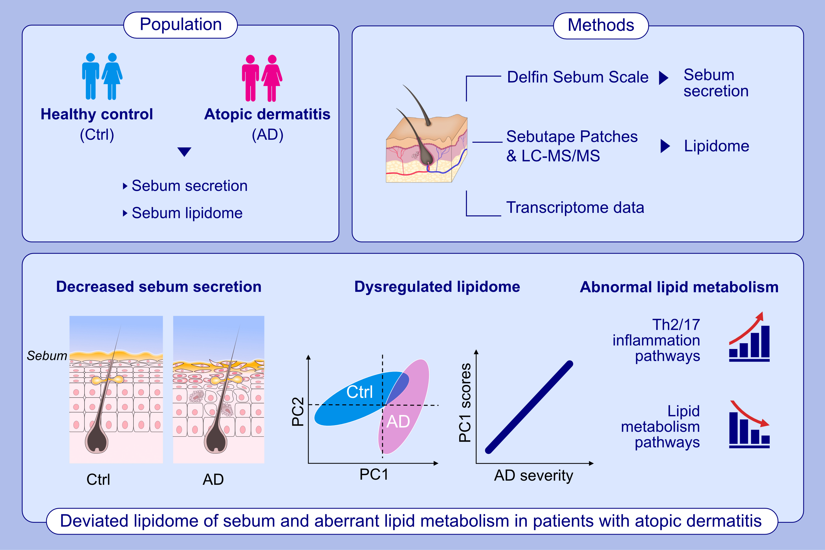
Dysregulated lipidome of sebum in patients with atopic dermatitis
Huibin Yin, Zhuoqiong Qiu, Ronghui Zhu, Shangshang Wang, Chaoying Gu, Xu Yao, Wei Li
Allergy. 2023; pages:1020-1035
https://doi.org/10.1111/all.15569
© 2019 EAACI and John Wiley and Sons A/S. Published by John Wiley and Sons Ltd.
Notes:
HIGHLIGHTS
The amount of sebum secreted from sebaceous glands is decreased in AD patients and negatively correlates with the barrier function and disease severity.
LC-MS/MS reveals the dysregulated lipidome of sebum in AD patients.
Transcriptome data demonstrate aberrant lipid metabolism in sebaceous glands of AD patients.
Abbreviations: AD, atopic dermatitis; Ctrl, healthy control; LC-MS/MS, liquid chromatography tandem-mass spectrometry; PC, principal component; Th, T helper cell

