Slide 1
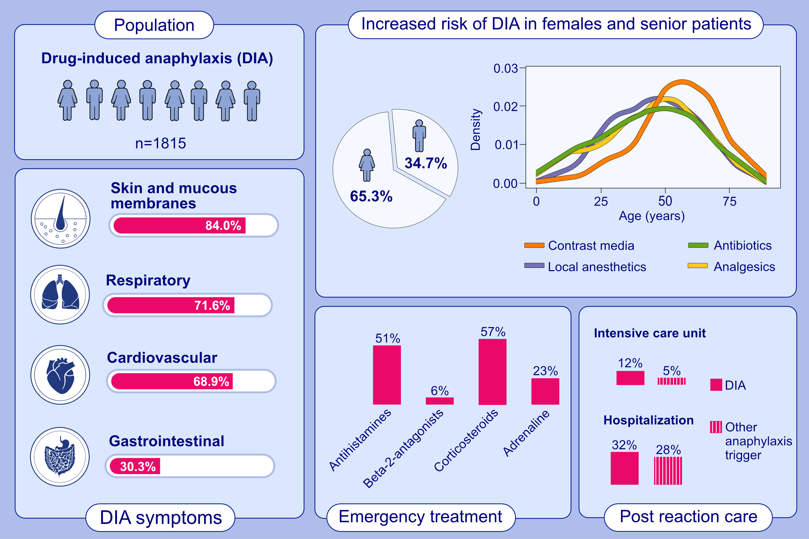
Different phenotypes of drug-induced anaphylaxis - data from the European Anaphylaxis Registry
Theresa Hanschmann, Wojciech Francuzik, Sabine Dölle-Bierke, Kathrin Scherer Hofmeier, Linus Grabenhenrich, et al.
Allergy. 2023; pages:1020-1035
https://doi.org/10.1111/all.15612
© 2019 EAACI and John Wiley and Sons A/S. Published by John Wiley and Sons Ltd.
Notes:
HIGHLIGHTS
This study analyzes data from the European Anaphylaxis Registry (2007-2019) with 1,815 reported cases of drug-induced anaphylaxis (DIA).
We show that female gender and higher age are relevant DIA risk factors. DIA symptoms affect skin and mucous membranes (84.0%), respiratory (71.6%), cardiovascular (68.9%) and gastrointestinal system (30.3%).
Intensive care admission and hospitalization rates are higher in DIA than in case of anaphylaxis caused by other elicitors (food- and insect venom-induced).
Abbreviations: DIA, drug-induced anaphylaxis

