Slide 1
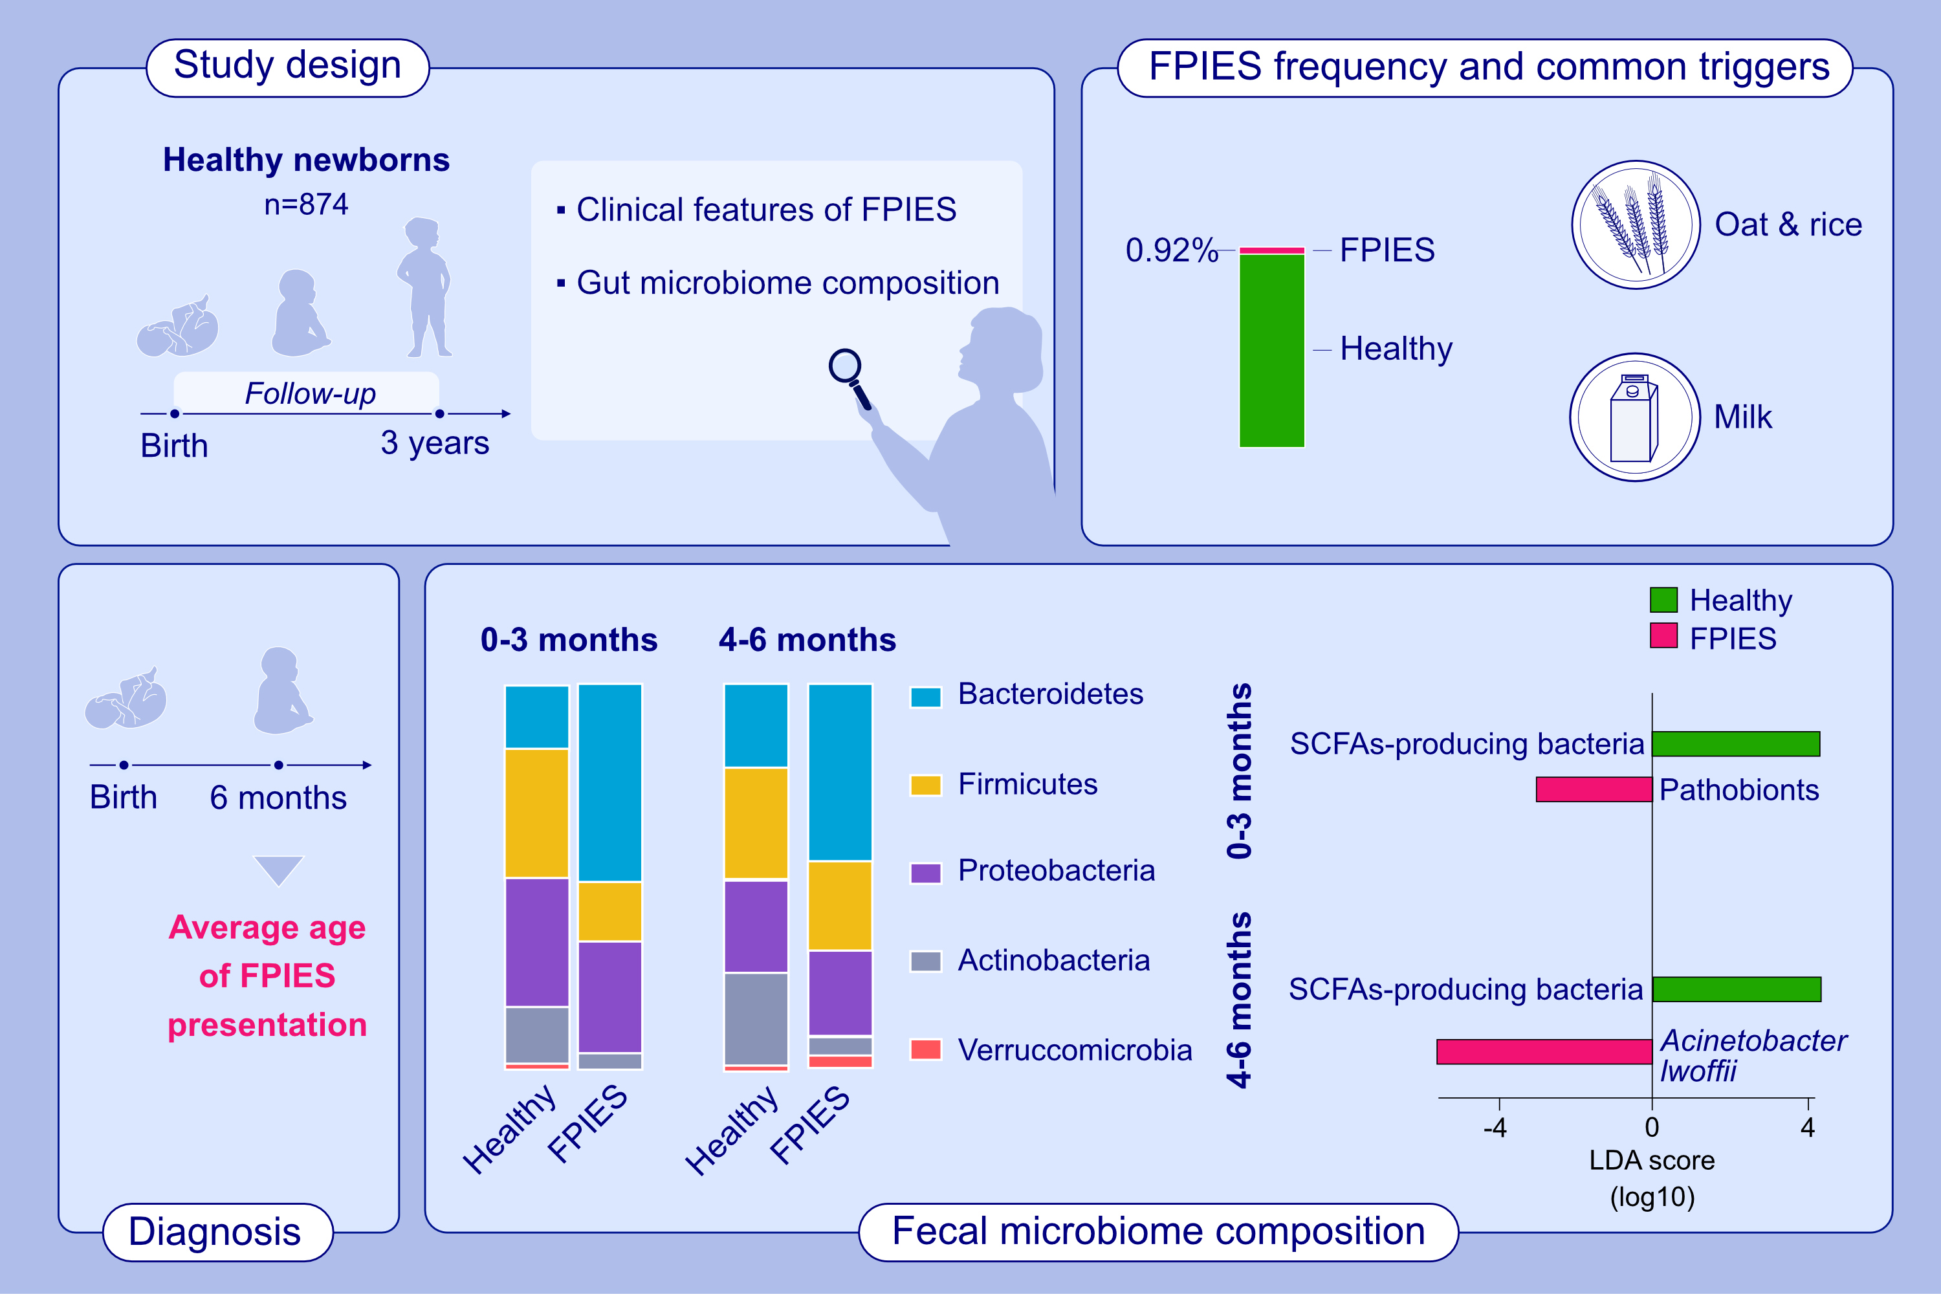
Early infancy dysbiosis in food protein-induced enterocolitis syndrome:
a prospective cohort study
Kuan-Wen Su, Murat Cetinbas, Victoria M. Martin, Yamini V. Virkud, Hannah Seay, et al.
Allergy. 2023; pages:1020-1035
https://doi.org/10.1111/all.15644
© 2019 EAACI and John Wiley and Sons A/S. Published by John Wiley and Sons Ltd.
Notes:
HIGHLIGHTS
The incidence of FPIES in 3 years in a healthy birth cohort was 0.92%. The average age of disease presentation was 6 months.
The most common FPIES triggers are oat and rice, followed by cow’s milk.
Dysbiosis, more pathobionts and less commensal bacteria were noted since birth from the stools of FPIES children.
Abbreviations: FPIES, food protein-induced enterocolitis syndrome; LDA, linear discriminant analysis; SCFAs, short chain fatty acid

