Slide 1
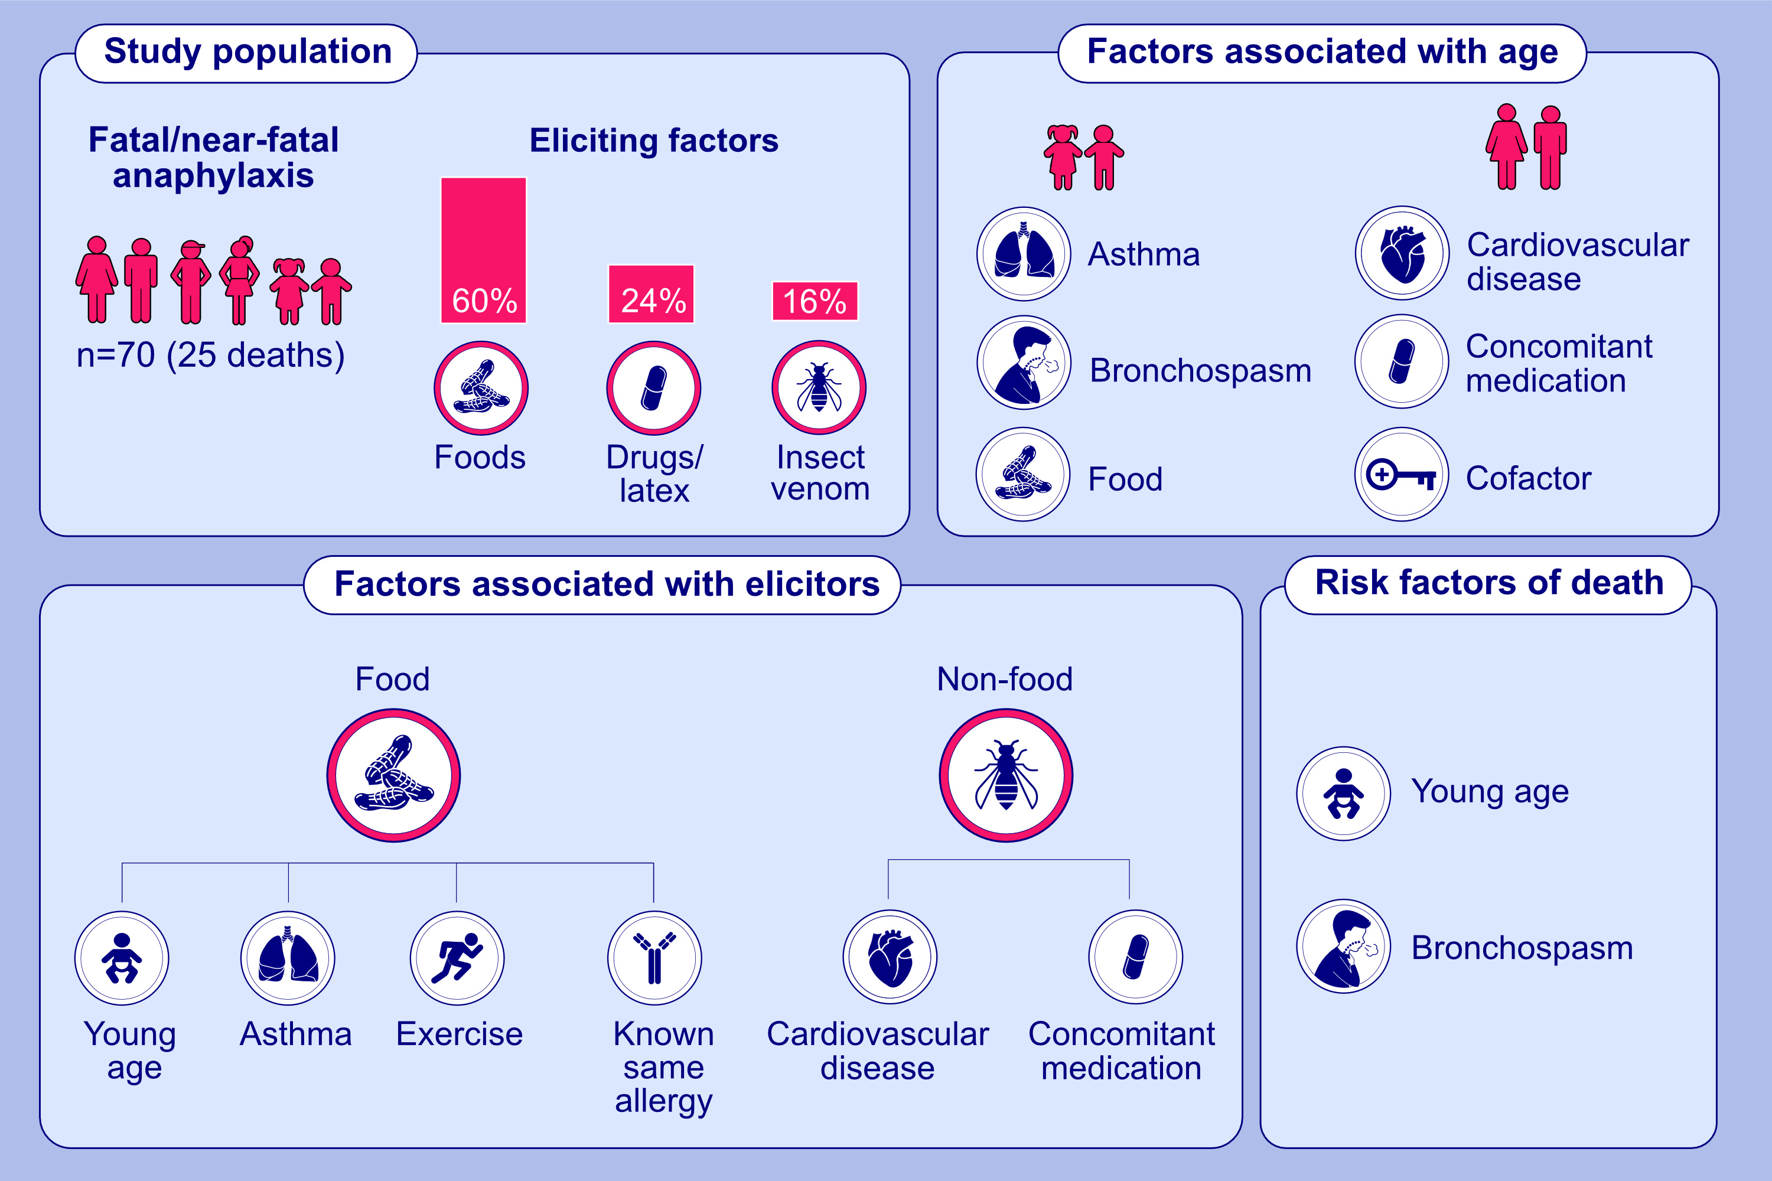
Fatal and near-fatal anaphylaxis:
the Allergy-Vigilance® Network data (2002-2020)
Guillaume Pouessel, Sabrina Alonzo, Amandine Divaret-Chauveau, Pascale Dumond, Eléna Bradatan, et al.
Allergy. 2023; pages:1020-1035
https://doi.org/10.1111/all.15645
© 2019 EAACI and John Wiley and Sons A/S. Published by John Wiley and Sons Ltd.
Notes:
HIGHLIGHTS
This study retrospectively analysed fatal/near-fatal anaphylaxis and evaluated the characteristics associated with survival, age and allergens. The major eliciting factors included: food (60%), drug/latex (24%) and insect venom (16%).
A history of asthma was identified in more than one-third of cases mainly involving food anaphylaxis and children, whereas bronchospasm was documented in the half of the food anaphylaxis cases.
The patients who died were younger than the survivors and mostly presented bronchospasm.

