Slide 1
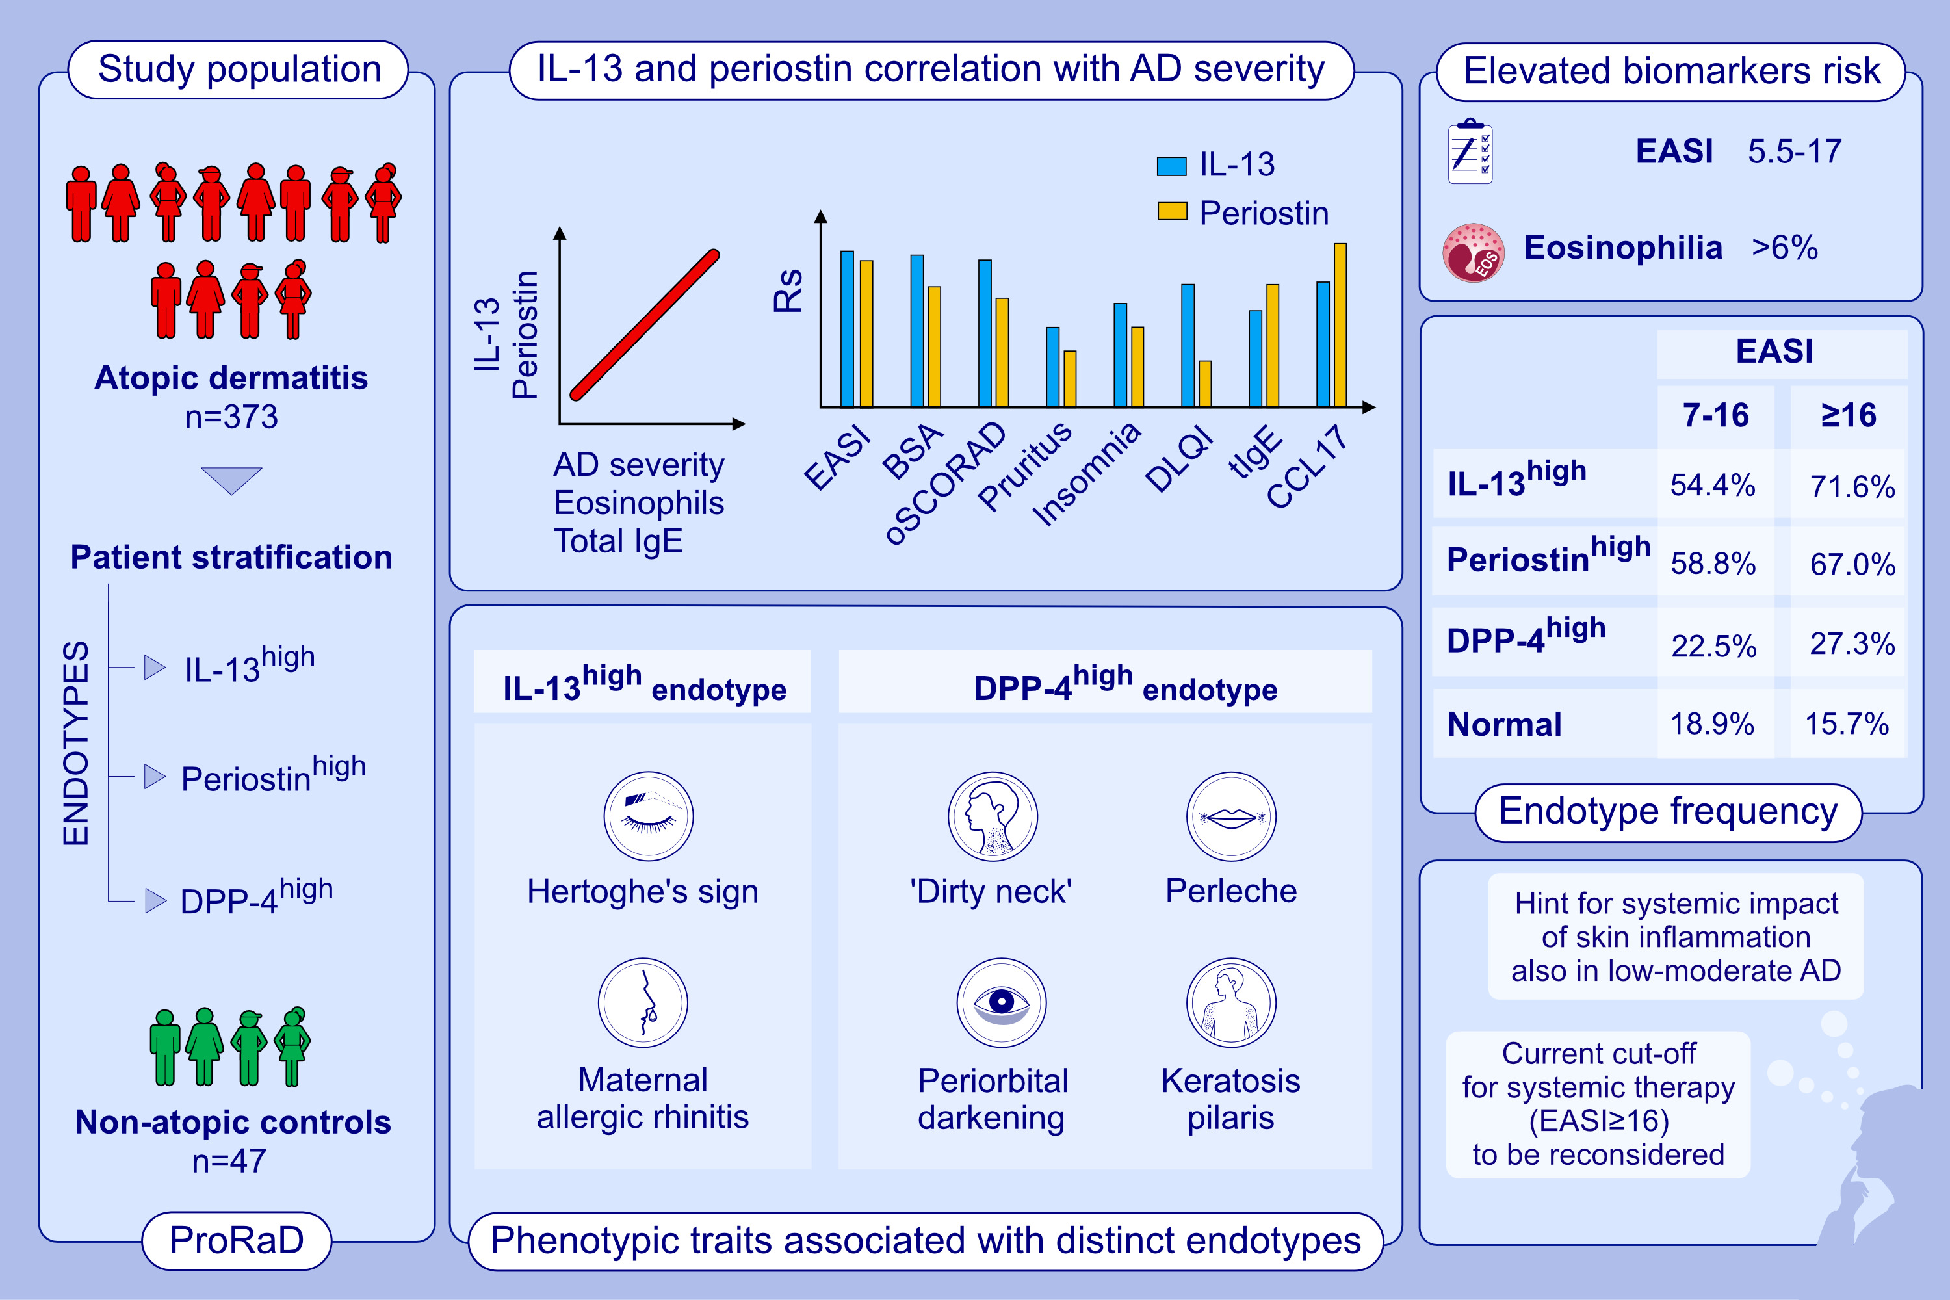
IL-13, periostin and dipeptidyl-peptidase-4 reveal endotype-phenotype associations
in atopic dermatitis
Laura Maintz, Thomas Welchowski, Nadine Herrmann, Juliette Brauer, Claudia Traidl-Hoffmann, et al.
Allergy. 2023; pages:1020-1035
https://doi.org/10.1111/all.15647
© 2019 EAACI and John Wiley and Sons A/S. Published by John Wiley and Sons Ltd.
Notes:
HIGHLIGHTS
IL-13 and periostin correlate with AD disease severity and eosinophils.
The substantial portion of biomarker^{high} patients with EASI<16 and machine-learning-based increasing probabilities of biomarker^{high} AD within EASI=5.5-17 dependent on the biomarker combination suggest systemic impact of skin inflammation also in mild-to-moderate AD and question the current cut-off EASI 16 for systemic therapy.
Several phenotypic traits (i.e. Hertoghe’s sign, periorbital darkening, ‘dirty neck’, keratosis pilaris, perleche) are associated with distinct endotypes.
Abbreviations: AD, atopic dermatitis; BSA, affected body surface area; CCL17, C-C motif chemokine ligand 17; DLQI, dermatology life quality index; DPP-4, dipeptidyl peptidase-4; EASI, eczema area and severity index; Eos, eosinophils; IL, interleukin; (o)SCORAD, (objective) scoring atopic dermatitis; ProRaD, prospective longitudinal study investigating the remission phase in patients with atopic dermatitis and other allergy-associated diseases; Rs, correlation coefficient; tIgE, total serum Immunoglobulin E

