Slide 1
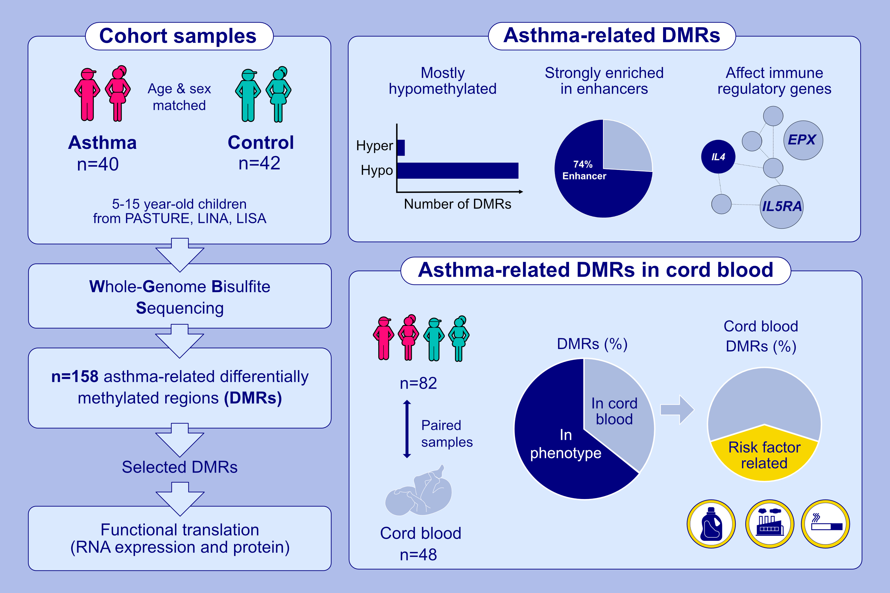
Global hypomethylation in childhood asthma identified by genome-wide
DNA-methylation sequencing preferentially affects enhancer regions
Loreen Thürmann, Matthias Klös, Sebastian D. Mackowiak, Matthias Bieg, Tobias Bauer, et al.
Allergy. 2023; pages:1020-1035
https://doi.org/10.1111/all.15658
© 2019 EAACI and John Wiley and Sons A/S. Published by John Wiley and Sons Ltd.
Notes:
HIGHLIGHTS
Whole-genome bisulfite sequencing in whole blood identifies 158 DMRs related
to childhood-asthma predominantly affecting enhancer regions, including an enhancer for IL-4.
Global DNA-hypomethylation in the asthma-phenotype affects key immune genes such as IL5RA or EPX.
35% of the aberrant DNA-methylation in asthma is already present in cord blood, which is partially related to adverse prenatal influences such as tobacco smoke exposure.
Abbreviations: DMR, differentially methylated region, EPX, eosinophil peroxidase; IL5RA, interleukin 5 receptor subunit alpha; LINA, Lifestyle and environmental factors and their influence on newborns allergy risk; LISA, Lifestyle-related factors on the immune system and the development of allergies in childhood; PASTURE, Protection against allergy: study in rural environments

