Slide 1
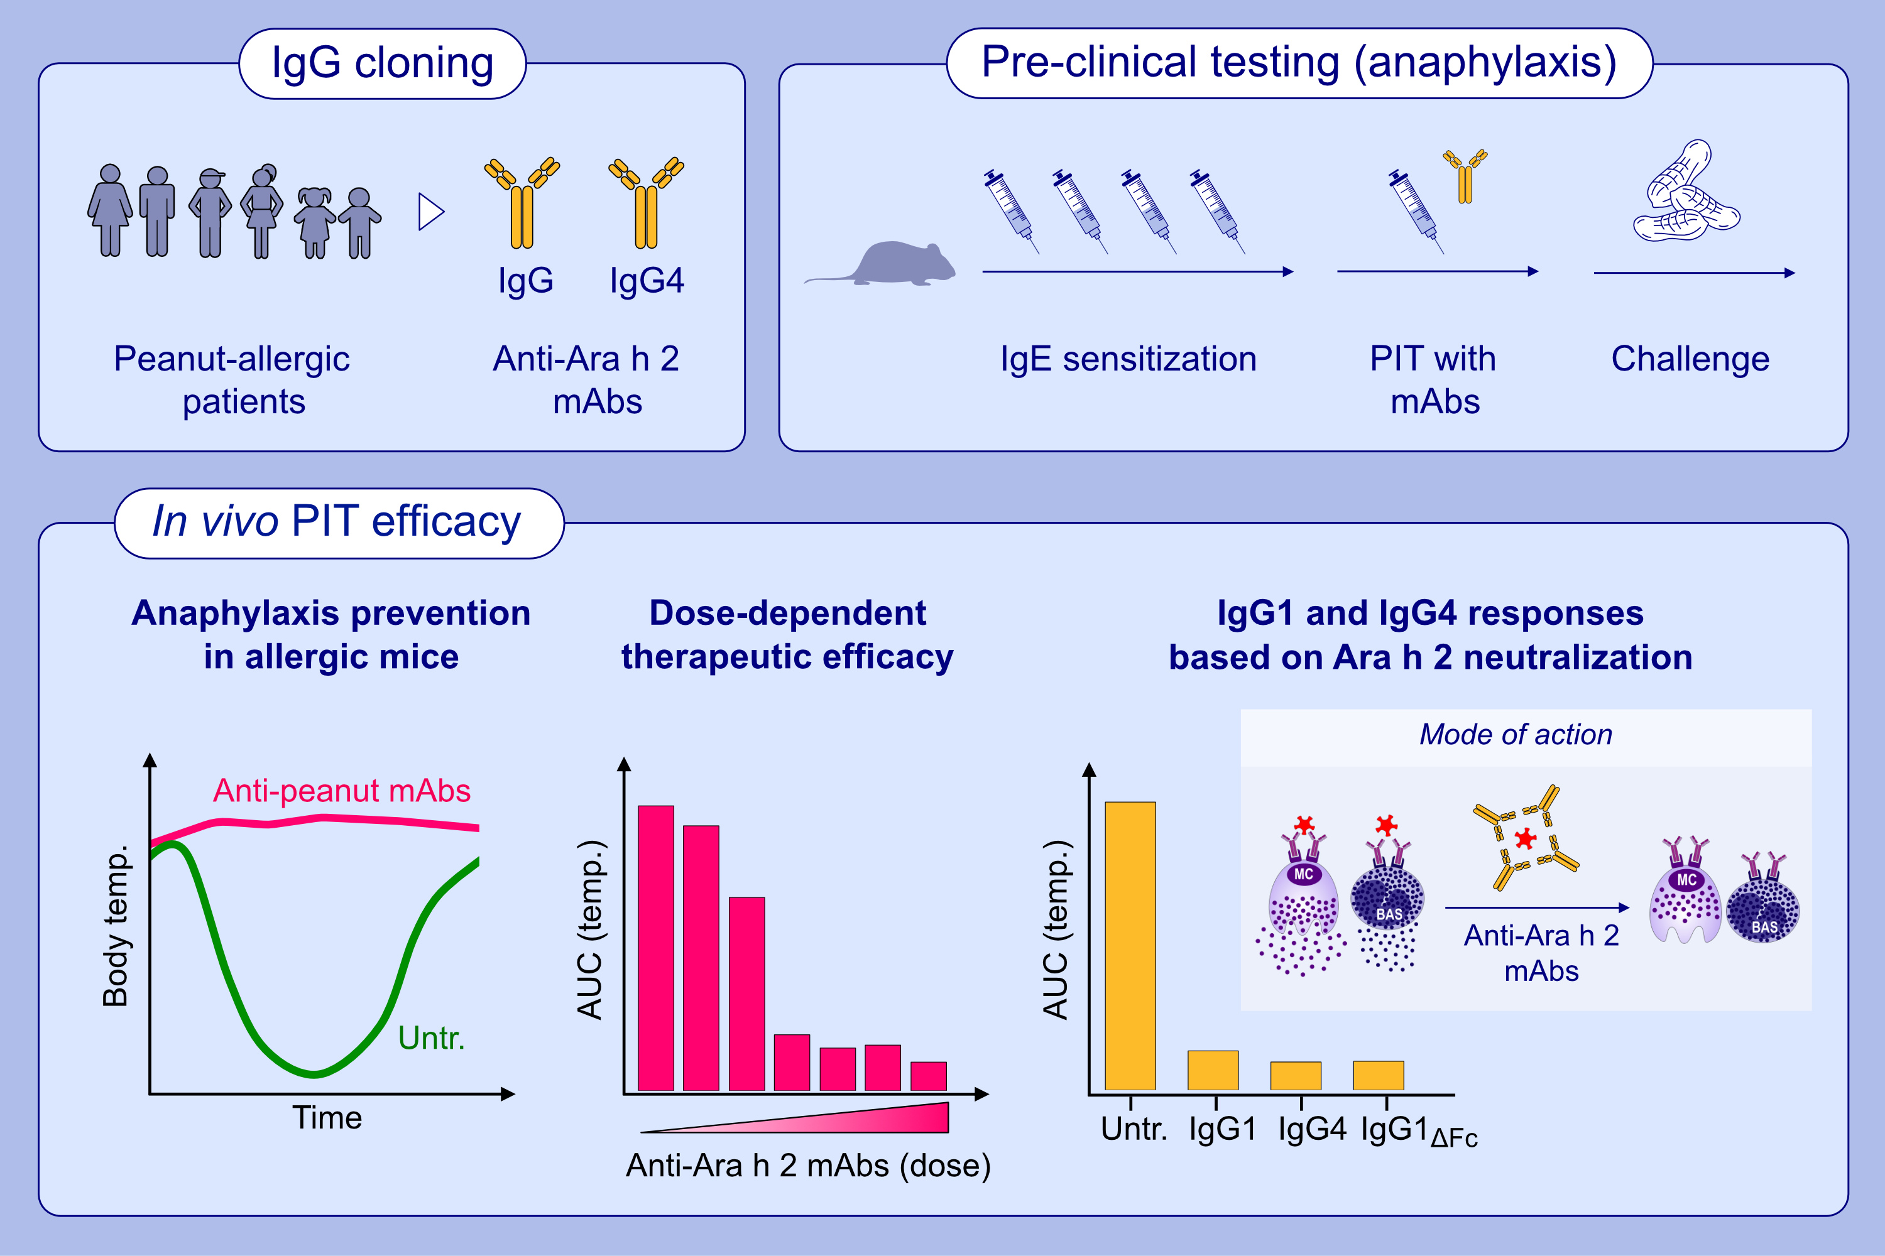
Targeting Ara h 2 with human-derived monoclonal antibodies prevents peanut-induced anaphylaxis in mice
Marta Paolucci, Natascha Wuillemin, Valentine Homère, Dimitri Bieli, Alice Köhli, et al.
Allergy. 2023; pages:1020-1035
https://doi.org/10.1111/all.15659
© 2019 EAACI and John Wiley and Sons A/S. Published by John Wiley and Sons Ltd.
Notes:
HIGHLIGHTS
Anti-Ara h 2 IgG1/IgG4 mAbs from peanut-allergic patients were cloned and recombinantly produced.
Pre-clinical testing was performed in peanut-sensitised mice receiving passive immunotherapy prior to an allergen challenge.
Anti-Ara h 2 mAbs prevent allergic anaphylaxis by neutralising peanut allergens before they bind to IgE and induce a FcɛRI-mediated degranulation of mast cells and basophils.
Abbreviations: AUC, area under the curve; FcɛRI, Fc epsilon receptor I; Ig, immunoglobulin; mAbs, monoclonal antibodies; PIT, passive immunotherapy; temp., temperature

