Slide 1
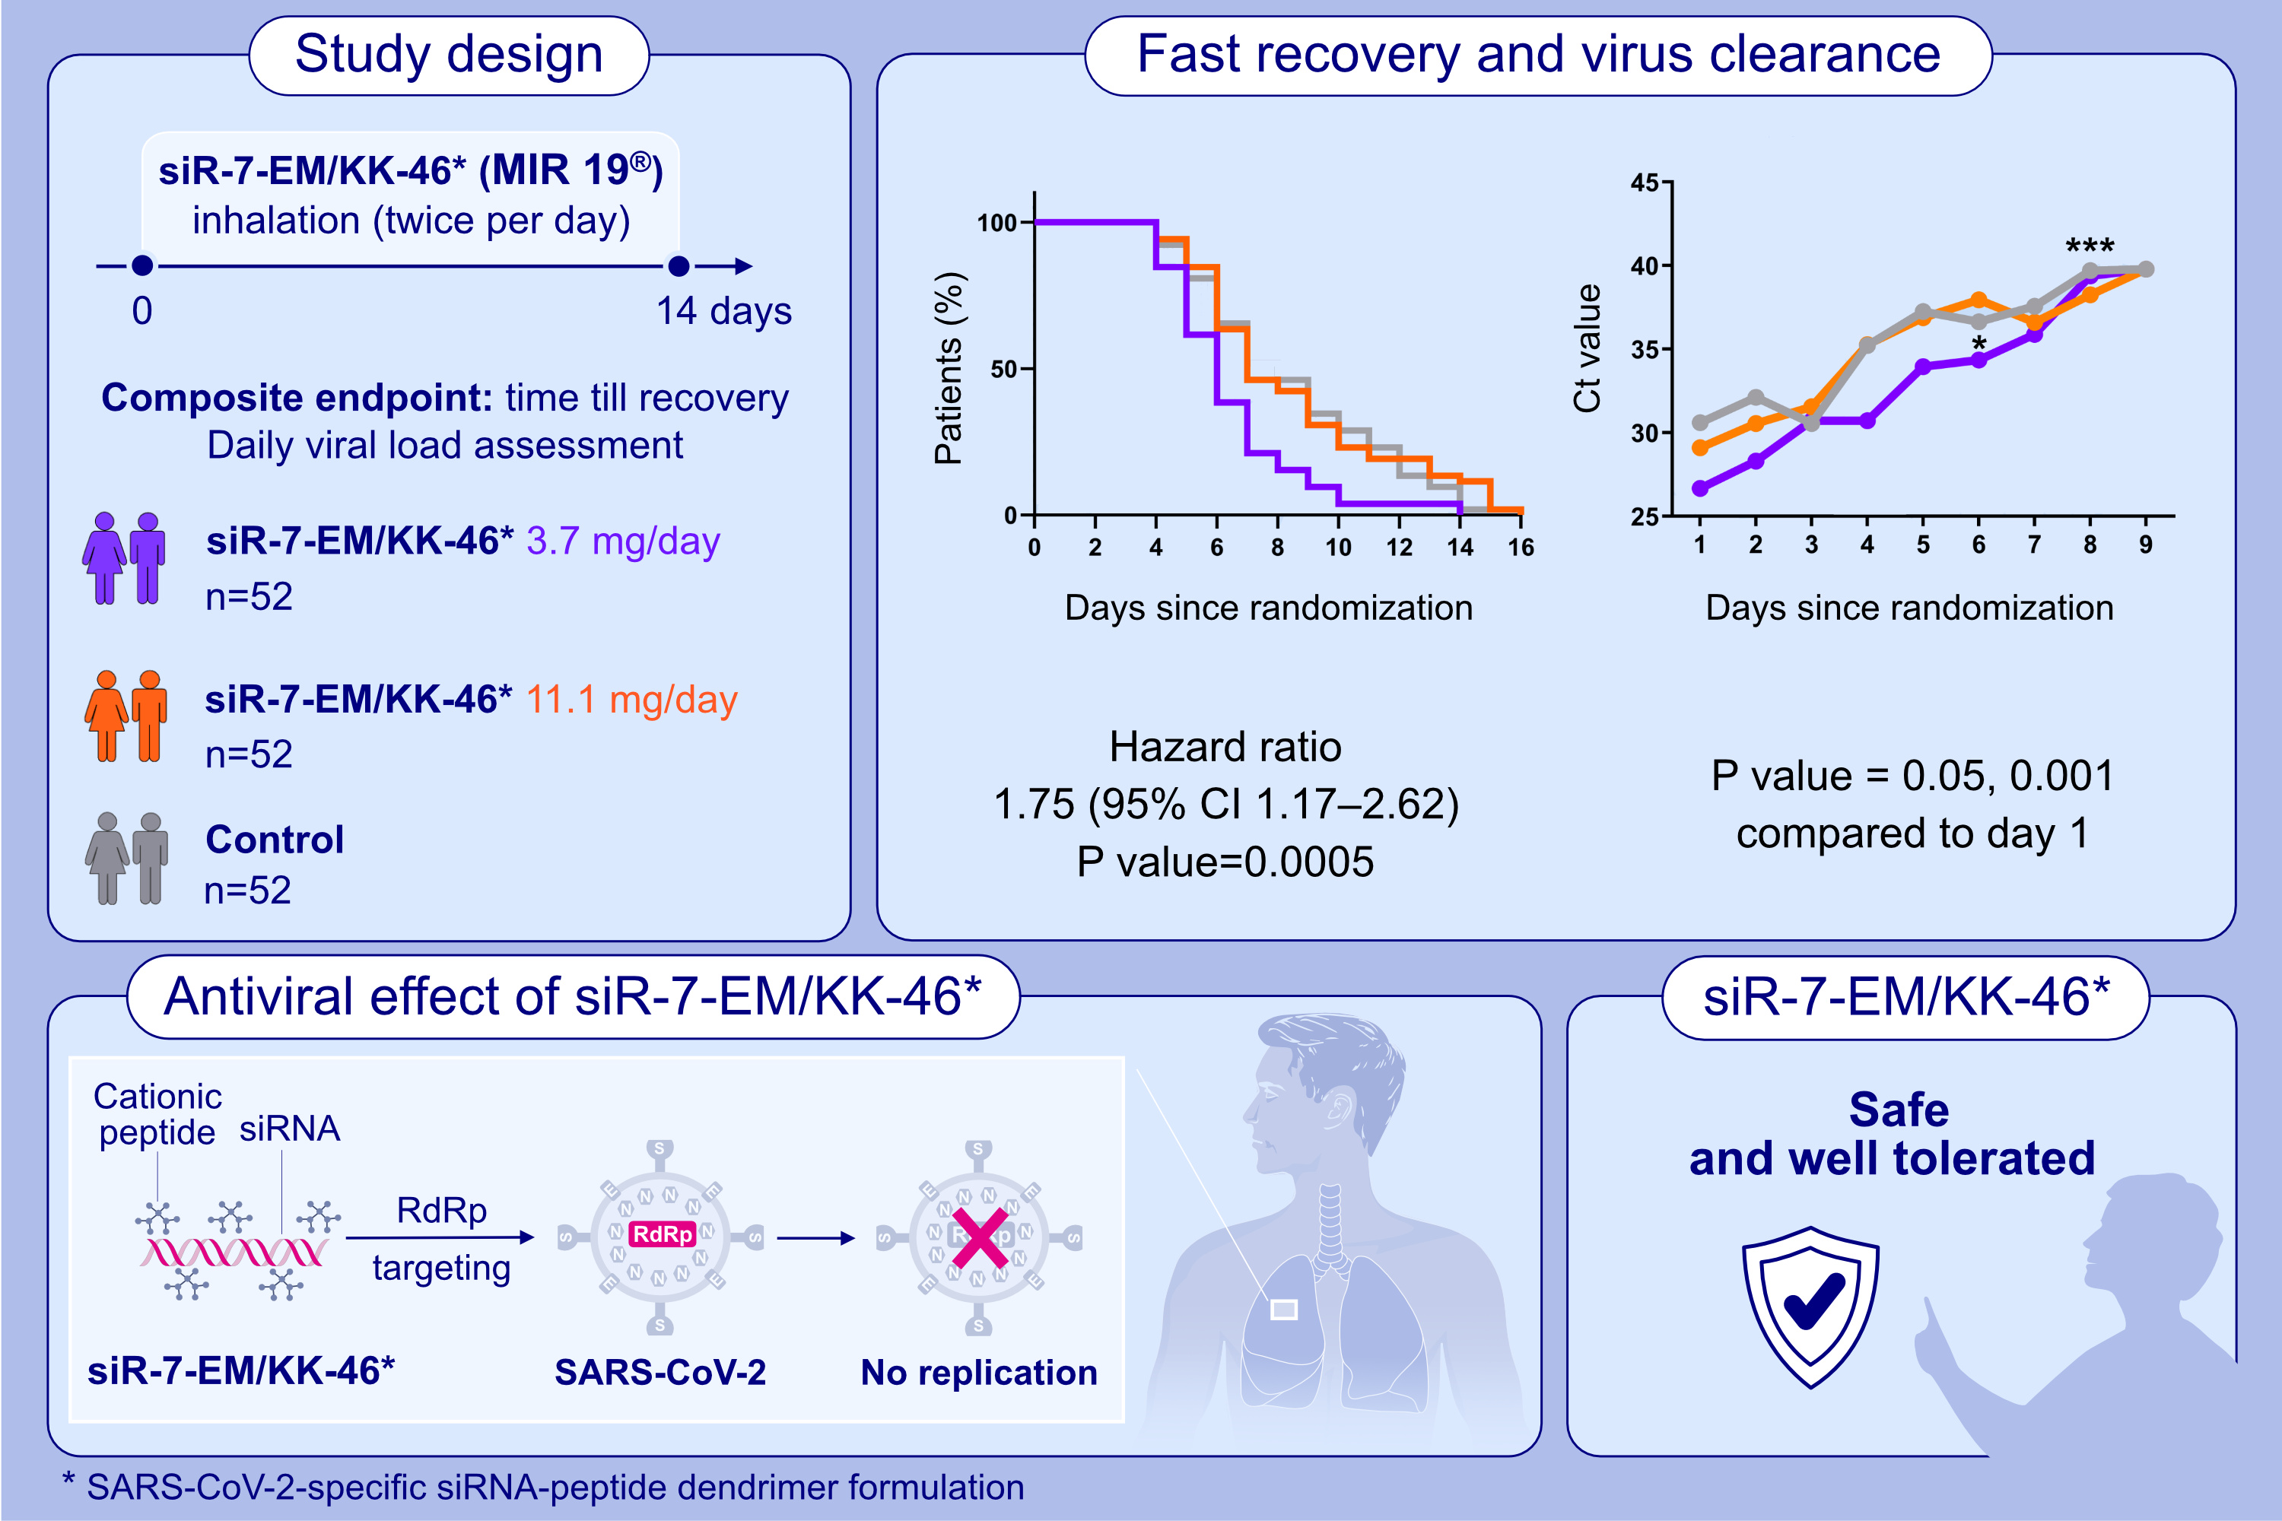
Treatment of COVID-19 patients with a SARS-CoV-2-specific siRNA-peptide dendrimer formulation
Musa Khaitov, Alexandra Nikonova, Ilya Kofiadi, Igor Shilovskiy, Valeriy Smirnov, et al.
Allergy. 2023; pages:1020-1035
https://doi.org/10.1111/all.15663
© 2019 EAACI and John Wiley and Sons A/S. Published by John Wiley and Sons Ltd.
Notes:
HIGHLIGHTS
MIR 19® is a siRNA-peptide dendrimer formulation targeting a conserved sequence in known SARS-CoV-2 variants.
Patients with moderate COVID-19 inhaled 3.7 mg/day of MIR 19 ® achieved the primary composite endpoint significantly earlier.
Significant clinical effect associated with MIR 19® at dose 3.7 mg/day was also accompanied by a significant reduction in viral load.
Abbreviations: CI, confidence interval; COVID-19, coronavirus disease 2019; Ct, cycle threshold; mg, milligram; MIR 19®, SARS-CoV-2-specific siRNA-peptide dendrimer formulation; SARS-CoV-2, severe acute respiratory syndrome coronavirus 2; siRNA, small interfering RNA; RdRp, RNA-dependent RNA polymerase.

