Slide 1
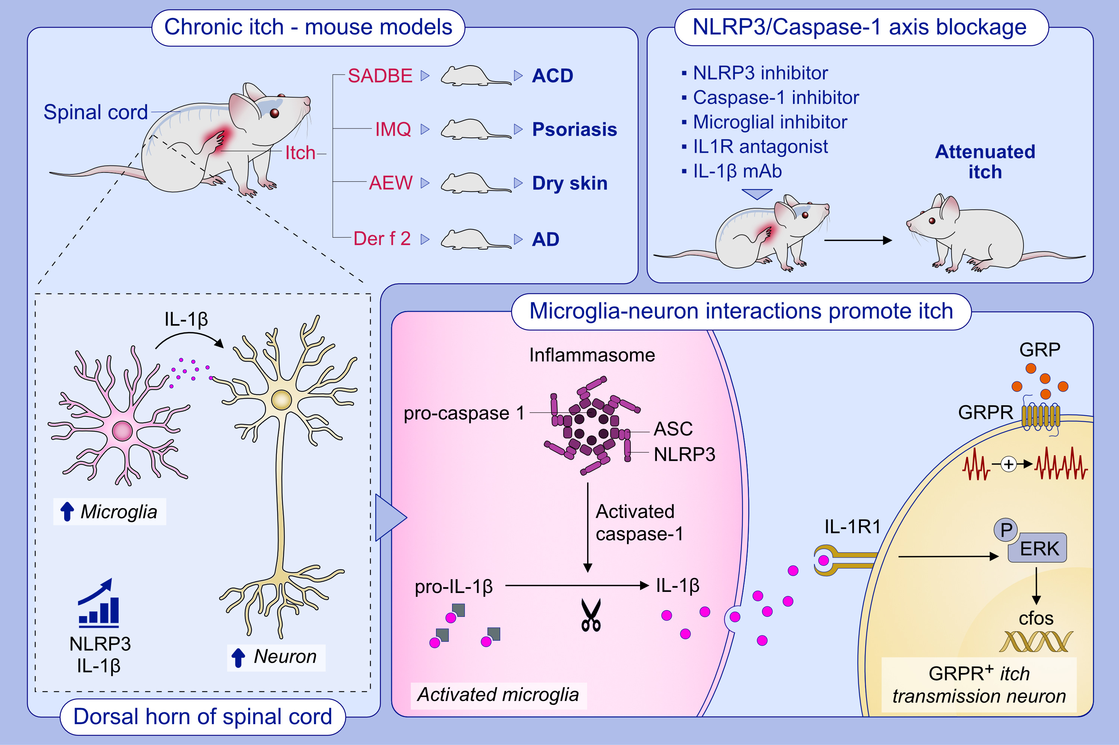
Microglia–Neuron Interactions Promote Chronic Itch
via the NLRP3-IL-1β-GRPR Axis
Xueting Liu, Yanmei Wang, Yueling Zeng, De Wang, Yuhuan Wen , et al.
Allergy. 2023; pages:1020-1035
https://doi.org/10.1111/all.15699
© 2019 EAACI and John Wiley and Sons A/S. Published by John Wiley and Sons Ltd.
Notes:
HIGHLIGHTS
NLRP3 inflammasome and IL-1β are selectively expressed in spinal microglia of four types of clinically related allergic itch models.
Blockade of the NLRP3/Caspase-1 axis attenuated chronic itch and neuronal activation.
Microglia enhances the activation of GRPR⁺ neurons through the IL-1β-IL1R signaling pathway.
Abbreviations: ACD, allergic contact dermatitis; AD, atopic dermatitis; AEW, acetone–ether–water; ASC, the adapter protein apoptosis-associated speck-like protein containing CARD; Der f 2, group 2 major mite allergen from Dermatophagoides farina; ERK, extracellular regulated protein kinases; GRP, gastrin-releasing peptide; GRPR, gastrin-releasing peptide receptor; IL, interleukin; IMQ, imiquimod; mAb, monoclonal antibody; NLRP3, NOD-like receptor thermal protein domain associated protein 3; SADBE, squaric acid dibutylester.

