Slide 1
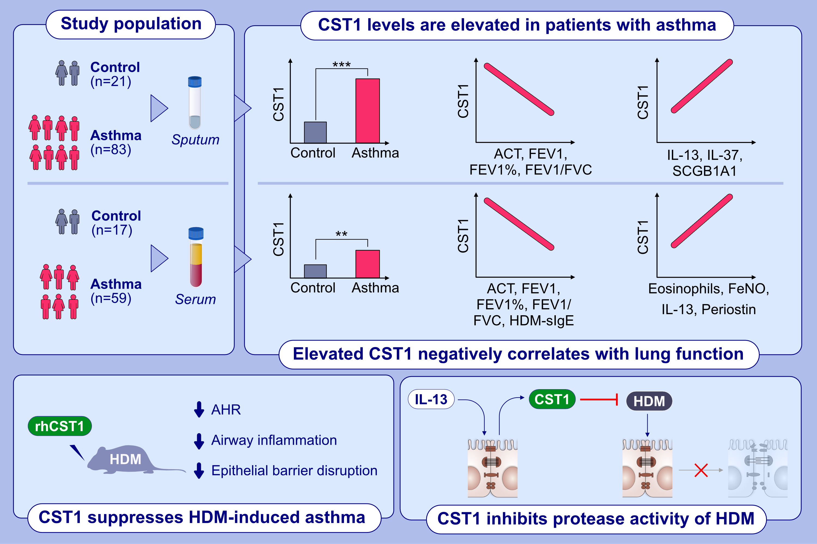
Epithelium-derived cystatin SN inhibits HDM protease activity in allergic asthma
Lei Yao, Xijing Yuan, Heng Fu, Qinxing Guo, Yunhui Wu , et al.
Allergy. 2023; pages:1020-1035
https://doi.org/10.1111/all.15739
© 2019 EAACI and John Wiley and Sons A/S. Published by John Wiley and Sons Ltd.
Notes:
HIGHLIGHTS
Sputum and serum CST1 protein levels are elevated in asthma and negatively correlate with lung function.
IL-13 induces upregulation of CST1 in 16HBE, whereas rhCST1 protein inhibits protease activity of HDM.
HDM-induced epithelial barrier function disruption is suppressed by rhCST1 protein in vitro. Intranasal administration of rhCST1 reduces AHR, inflammation, and epithelial barrier function in mice.
Abbreviations: ACT, asthma control test; AHR, airway hyperresponsiveness; CST1, cystatin SN; FeNO, fractional exhaled nitric oxide; FEV1, forced expiratory volume in one second; FVC, forced vital capacity; HDM, house dust mite; IL, interleukin; rhCST1, recombinant human CST1; SCGB1A1, secretoglobin family 1A member 1; sIgE, specific immunoglobulin E; 16HBE, human bronchial epithelial cell line

