Slide 1
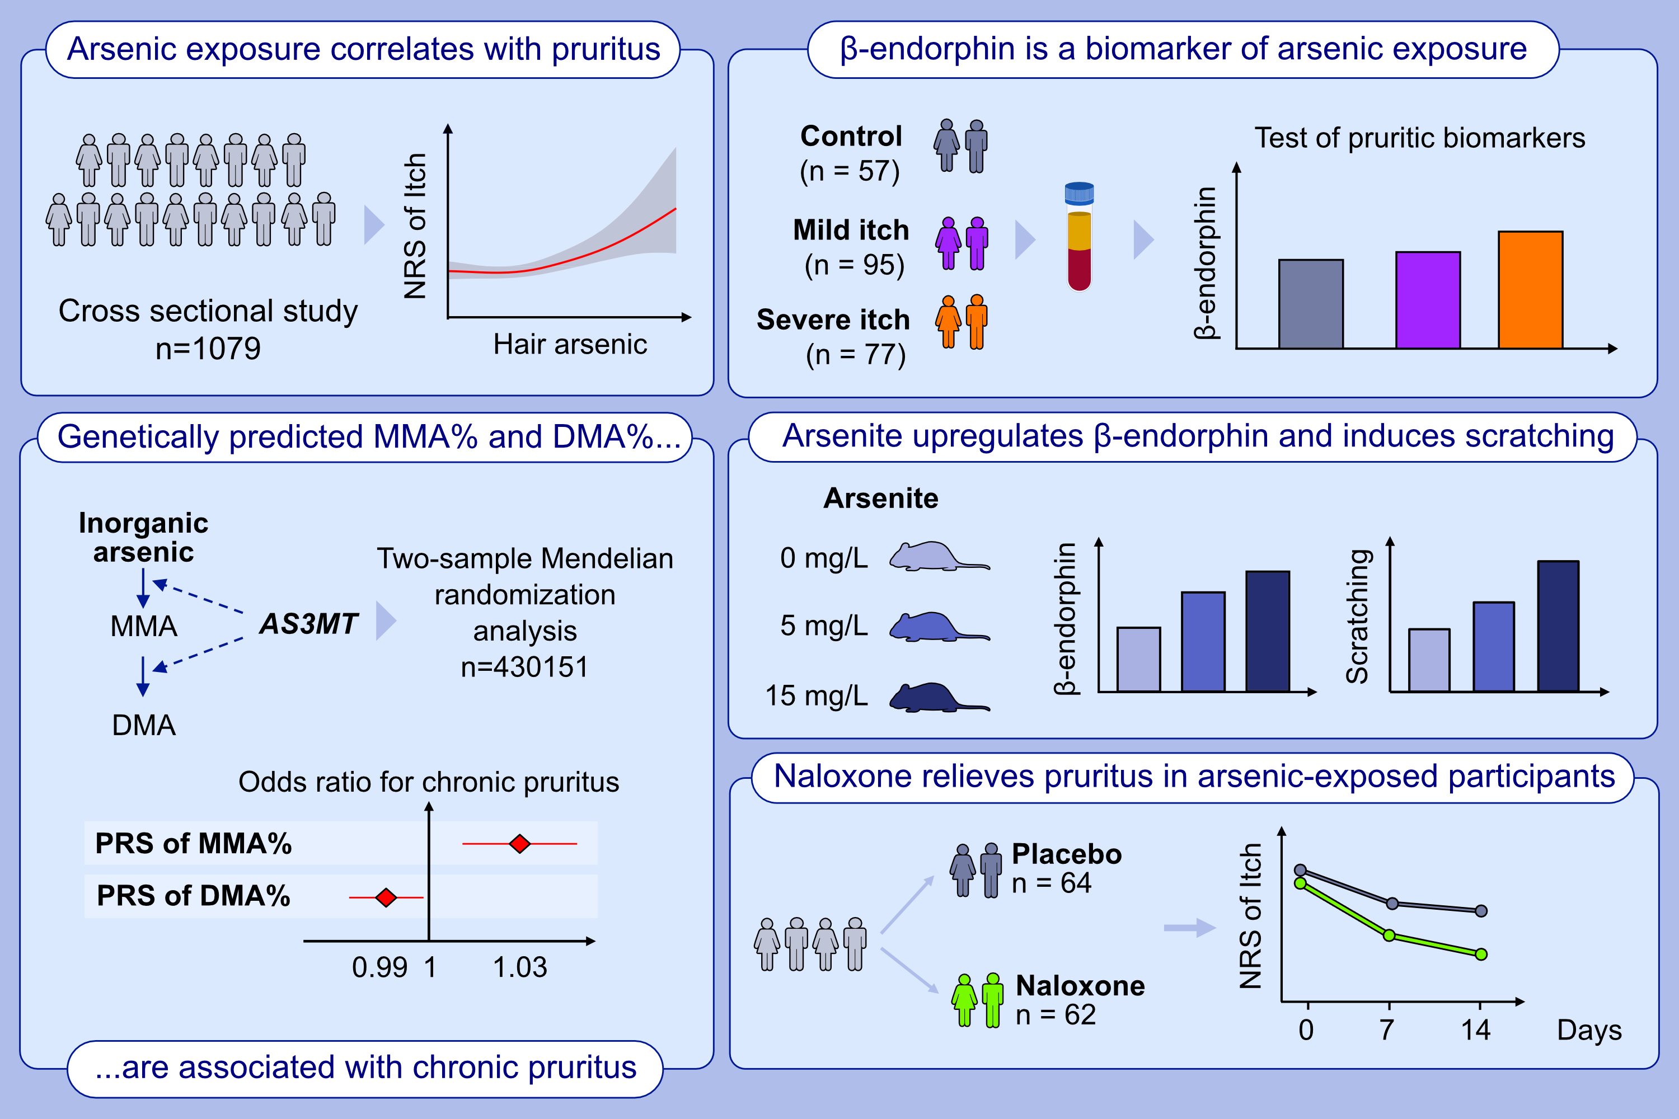
Arsenic exposure and pruritus: evidence from observational, interventional, and Mendelian randomization studies
Xiaoyan Huang, Yi Xiao, Danrong Jing, Yuzhou Huang, Songchun Yang , et al.
Allergy. 2023; pages:1020-1035
https://doi.org/10.1111/all.15758
© 2019 EAACI and John Wiley and Sons A/S. Published by John Wiley and Sons Ltd.
Notes:
HIGHLIGHTS
Arsenic exposure is associated with pruritus, and β-endorphin serves as a biomarker of pruritus.
The Mendelian randomization analysis confirms the casual relationship between chronic pruritus and genetically predicted MMA% and DMA%, with ORs of 1.043 for MMA% (P=0.029) and 0.904 for DMA% (P=0.077) above versus under median.
Arsenite treatment in mice upregulates the level of β-endorphin and induces scratching. Individuals with arseniasis report a reduction in pruritus intensity following treatment with naloxone.
Abbreviations: AS3MT, gene encoding arsenite methyltransferase; DMA, dimethylated arsenic; MMA, monomethylated arsenic; NRS, numerical rating scale; OR, odds ratio; PRS, polygenic risk score.

