Slide 1
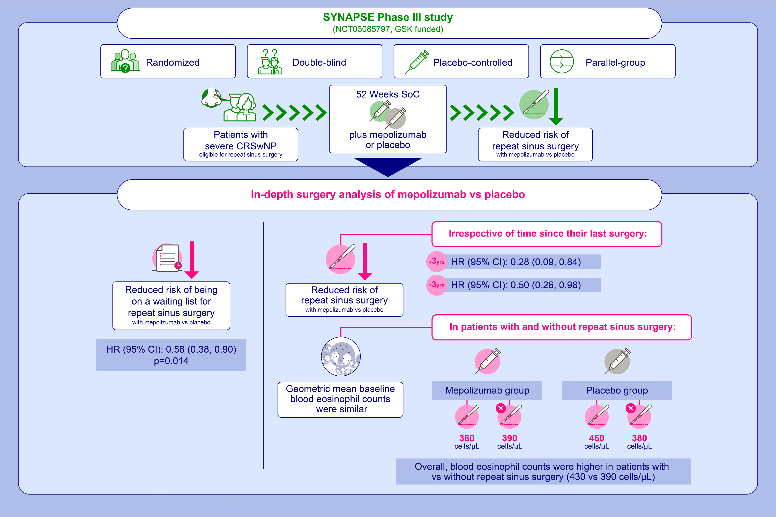
Mepolizumab for chronic rhinosinusitis with nasal polyps (SYNAPSE): in-depth sinus surgery analysis
Wytske J. Fokkens, Joaquim Mullol, David Kennedy, Carl Philpott, Veronica Seccia, et al.
Allergy. 2022; pages: 812-821
https://doi.org/10.1111/all.15434
© 2019 EAACI and John Wiley and Sons A/S. Published by John Wiley and Sons Ltd.
Notes:
HIGHLIGHTS
This post hoc analysis assessed surgery-specific endpoints from the SYNAPSE trial of mepolizumab in patients with severe CRSwNP.
Mepolizumab versus placebo reduced the risk of undergoing sinus surgery irrespective of the patient characteristics assessed.
Mepolizumab reduces the need for repeat sinus surgery in patients with severe CRSwNP.
Abbreviations: CI, confidence interval; CRSwNP, chronic rhinosinusitis with nasal polyps; HR, hazard ratio, SoC standard of care

