Slide 1
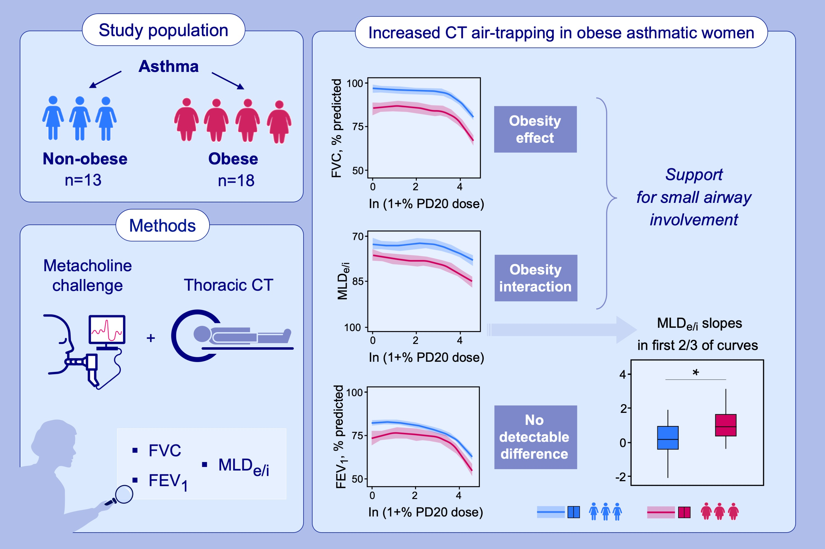
Obesity in women with asthma: baseline disadvantage plus greater small-airway reactivity
Arnaud Bourdin, Sébastien Bommart, Gregory Marin, Isabelle Vachier, Anne Sophie Gamez, et al.
Allergy. 2022; pages: 780-790
https://doi.org/10.1111/all.15509
© 2019 EAACI and John Wiley and Sons A/S. Published by John Wiley and Sons Ltd.
Notes:
HIGHLIGHTS
Non-obese versus obese women with asthma underwent methacholine provocation coupled with CT scanning to determine MLD_{e/i} per step.
Mixed models on standardised response curves determined an obesity x dose interaction for MLD_{e/i}.
Greater MLD_{e/i} slopes for obese patients were pinpointed to the first two-thirds of curves, corresponding to higher bronchial responsiveness during methacholine provocation.
Abbreviations: CT, computed tomography; FEV ₁, forced expiratory volume in one second (% predicted); FVC, forced vital capacity (% predicted); MLD_{e/i}, expiratory:inspiratory ratios of mean lung density; PD20, the end of methacholine provocation, when a drop of at least 20% in FEV1 is observed.

