Slide 1
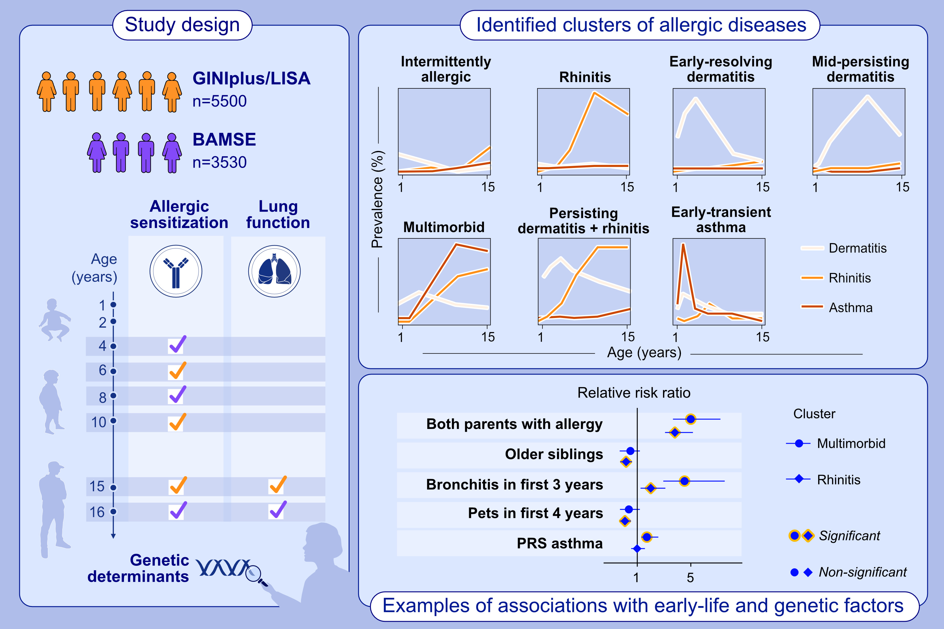
Allergic disease trajectories up to adolescence: Characteristics, early-life and genetic determinants
Anna Kilanowski, Elisabeth Thiering, Gang Wang, Ashish Kumar, Sara Kress , et al.
Allergy. 2022; pages: 836-850
https://doi.org/10.1111/all.15511
© 2019 EAACI and John Wiley and Sons A/S. Published by John Wiley and Sons Ltd.
Notes:
HIGHLIGHTS
We identified seven allergic disease trajectories up to adolescence, which are corresponding to clinical observation in the German GINIplus and LISA studies and replicated the results in the Swedish BAMSE cohort.
The clusters can be characterized using polygenic risk scores and early-life determinants, which support the hygiene hypothesis.
The clusters also pose clinical implications for allergic sensitization, increasing with number of present allergic diseases, and lung function.
Abbreviations: BAMSE, Barn/Child Allergy Milieu Stockholm Epidemiology; GINIplus, German Infant Study on the Influence of Nutrition Intervention plus Air pollution and Genetics on Allergy Development; LISA, Influence of Life-style factors on Development of the Immune System and Allergies in East and West Germany study; PRS, polygenic risk score.

