Slide 1
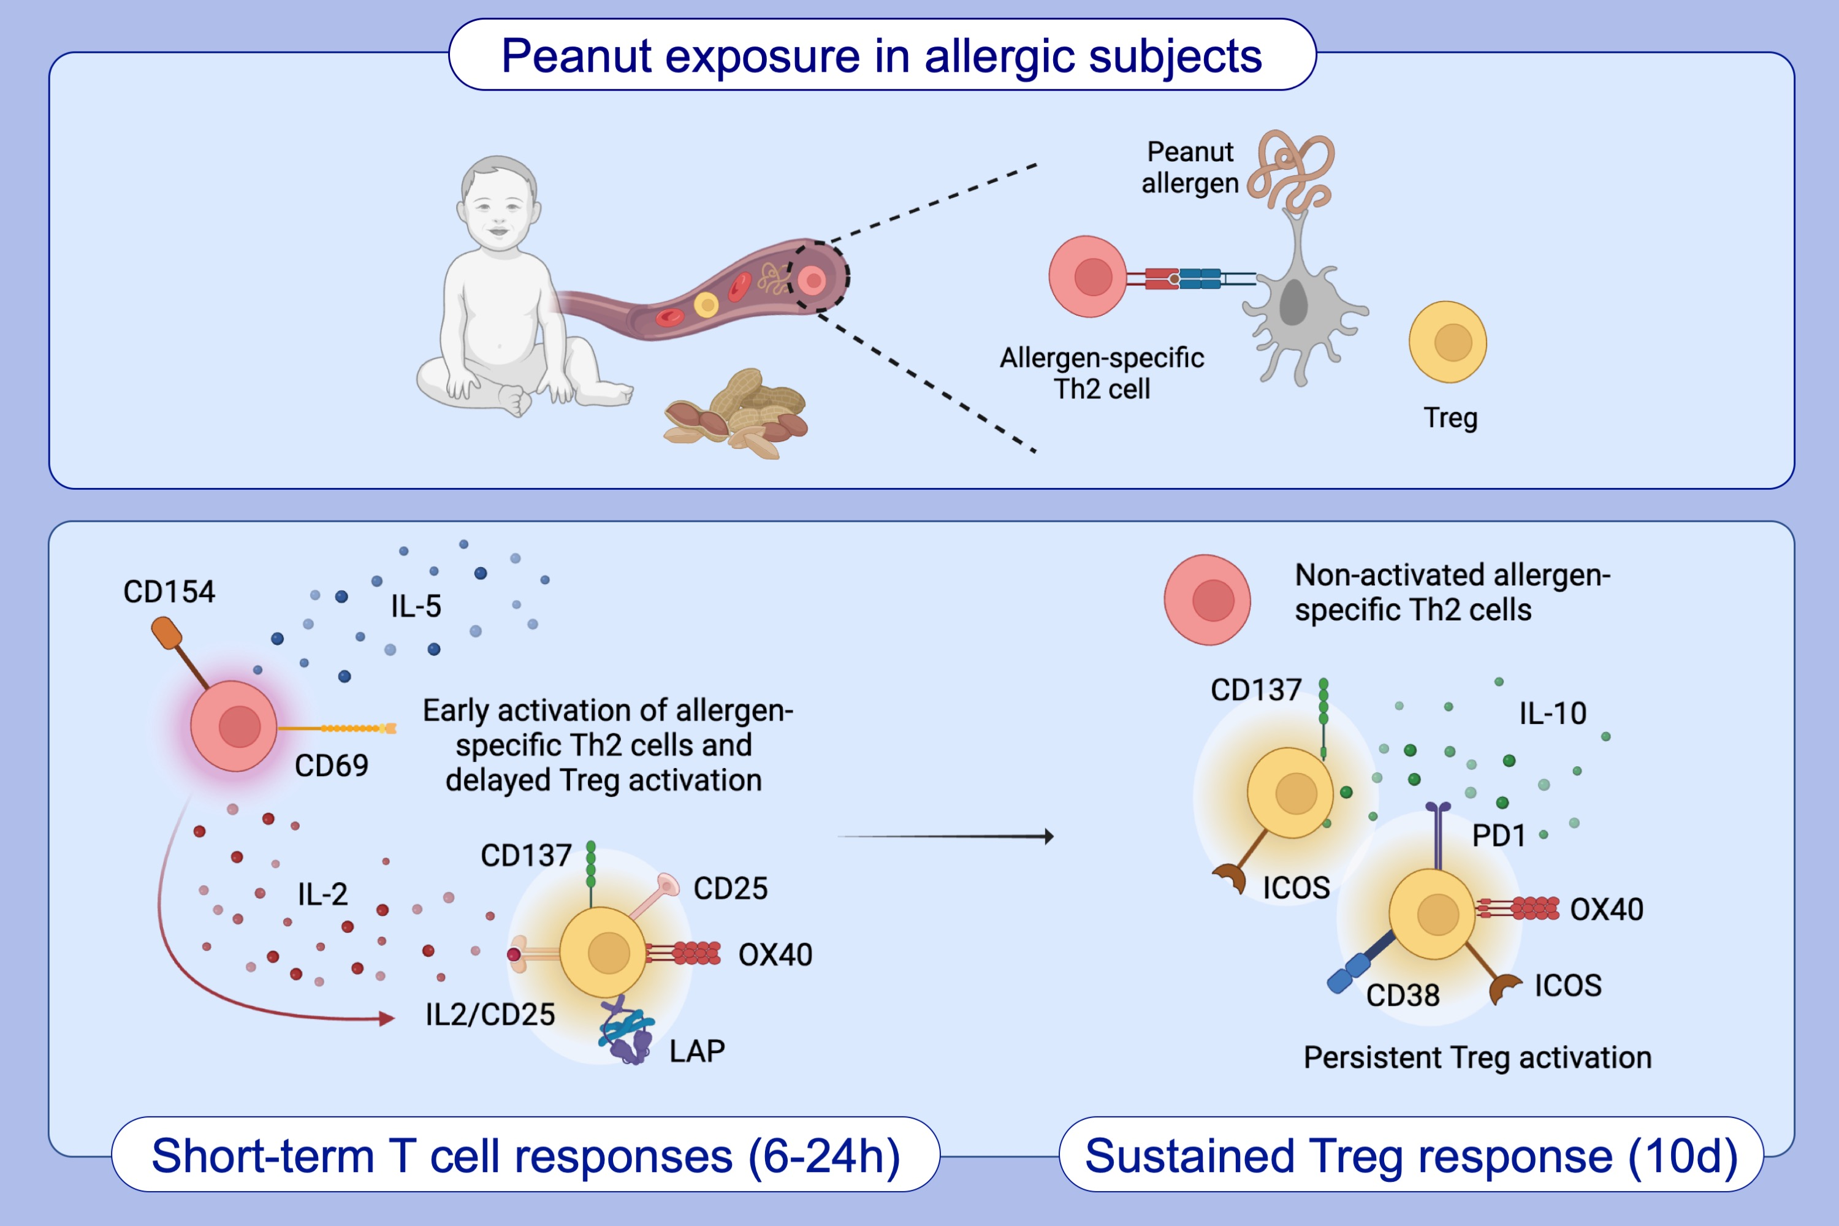
Allergen recognition by specific effector Th2 cells enables IL-2-dependent activation of regulatory T cell responses in humans
Daniel Lozano-Ojalvo, Scott R. Tyler, Carlos J. Aranda, Julie Wang, Scott Sicherer, et al.
Allergy. 2022; pages: 697-713
https://doi.org/10.1111/all.15512
© 2019 EAACI and John Wiley and Sons A/S. Published by John Wiley and Sons Ltd.
Notes:
HIGHLIGHTS
Initiation of allergen-specific Th2 cell responses generates an IL-2-mediated activation of Tregs.
IL-2-activated T cells exert an immunosuppressive effect on effector T cells.
In vivo exposure to peanut induces a delayed and persistent activation of Tregs.
Abbreviations: ICOS, inducible T cell co-stimulator; IL, interleukin; LAP, latency-associated peptide; OX40, TNF receptor superfamily member 4; PD1, programmed cell death protein 1; Th, T helper cell; Treg, regulatory T cell

