Slide 1
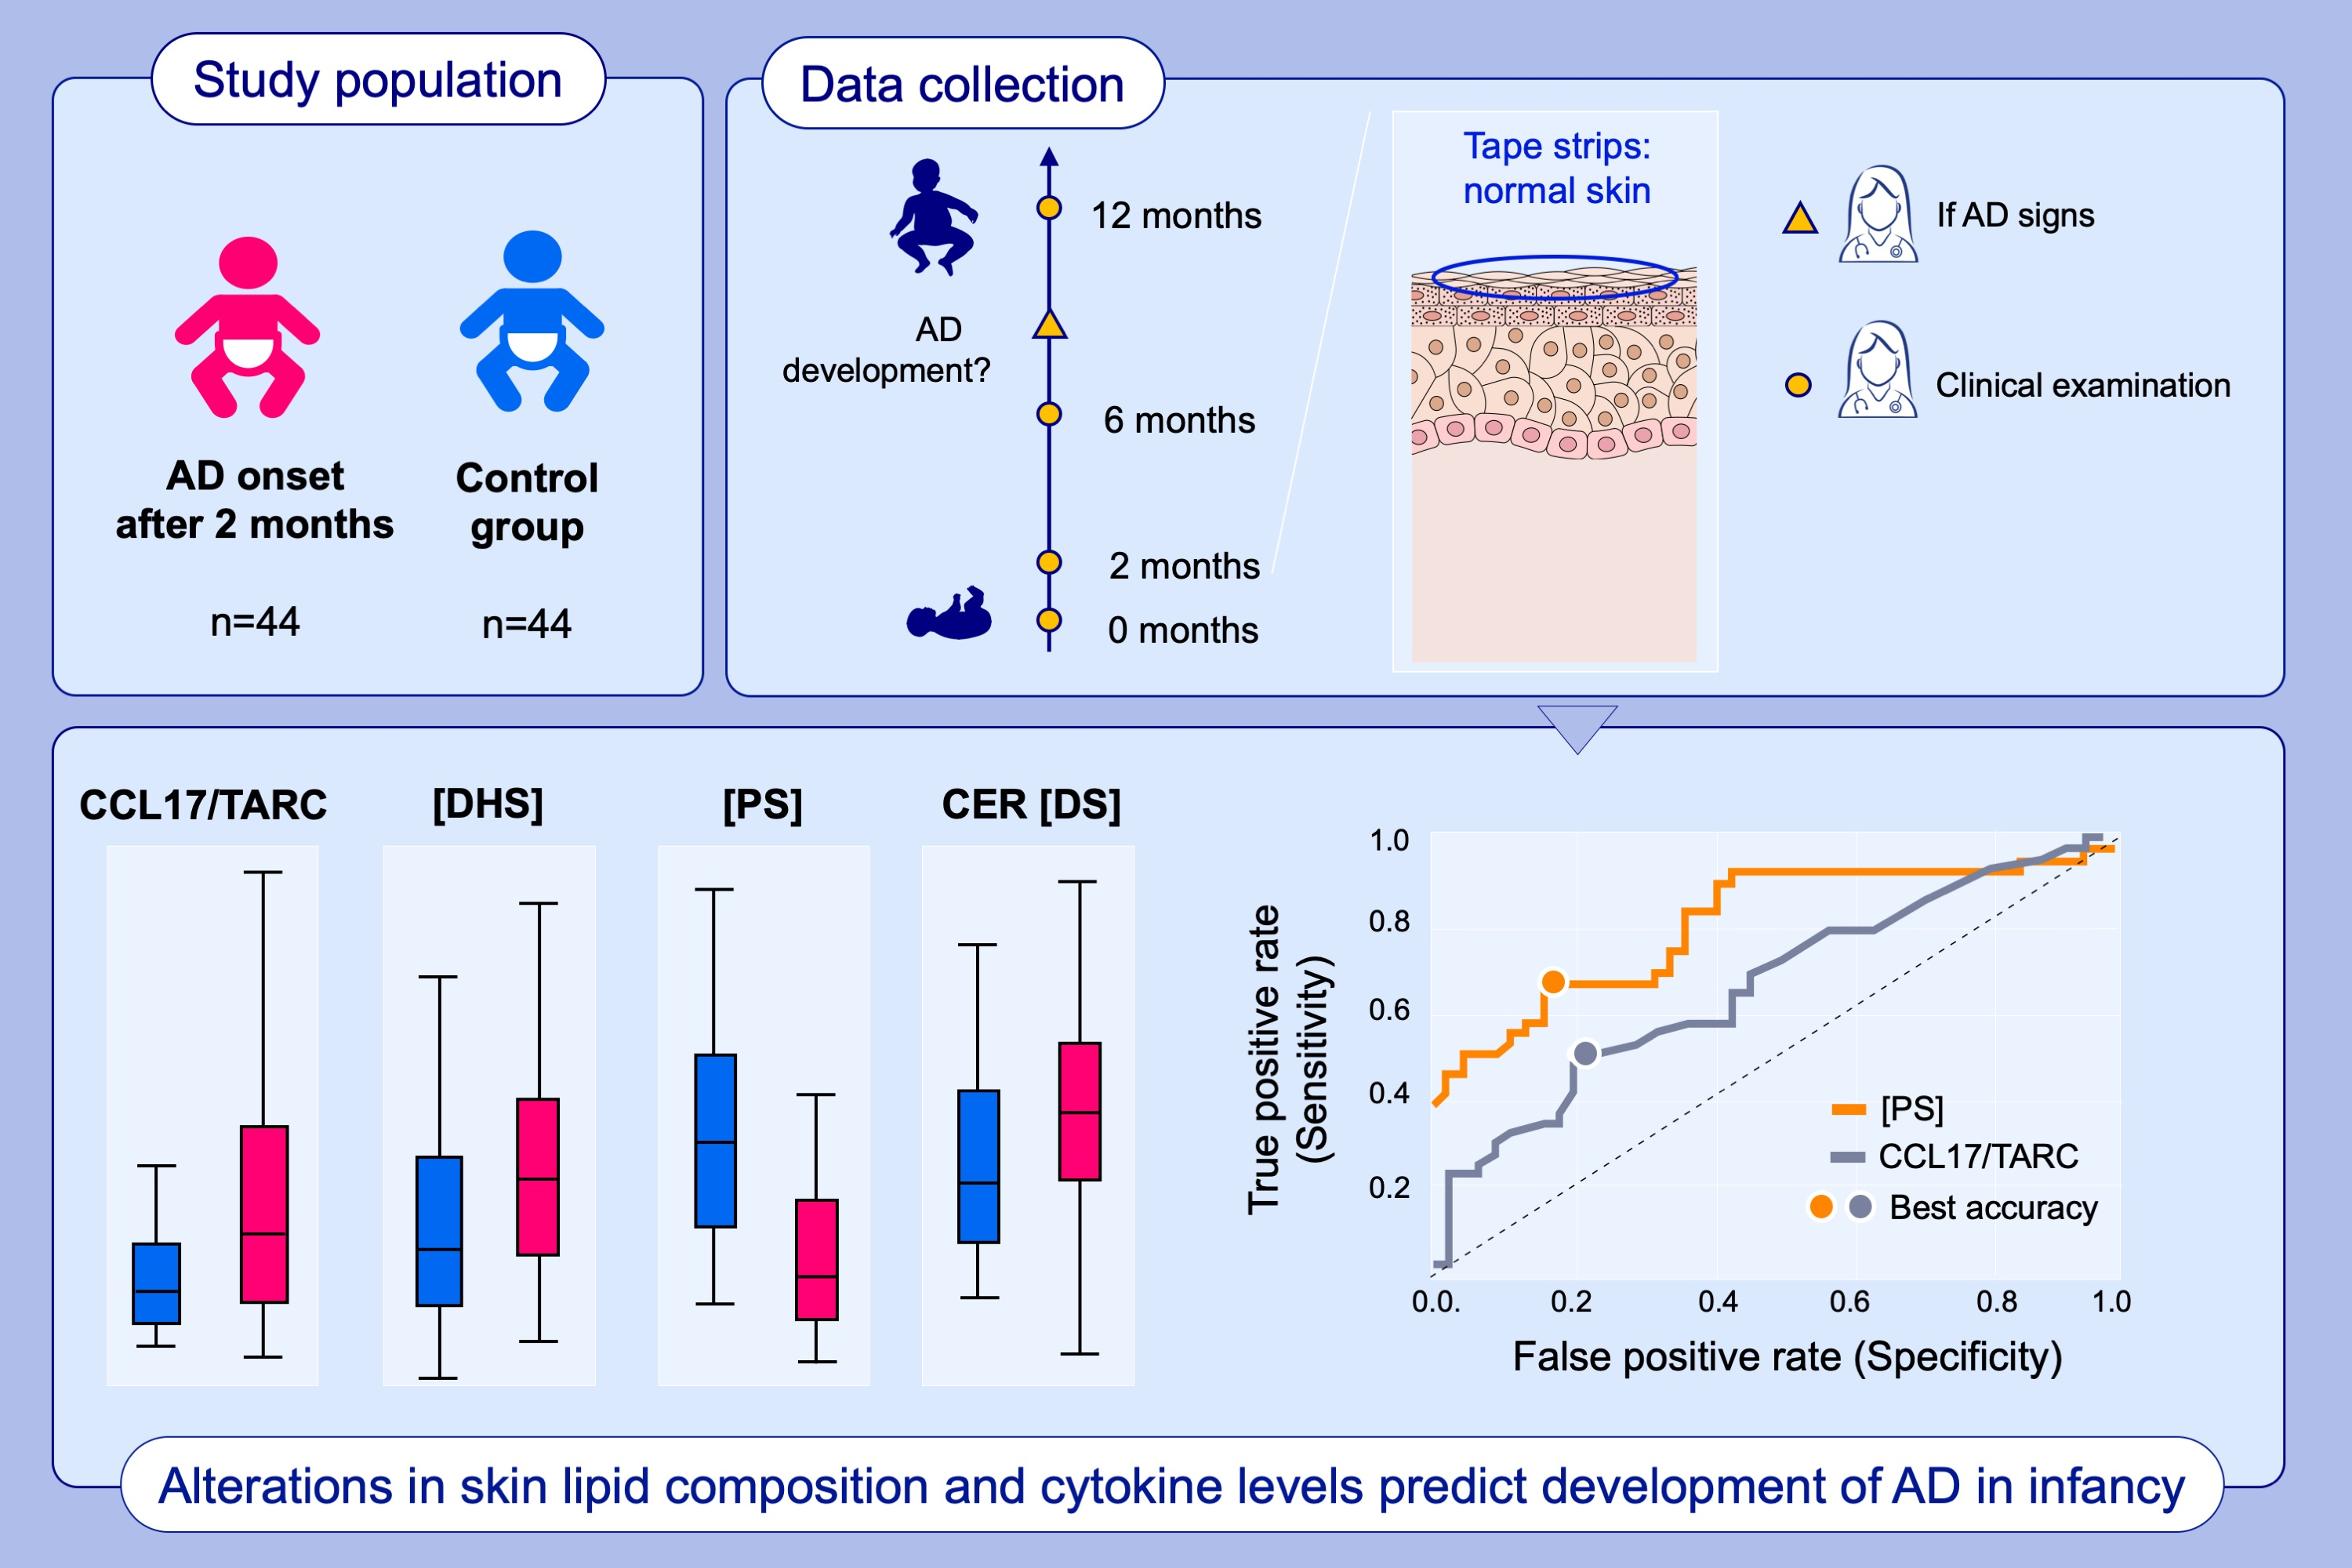
Skin biomarkers p­­redict development of atopic dermatitis in infancy
Maria Rasmussen Rinnov, Anne-Sofie Halling, Trine Gerner, Nina Haarup Ravn, Mette Hjorslev Knudgaard, et al.
Allergy. 2022; pages: 791-802
https://doi.org/10.1111/all.15518
© 2019 EAACI and John Wiley and Sons A/S. Published by John Wiley and Sons Ltd.
Notes:
HIGHLIGHTS
This study examines whether selected skin biomarkers in stratum corneum tape strips from infants with clinically normal skin at 2 months of age are different in children who develop AD in the first year of life.
Skin CCL17/TARC levels as well as lipid markers, including [P], [DS] and CER [DS] show significant alteration between children who developed AD and those who did not.
ROC curve demonstrate that phytosphingosine, and to a lesser extend CCL17/TARC separate children who developed AD from those who did not.
Abbreviations: AD, atopic dermatitis; CCL17/TARC, C-C motif chemokine ligand 17/ TARC, thymus- and activation-regulated chemokine; CER [DS], ceramide class with dihydrosphingosine as a sphingoid base; [DHS], dihydrosphingosine (sphinganine) [PS], phytosphingosine.

