Slide 1
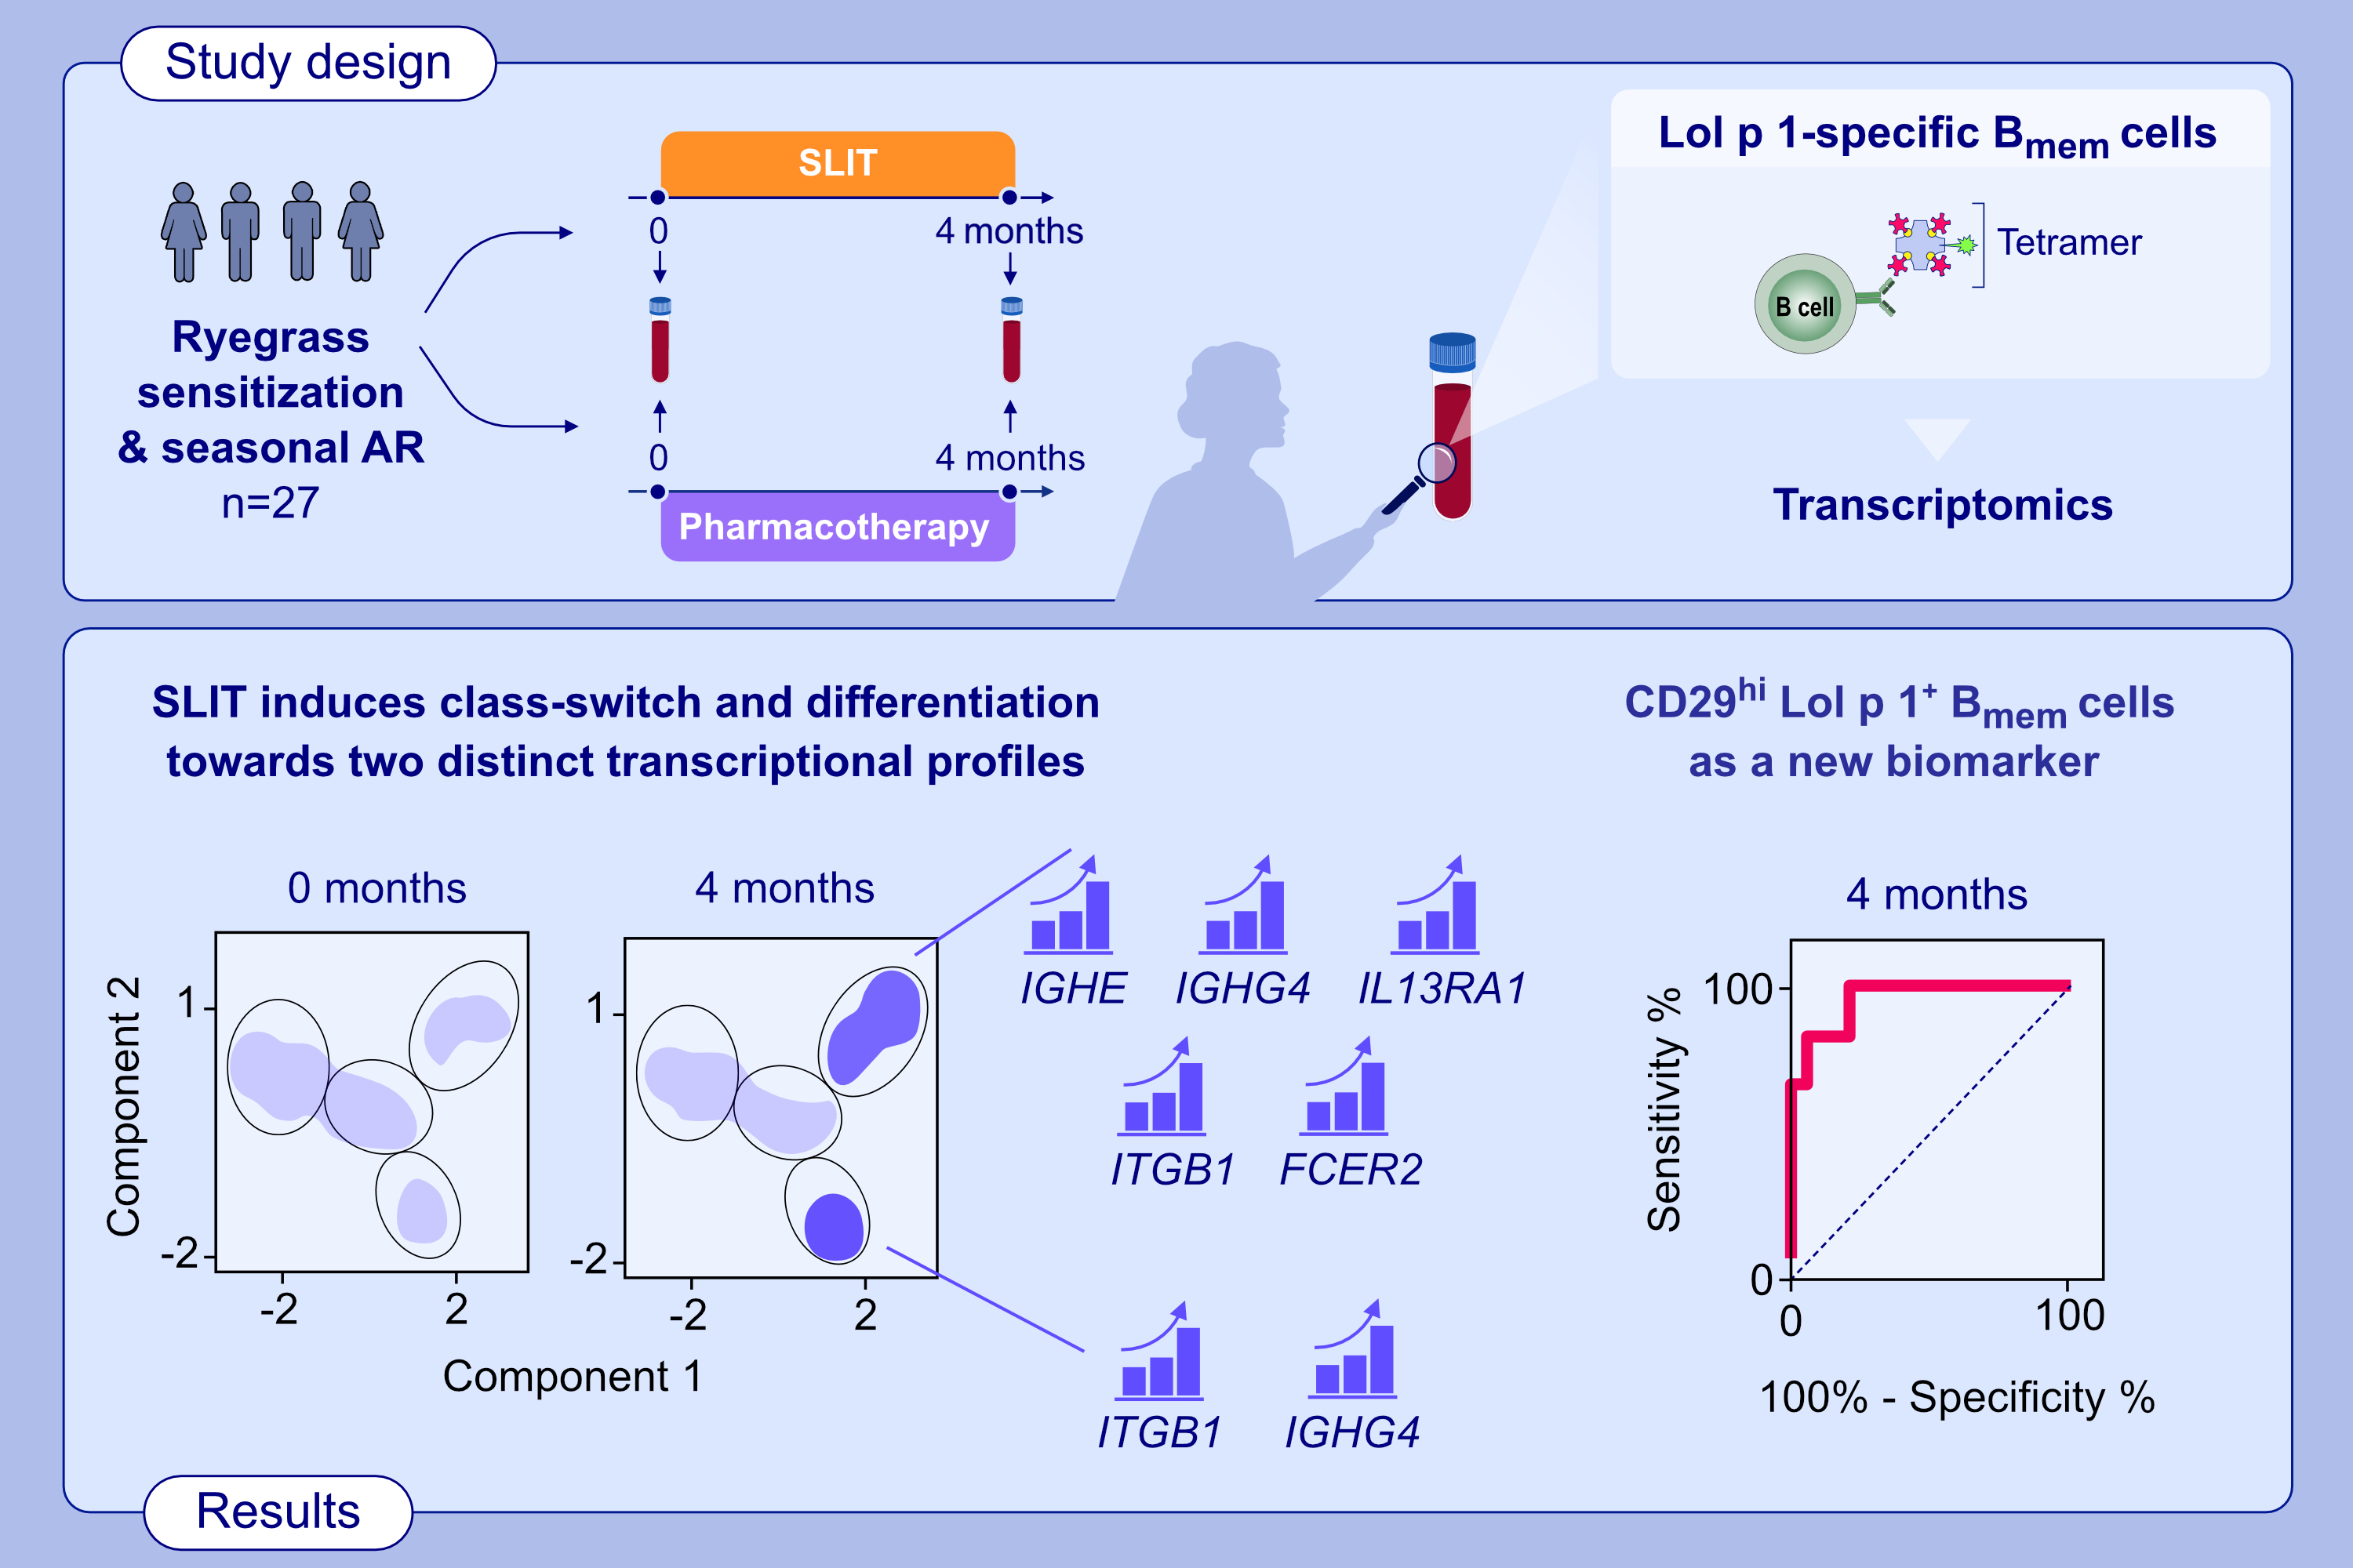
RNA sequencing of single allergen-specific memory B cells after grass pollen immunotherapy: two unique cell fates and CD29 as biomarker
Craig I. McKenzie, Nirupama Varese, Pei Mun Aui, Simone Reinwald, Bruce D. Wines, et al.
Allergy. 2022; pages: 822-835
https://doi.org/10.1111/all.15529
© 2019 EAACI and John Wiley and Sons A/S. Published by John Wiley and Sons Ltd.
Notes:
HIGHLIGHTS
Using recombinant Lol p 1 tetramers, allergen-specific B_{mem} from patients allergic to ryegrass pollen were examined before and after 4 months of SLIT.
Single-cell RNA sequencing revealed that SLIT drives two unique transcriptional B_{mem} cell fates, typified by CD23, IgG4, IgE, CD29 and IL13Ra2 expression.
Flow cytometry confirmation revealed that CD29 expression is the best positive predictor of SLIT effects.
Abbreviations: AR, allergic rhinitis; B_{mem}, memory B cells; FCER2, Fc epsilon receptor II; IGH, immunoglobulin heavy constant; IL13RA2, interleukin 13 receptor subunit alpha 2; ITGB1, integrin subunit beta 1; SLIT, sublingual immunotherapy

