Slide 1
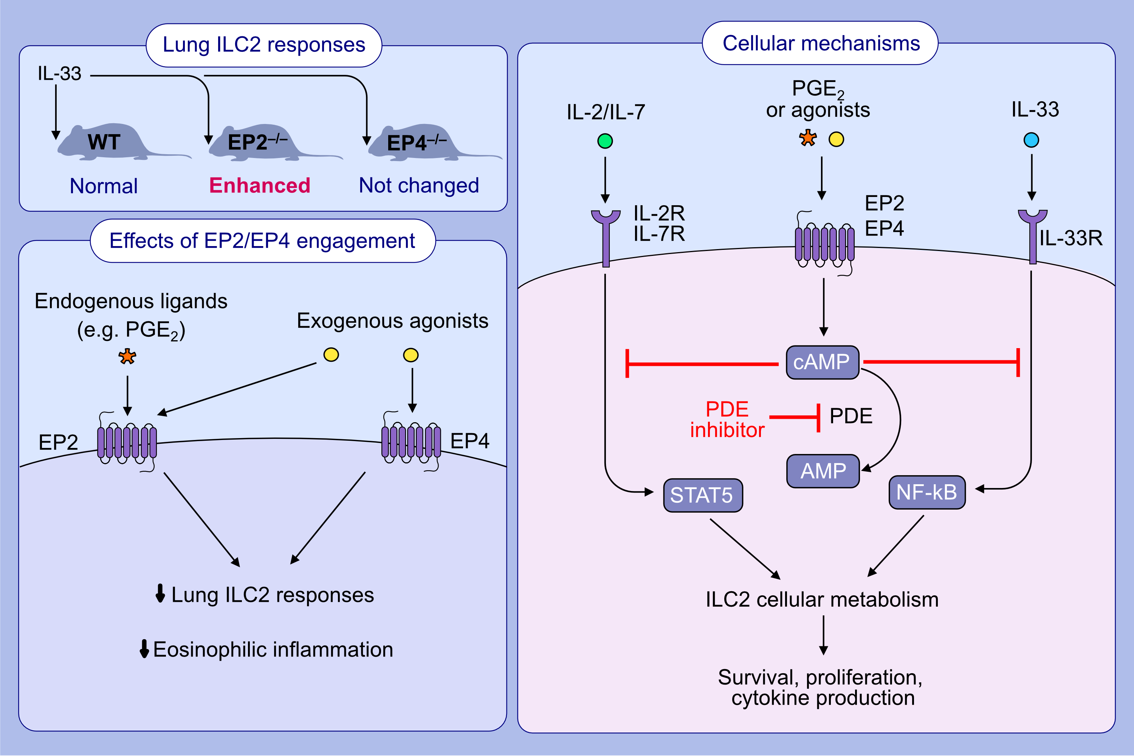
Metabolic regulation by prostaglandin E₂ impairs lung group 2 innate lymphoid cell responses
Calum T. Robb, You Zhou, Jennifer M. Felton, Birong Zhang, Marie Goepp, et al.
Allergy. 2022; pages: 714-730
https://doi.org/10.1111/all.15417
© 2019 EAACI and John Wiley and Sons A/S. Published by John Wiley and Sons Ltd.
Notes:
HIGHLIGHTS
Deficiency of EP2 rather than EP4 enhances IL-33-induced lung ILC2 responses and eosinophilic inflammation.
Both EP2 and EP4 agonism represses IL-33-induced mouse lung ILC2 responses.
PGE₂-EP2/EP4-cAMP signaling inhibits ILC2 survival, proliferation and effector function through disturbing the IL-2/IL-7/IL-33-activated metabolic program in ILC2s.
Abbreviations: AMP, adenosine monophosphate; cAMP, cyclic adenosine monophosphate; EP2, E prostanoid receptor 2; EP4, E prostanoid receptor 4; ILC2, group 2 innate lymphoid cell; NF-κB, nuclear factor kappa B; PDE, phosphodiesterase; PGE₂, prostaglandin E₂; STAT5: signal transducer and activator of transcription 5.

