Slide 1
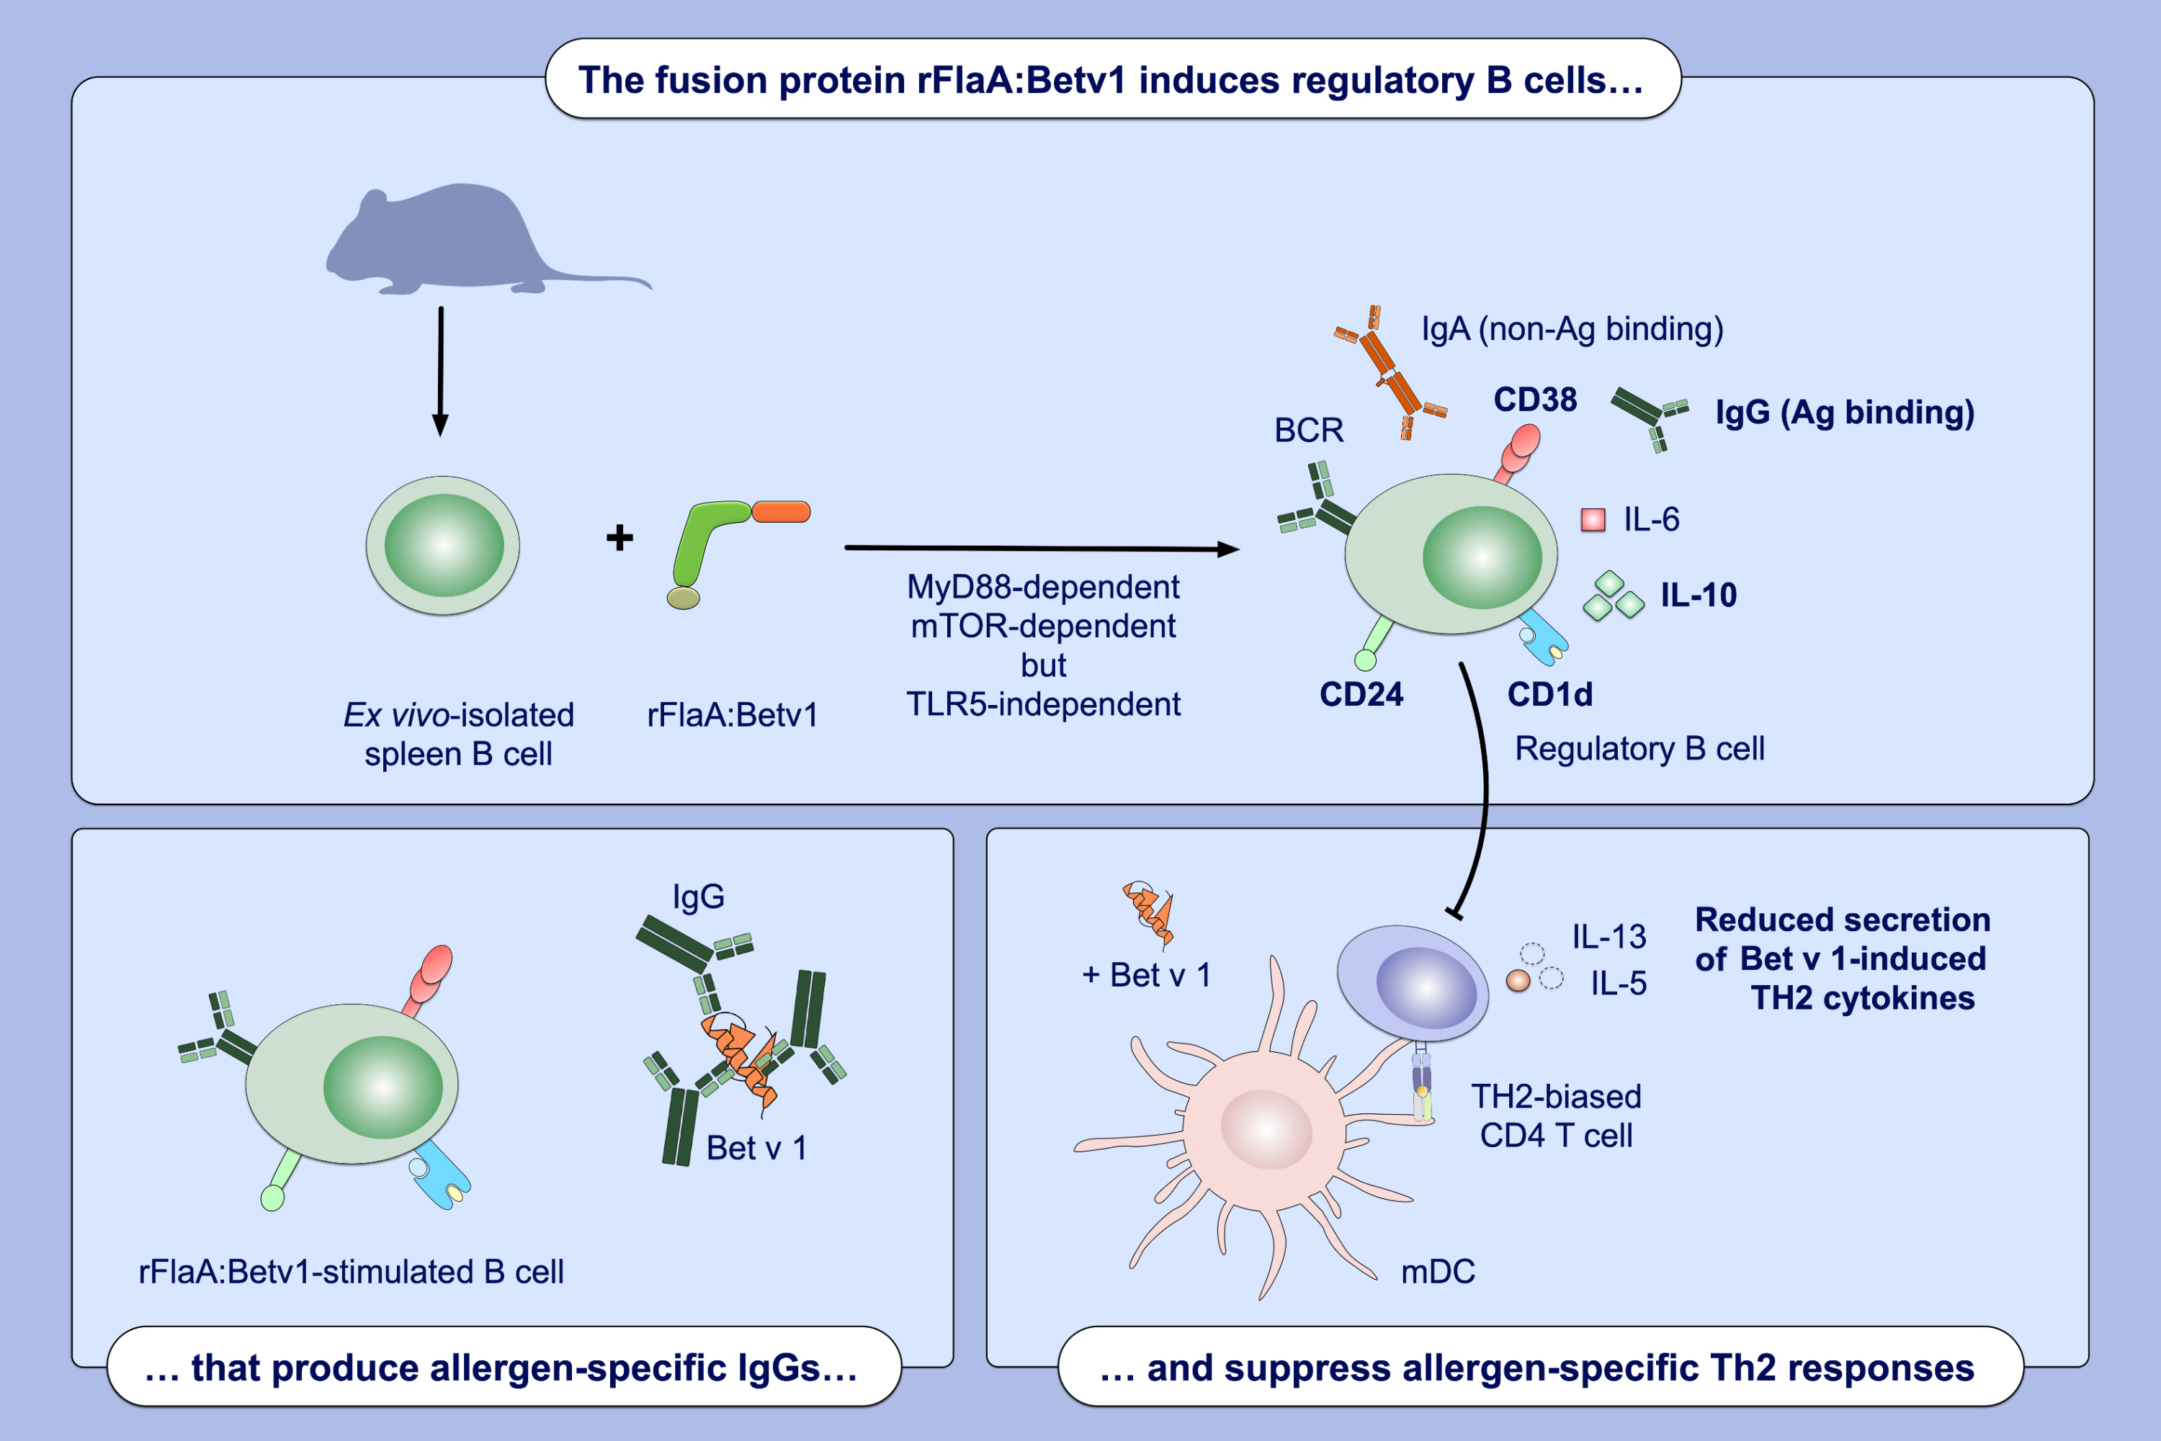
Stimulation of naïve B cells with a fusion protein consisting of FlaA and Bet v 1 induces regulatory B cells ex vivo
Alexandra Goretzki, Yen-Ju Lin, Clara Meier, Britta Dorn, Sonja Wolfheimer, et al.
Allergy. 2022; pages: 663-681
https://doi.org/10.1111/all.15542
© 2019 EAACI and John Wiley and Sons A/S. Published by John Wiley and Sons Ltd.
Notes:
HIGHLIGHTS
Stimulation of naïve ex vivo-isolated B cells with rFlaA:Betv1 results in a MyD88- and mTOR- dependent, but TLR5-independent differentiation of regulatory B cells.
Regulatory B cells were shown to be CD19⁺CD24⁺CD1d⁺IgM⁺CD38⁺ and secreted both anti-inflammatory cytokine IL-10 and allergen-specific IgG antibodies.
In co-cultures with TH2-biased Bet v 1-specific CD4⁺ T cells rFlaA:Betv1-stimulated B cells suppressed Th2 responses.
Abbreviations: BCR, B cell receptor; mDC, myeloid dendritic cell; MyD88, myeloid differentiation primary response 88; mTOR, mammalian target of rapamycin; rFlaA:Betv1, fusion protein of the TLR5-ligand flagellin A and the major birch pollen allergen Bet v 1; TLR5, Toll-like receptor 5.

