Slide 1
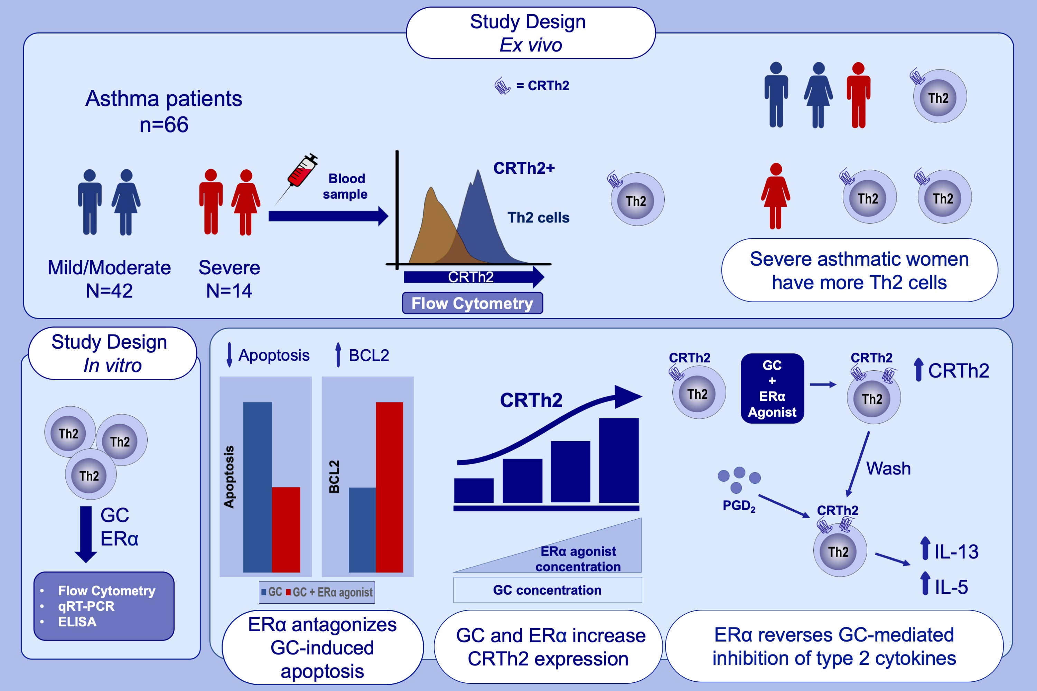
Dual Activation of Estrogen Receptor Alpha and Glucocorticoid Receptor Upregulate CRTh2-Mediated Type 2 Inflammation; Mechanism Driving Asthma Severity in Women?
Meerah Vijeyakumaran, MohdWessam Al Jawhri, Jenna Fortunato, Lauren Solomon, Nami Shrestha Palikhe, et al
Allergy. 2022; pages: 767-779
https://doi.org/10.1111/all.15543
© 2019 EAACI and John Wiley and Sons A/S. Published by John Wiley and Sons Ltd.
Notes:
HIGHLIGHTS
Th2 cells were higher in women with severe vs mild/moderate asthma and men of either phenotype; Th2 cell numbers correlated with ICS in women, but not men.
ERα antagonized GC-mediated Th2 cell death, increased CRTh2 and reversed GC inhibition of Th2 cytokines induced by PGD₂.
ERα activation may drive asthma severity in women by interfering with GC.
Abbreviations: Th2, T helper 2 cells; ICS, total daily dose of inhaled corticosteroid; GC, glucocorticosteroid; ERα, estrogen receptor alpha; PGD₂, prostaglandin D₂; CRTh2, chemoattractant receptor-homologous expressed on Th2 cells

