Slide 1
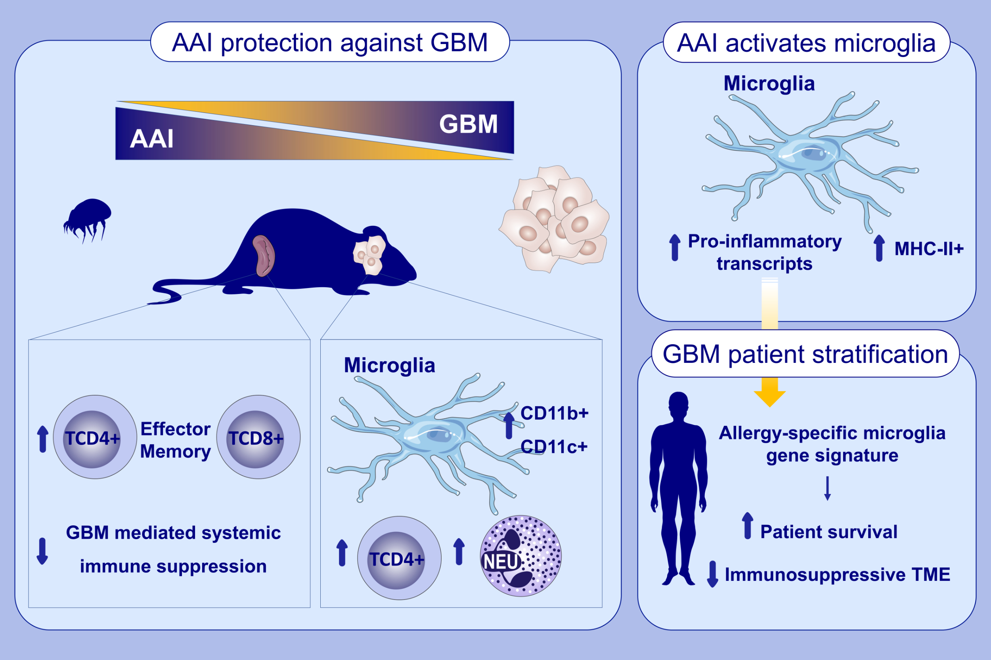
Allergic Airway Inflammation Delays Glioblastoma Progression and Reinvigorates Systemic and Local Immunity in Mice
Aurélie Poli, Anaïs Oudin, Arnaud Muller, Ilaria Salvato, Andrea Scafidi, et al.
Allergy. 2022; pages: 682-696
https://doi.org/10.1111/all.15545
© 2019 EAACI and John Wiley and Sons A/S. Published by John Wiley and Sons Ltd.
Notes:
HIGHLIGHTS
Allergy-induced protection against GBM is recapitulated in a preclinical syngeneic mouse model.
Allergic airway inflammation skews microglia toward pro-inflammatory and antigen-presenting like-states, uncovering a gene-signature in mice associated with improved patient survival and reduced local immunosuppression in glioma patients.
Allergic airway inflammation promotes the recruitment of CD4+T-cells within the tumor-microenvironment and mitigates glioma-induced systemic immunosuppression.
Abbreviations: AAI, allergic airway inflammation; GBM, glioblastoma; Neu, neutrophil; TME, tumor-microenvironment.

