Slide 1
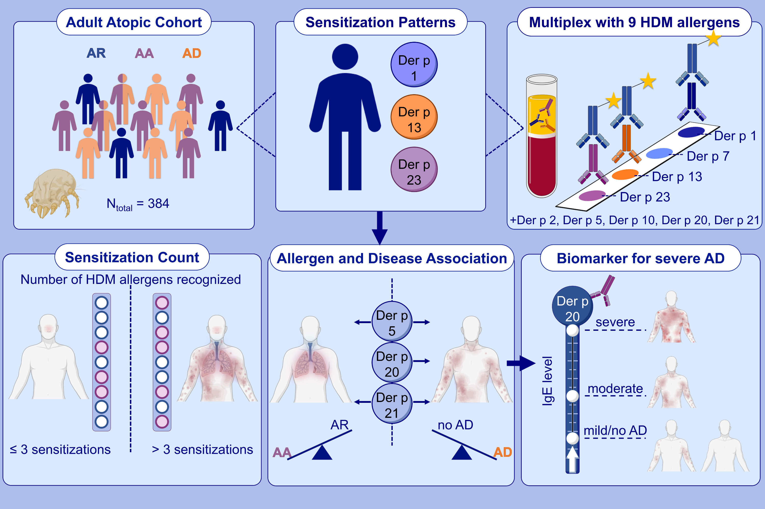
Specific IgE against the house dust mite allergens Der p 5, 20 and 21 influences the phenotype and severity of atopic diseases
Theresa Walsemann, Marisa Böttger, Stephan Traidl, Christian Schwager, Askin Gülsen, et al.
Allergy. 2022; pages: 731-742
https://doi.org/10.1111/all.15553
© 2019 EAACI and John Wiley and Sons A/S. Published by John Wiley and Sons Ltd.
Notes:
HIGHLIGHTS
Individual HDM sensitization patterns to nine HDM allergens were investigated in 384 patients with different allergic diseases.
Sensitization to more than three HDM allergens was associated with the simultaneous occurrence of multiple allergic diseases.
Der p 5 and Der p 21 were associated with allergic asthma and atopic dermatitis. High Der p 20-IgE was strongly associated with severe atopic dermatitis.
Abbreviations: AA, allergic asthma, AD, atopic dermatitis, AR, allergic rhinitis, HDM, house dust mite

