Slide 1
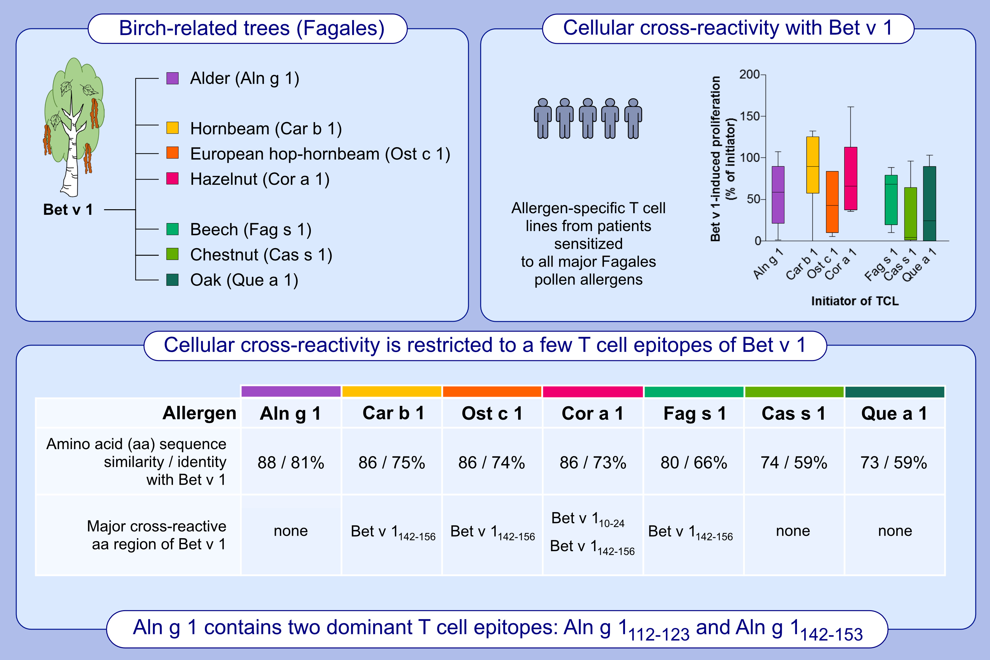
Bet v 1-independent sensitization to major allergens in Fagales pollen: evidence at the T cell level
Dominika Polak, Ute Vollmann, Joao Grilo, Ivan V. Bogdanov, Lorenz Aglas, et al.
Allergy. 2022; pages: 743-751
https://doi.org/10.1111/all.15594
© 2019 EAACI and John Wiley and Sons A/S. Published by John Wiley and Sons Ltd.
Notes:
HIGHLIGHTS
In birch-dominated areas Bet v 1 is considered as primary sensitizer of IgE-mediated allergies to pollen from birch-related trees.
T cell lines established with Bet v 1-homologous pollen allergens show limited cross-reactivity with Bet v 1. Despite high amino acid (aa) sequence homology of major Fagales allergens with Bet v 1 T cell cross-reactivity is restricted to very few epitopes of the major birch pollen allergen.
Two dominant T cell epitopes of Aln g 1 indicate genuine sensitizing capacity.
Abbreviation: TCL, T cell line.

