Slide 1
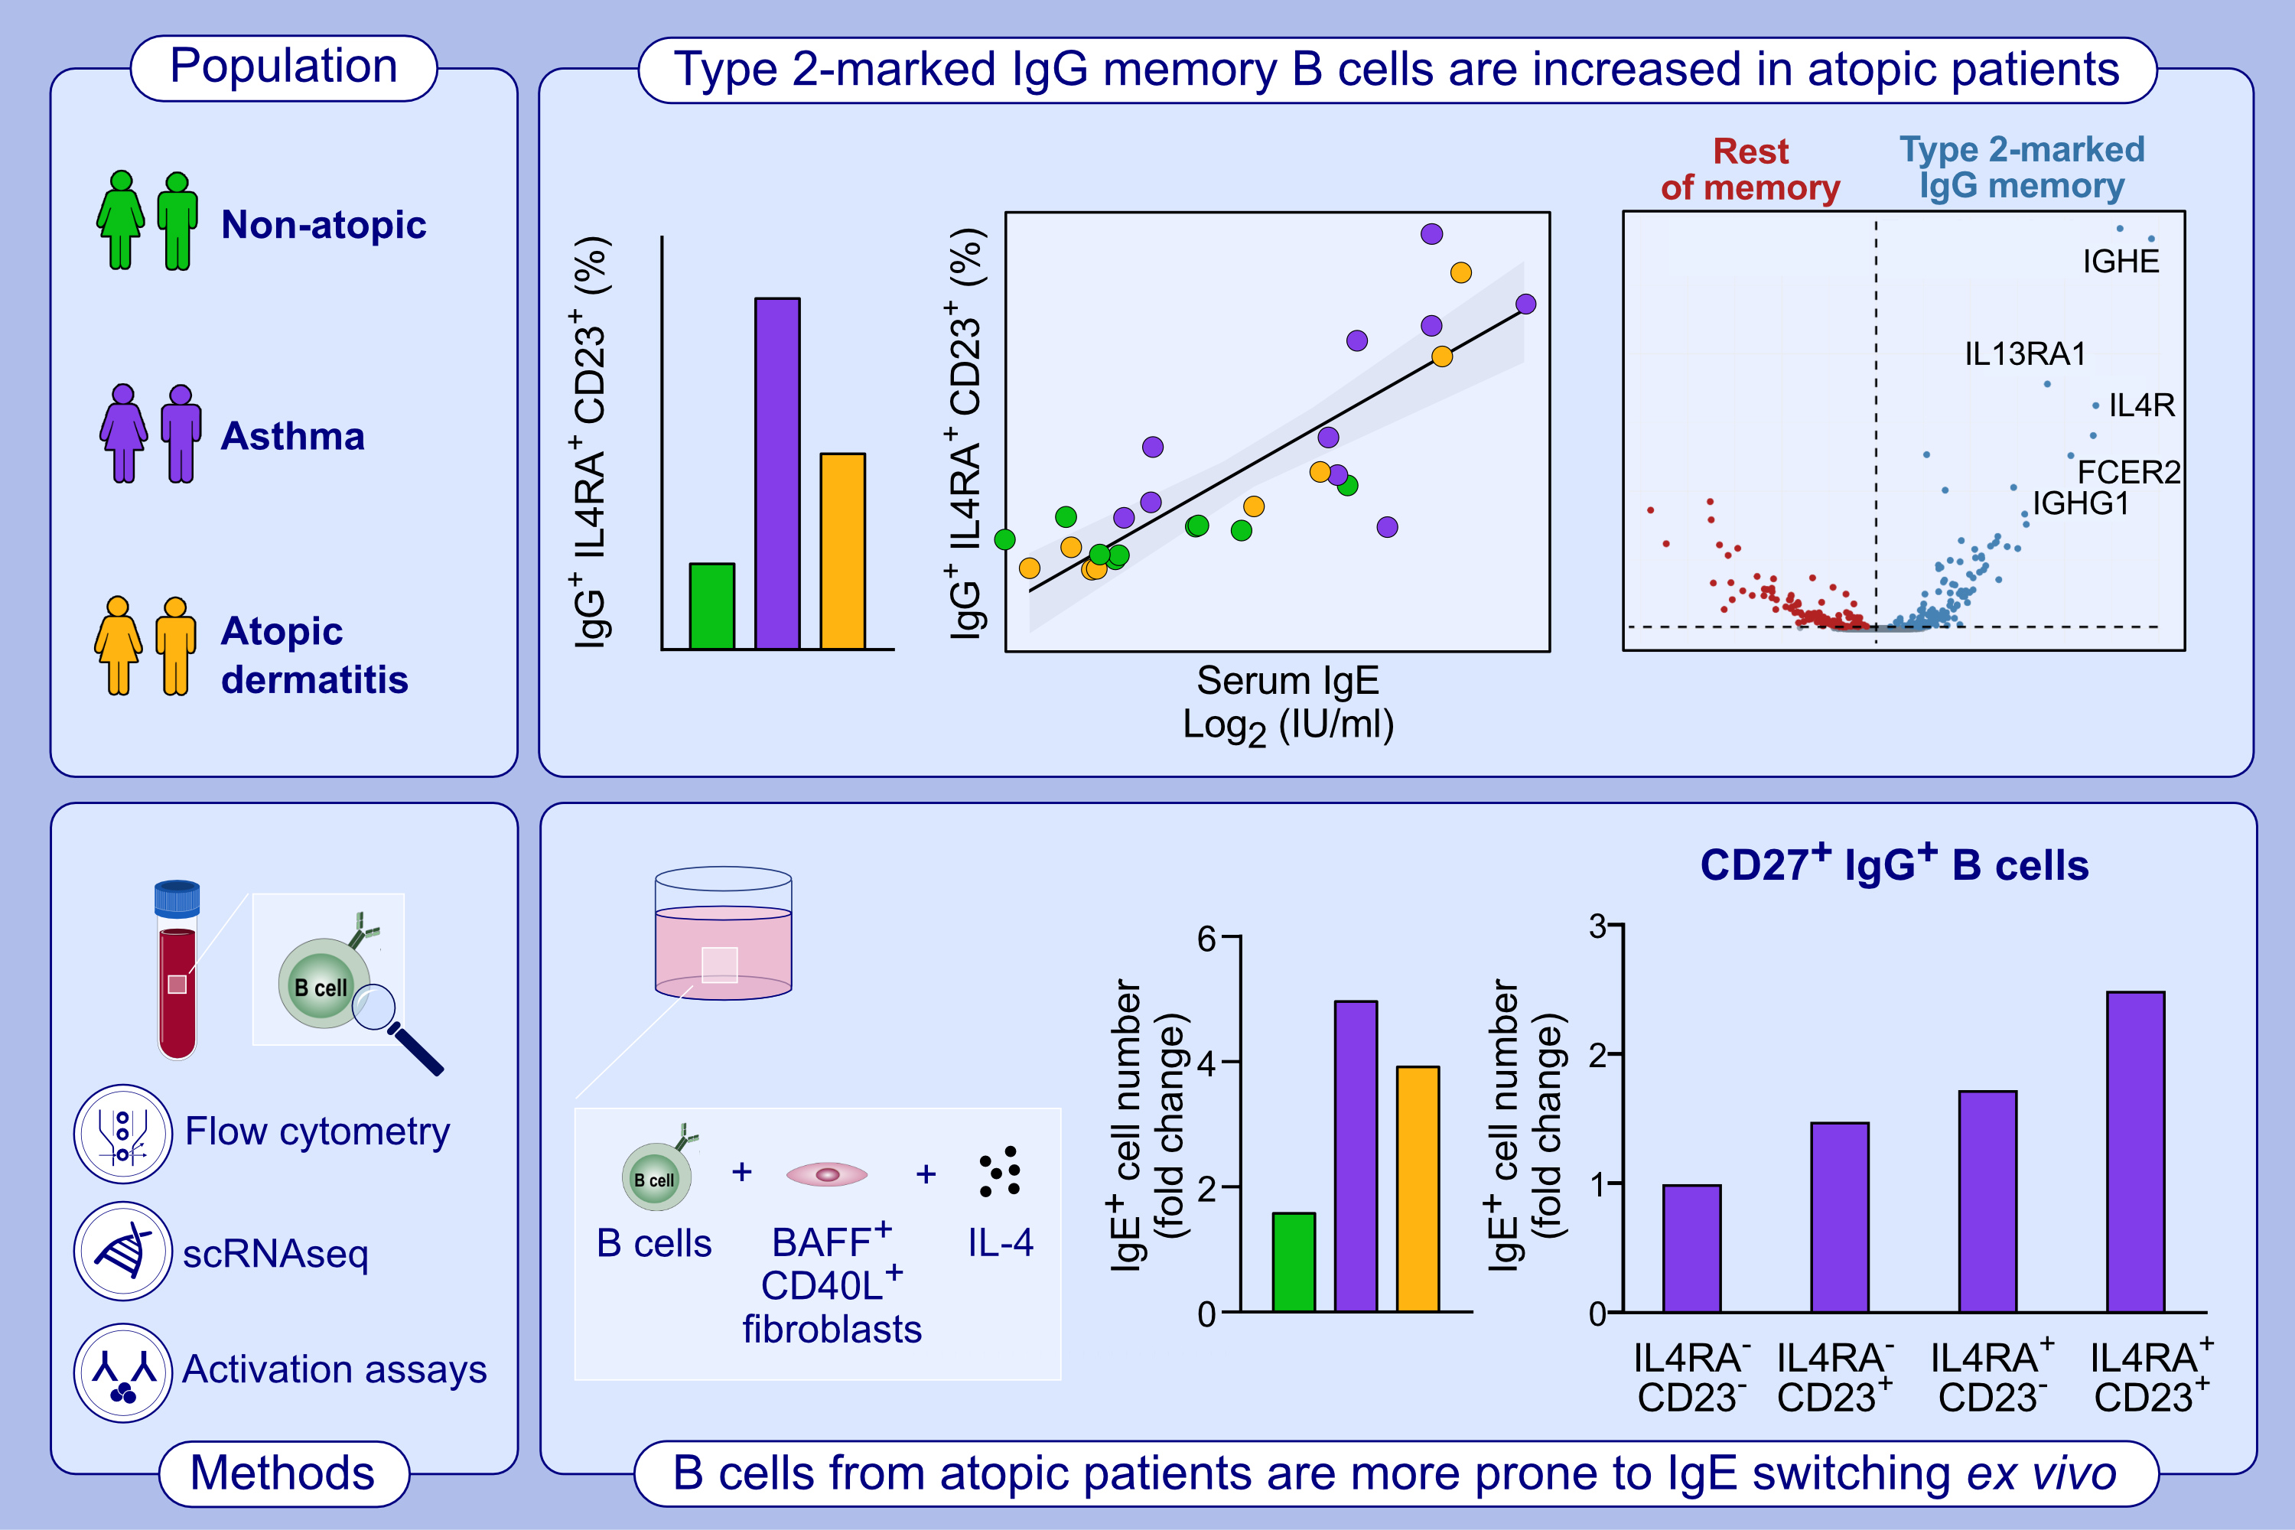
IgG memory B cells expressing IL4R and FCER2 are associated with atopic diseases
Carlos J. Aranda, Edgar Gonzalez-Kozlova, Sean P. Saunders, Weslley Fernandes-Braga, Miyo Ota, et al.
Allergy. 2022; pages: 752-766
https://doi.org/10.1111/all.15601
© 2019 EAACI and John Wiley and Sons A/S. Published by John Wiley and Sons Ltd.
Notes:
HIGHLIGHTS
We identified a novel population of IgG⁺IL4R⁺CD23⁺ type 2-marked memory B cells that are increased in peripheral blood of subjects with asthma or atopic dermatitis compared to non-atopic subjects.
Type 2-marked IgG memory B cell frequency correlates with circulating levels of IgE antibodies. They express IL-4/IL-13 regulated genes, ie. FCER2/CD23, IL4R, IL13RA1 and IGHE.
B cells from atopic subjects generate more IgE cells when stimulated in ex vivo cultures than B cells from non-atopic subjects. IgG⁺IL4R⁺CD23⁺ have the highest ability to switch to IgE among IgG memory B cells.
Abbreviations: BAFF, B cell activating factor; CD40L, CD40 ligand; FCER2, Fc epsilon receptor II; Ig, immunoglobulin; IGH, immunoglobulin heavy constant; IL, interleukin; IL4RA, IL-4 receptor subunit alpha; IL13RA1, IL-13 receptor subunit alpha 1; IU/ml, international units per milliliter; scRNAseq, single cell RNA sequencing

