Slide 1
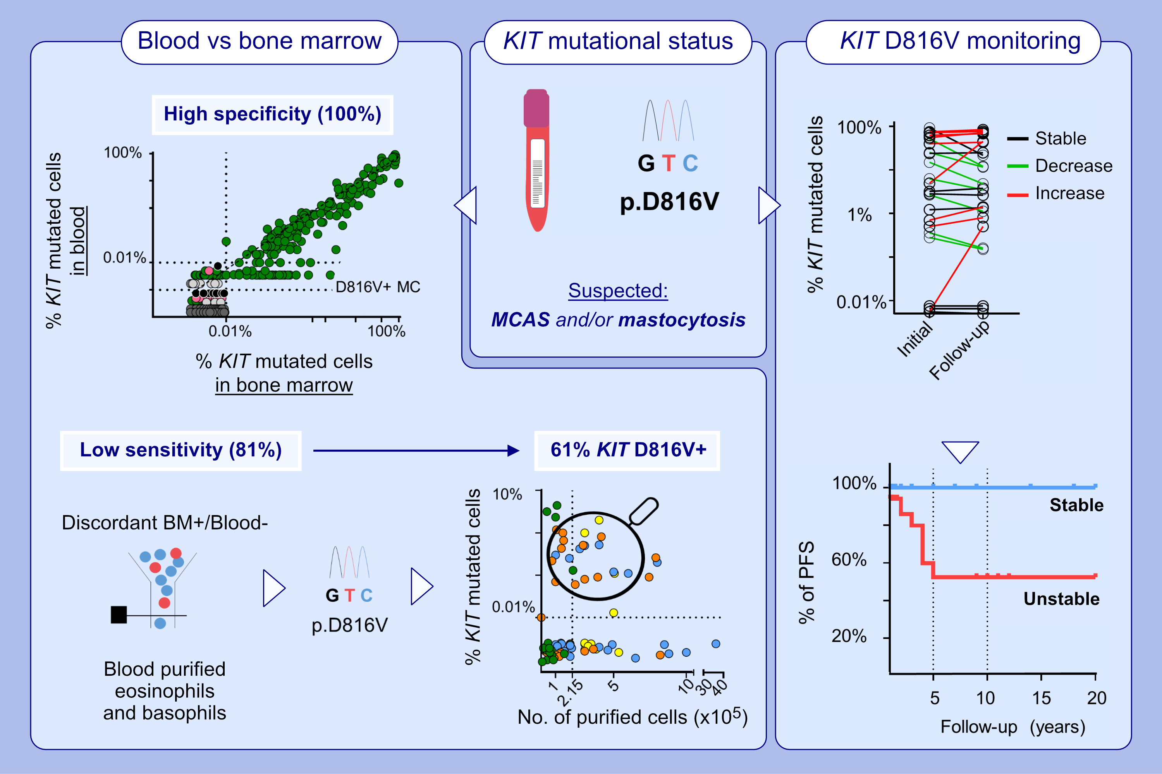
KITD816V mutation in blood for the diagnostic screening of systemic mastocytosis and mast cell activation syndromes
Paula Navarro-Navarro, Iván Álvarez-Twose, Alba Pérez-Pons, Ana Henriques, Andrea Mayado , et al.
Allergy. 2023; pages:1347-1359
https://doi.org/10.1111/all.15584
© 2019 EAACI and John Wiley and Sons A/S. Published by John Wiley and Sons Ltd.
Notes:
HIGHLIGHTS
This study evaluates the utility of KITD816V mutational status in blood (vs. bone marrow) for the diagnostic screening of SM and MCAS patients, having a high specificity but a limited sensitivity in patients presenting with clonal MCAS without skin lesions.
Assessment of KITD816V in blood-purified myeloid cell populations increases the diagnostic sensitivity of this mutation in 61% of patients.
Further, an unstable (decrease or increase) KIT-mutation cell burden during follow-up is a strong predictor of shortened progression-free survival in SM.
Abbreviations: BM, bone marrow; KITD816V, somatic mutation in codon 816 of the stem cell growth factor receptor gene; MC, mast cell; MCAS, mast cell activation syndromes; No., number; PFS, progression-free survival; SM, systemic mastocytosis.

