Slide 1
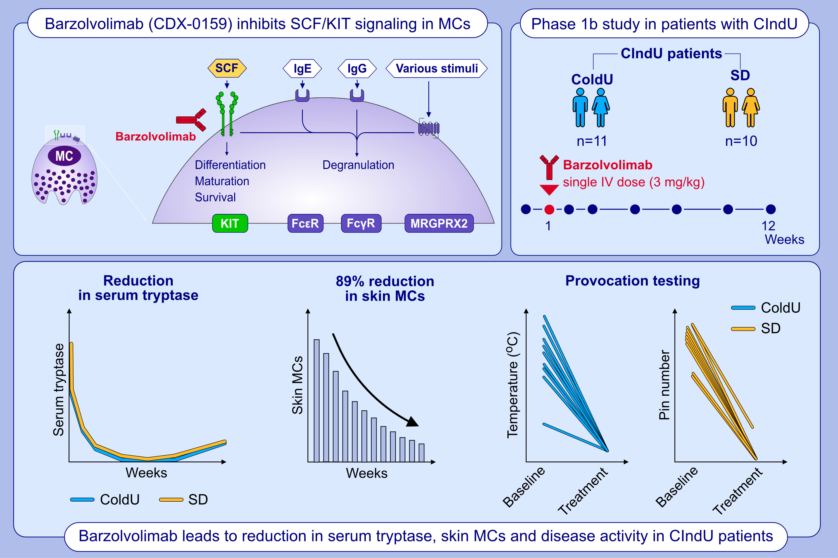
Anti-KIT antibody, barzolvolimab, reduces skin mast cells and disease activity in chronic inducible urticaria
Dorothea Terhorst-Molawi, Tomasz Hawro, Eva Grekowitz, Lea Kiefer, Kunal Merchant, et al.
Allergy. 2023; pages: 1269-1279
https://doi.org/10.1111/all.15585
© 2019 EAACI and John Wiley and Sons A/S. Published by John Wiley and Sons Ltd.
Notes:
HIGHLIGHTS
In this Phase 1b study of CIndU (ColdU and SD) patients, barzolvolimab, a humanized antibody that inhibits KIT activation by SCF, was well tolerated.
Barzolvolimab demonstrated marked, rapid, durable depletion of skin MCs, circulating tryptase, reductions in clinical activity, and significant improvements in disease control and QoL.
Barzolvolimab has potential as a therapy for MC-mediated diseases.
Abbreviations: CIndU, chronic inducible urticaria; ColdU, cold urticaria; FcR, Fc receptor; Ig, immunoglobulin; KIT, KIT proto-oncogene, receptor tyrosine kinase; MC, mast cell; MRGPRX2, mas-related G protein-coupled receptor-X2; QoL, quality of life; SCF, stem cell factor; SD, symptomatic dermographism.

