Slide 1
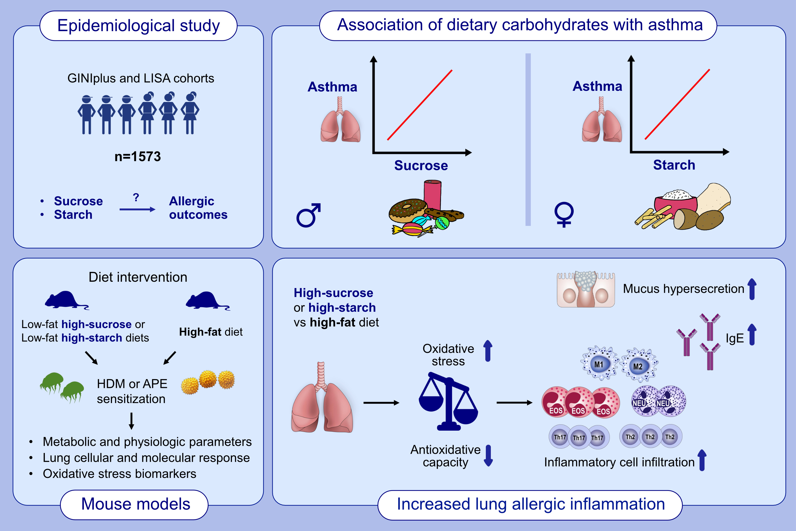
Dietary digestible carbohydrates are associated with higher prevalence of asthma in humans and with aggravated lung allergic inflammation in mice
Stephanie Musiol, Carla P. Harris, Ruth Karlina, Johanna M. Gostner, Birgit Rathkolb,et al.
Allergy. 2023; pages:1218-1233
https://doi.org/10.1111/all.15589
© 2019 EAACI and John Wiley and Sons A/S. Published by John Wiley and Sons Ltd.
Notes:
HIGHLIGHTS
Epidemiological study discovers novel associations between high intake of dietary sucrose and starch with current asthma in males and females, respectively.
High-carbohydrate feeding in mice aggravates allergic outcomes: serum IgE, lung inflammatory cell infiltration, T_{H}2- or T_{H}2-T_{H}17 profiles and mucus hypersecretion.
Dietary carbohydrate-driven enhanced pulmonary oxidative stress and decreased systemic anti-oxidative capacity are involved in this context.
Abbreviations: APE, aqueous pollen extract; EOS, eosinophils; GINIplus: German Infant study on the Influence of Nutrition Intervention plus environmental and genetic influences on allergy development; HDM, house dust mite; IgE, immunoglobulin E; LISA: Life-style related factors on the development of the Immune System and Allergies in East and West Germany; M, macrophages; NEU, neutrophils; Th, T helper.

