Slide 1
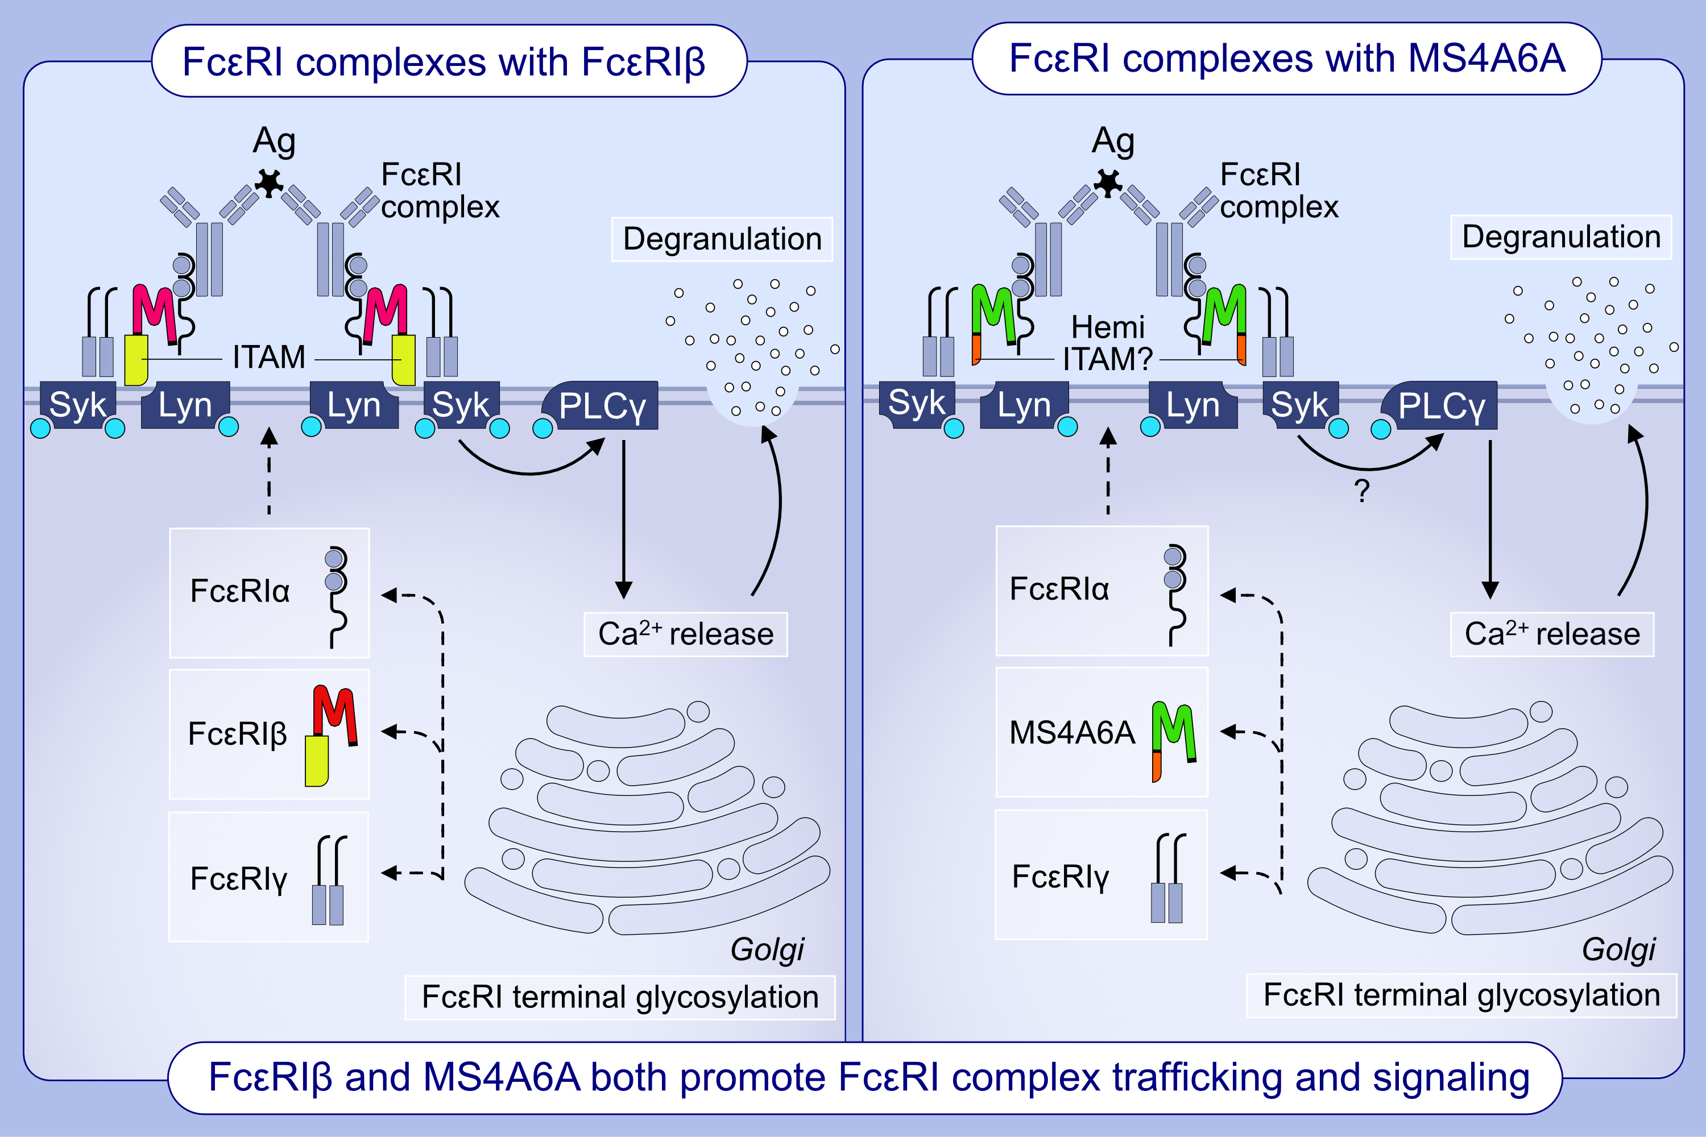
Identification of redundancy between human FcεRIβ and MS4A6A proteins points toward additional complex mechanisms for FcεRI trafficking and signaling
Katie Bitting, Barry Hedgespeth, Lauren C. Ehrhardt-Humbert, Greer K. Arthur, Alicia G. Schubert, et al.
Allergy. 2023; pages: 1204-1217
https://doi.org/10.1111/all.15595
© 2019 EAACI and John Wiley and Sons A/S. Published by John Wiley and Sons Ltd.
Notes:
HIGHLIGHTS
We identify that MS4A6A is expressed in human mast cells and has high sequence homology to FcεRIβ.
We show that MS4A6A contains a putative hemi-ITAM that may function similarly to the FcεRIβ ITAM.
We demonstrate that MS4A6A and FcεRIβ perform at least partially redundant roles in FcεRI complex trafficking and function.
Abbreviations: Ag, antigen; Ca2⁺, calcium ion; FcεRI, high-affinity IgE receptor; ITAM, immunoreceptor tyrosine-based activation motif; Lyn, Src family tyrosine kinase; MS4A6A, membrane spanning 4-domains A6A; PLC, phospholipase C; Syk, spleen associated tyrosine kinase.

