Slide 1
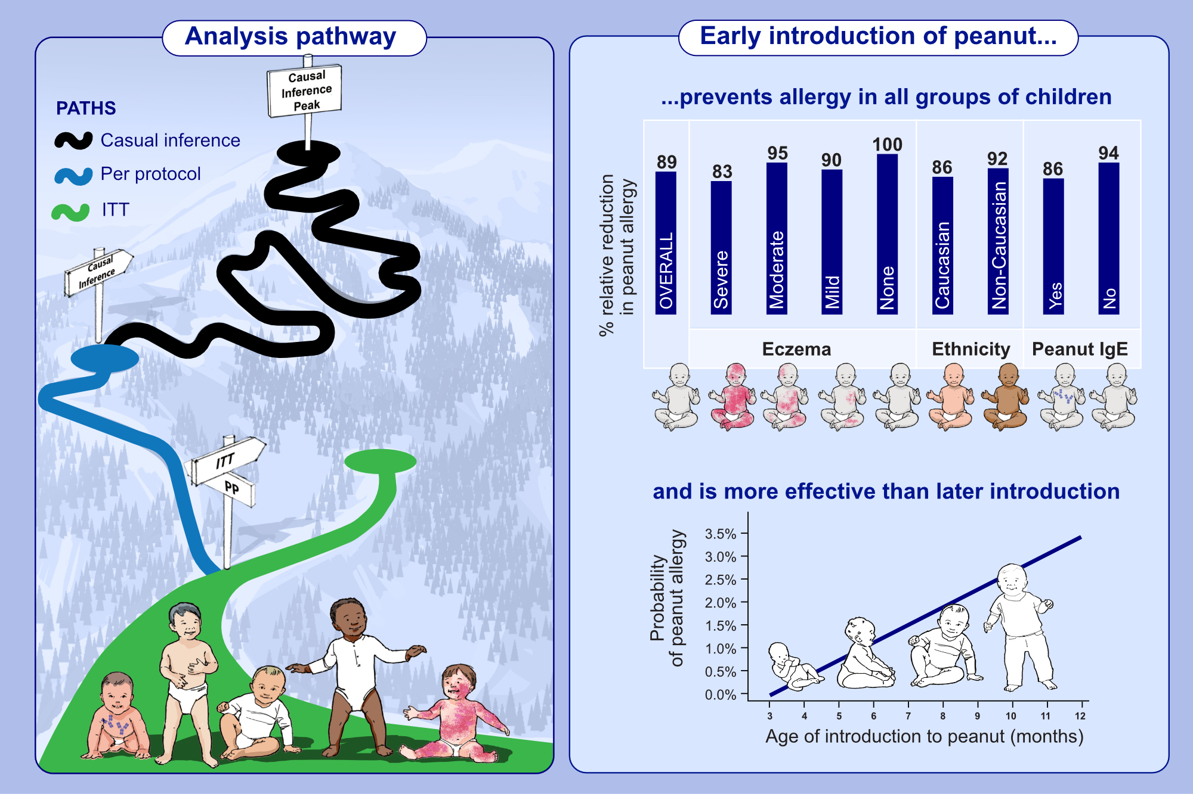
Early introduction of peanut reduces peanut allergy across risk groups in pooled and causal inference analyses
Kirsty Logan, Henry T. Bahnson, Alyssa Ylescupidez, Kirsten Beyer, Johanna Bellach, et al.
Allergy. 2023; pages: 1307-1318
https://doi.org/10.1111/all.15597
© 2019 EAACI and John Wiley and Sons A/S. Published by John Wiley and Sons Ltd.
Notes:
HIGHLIGHTS
An integrated meta-analysis employing both LEAP (high-risk) and EAT (normal risk) individual patient data shows that early introduction of peanut in infancy prevents the development of peanut allergy regardless of presence or severity of eczema, ethnicity, and sensitization to peanut.
Earlier introduction of peanut before 6 months of age is more effective than later introduction in the prevention of peanut allergy.
Causal inference methods accurately estimated the efficacy of this strategy while addressing the problems of poor adherence in the Intention to Treat analyses and biases in the Per Protocol analyses.
Abbreviations: EAT, Enquiring About Tolerance; ITT, Intention to Treat; LEAP, Learning Early About Allergy; PP, Per Protocol.

