Slide 1
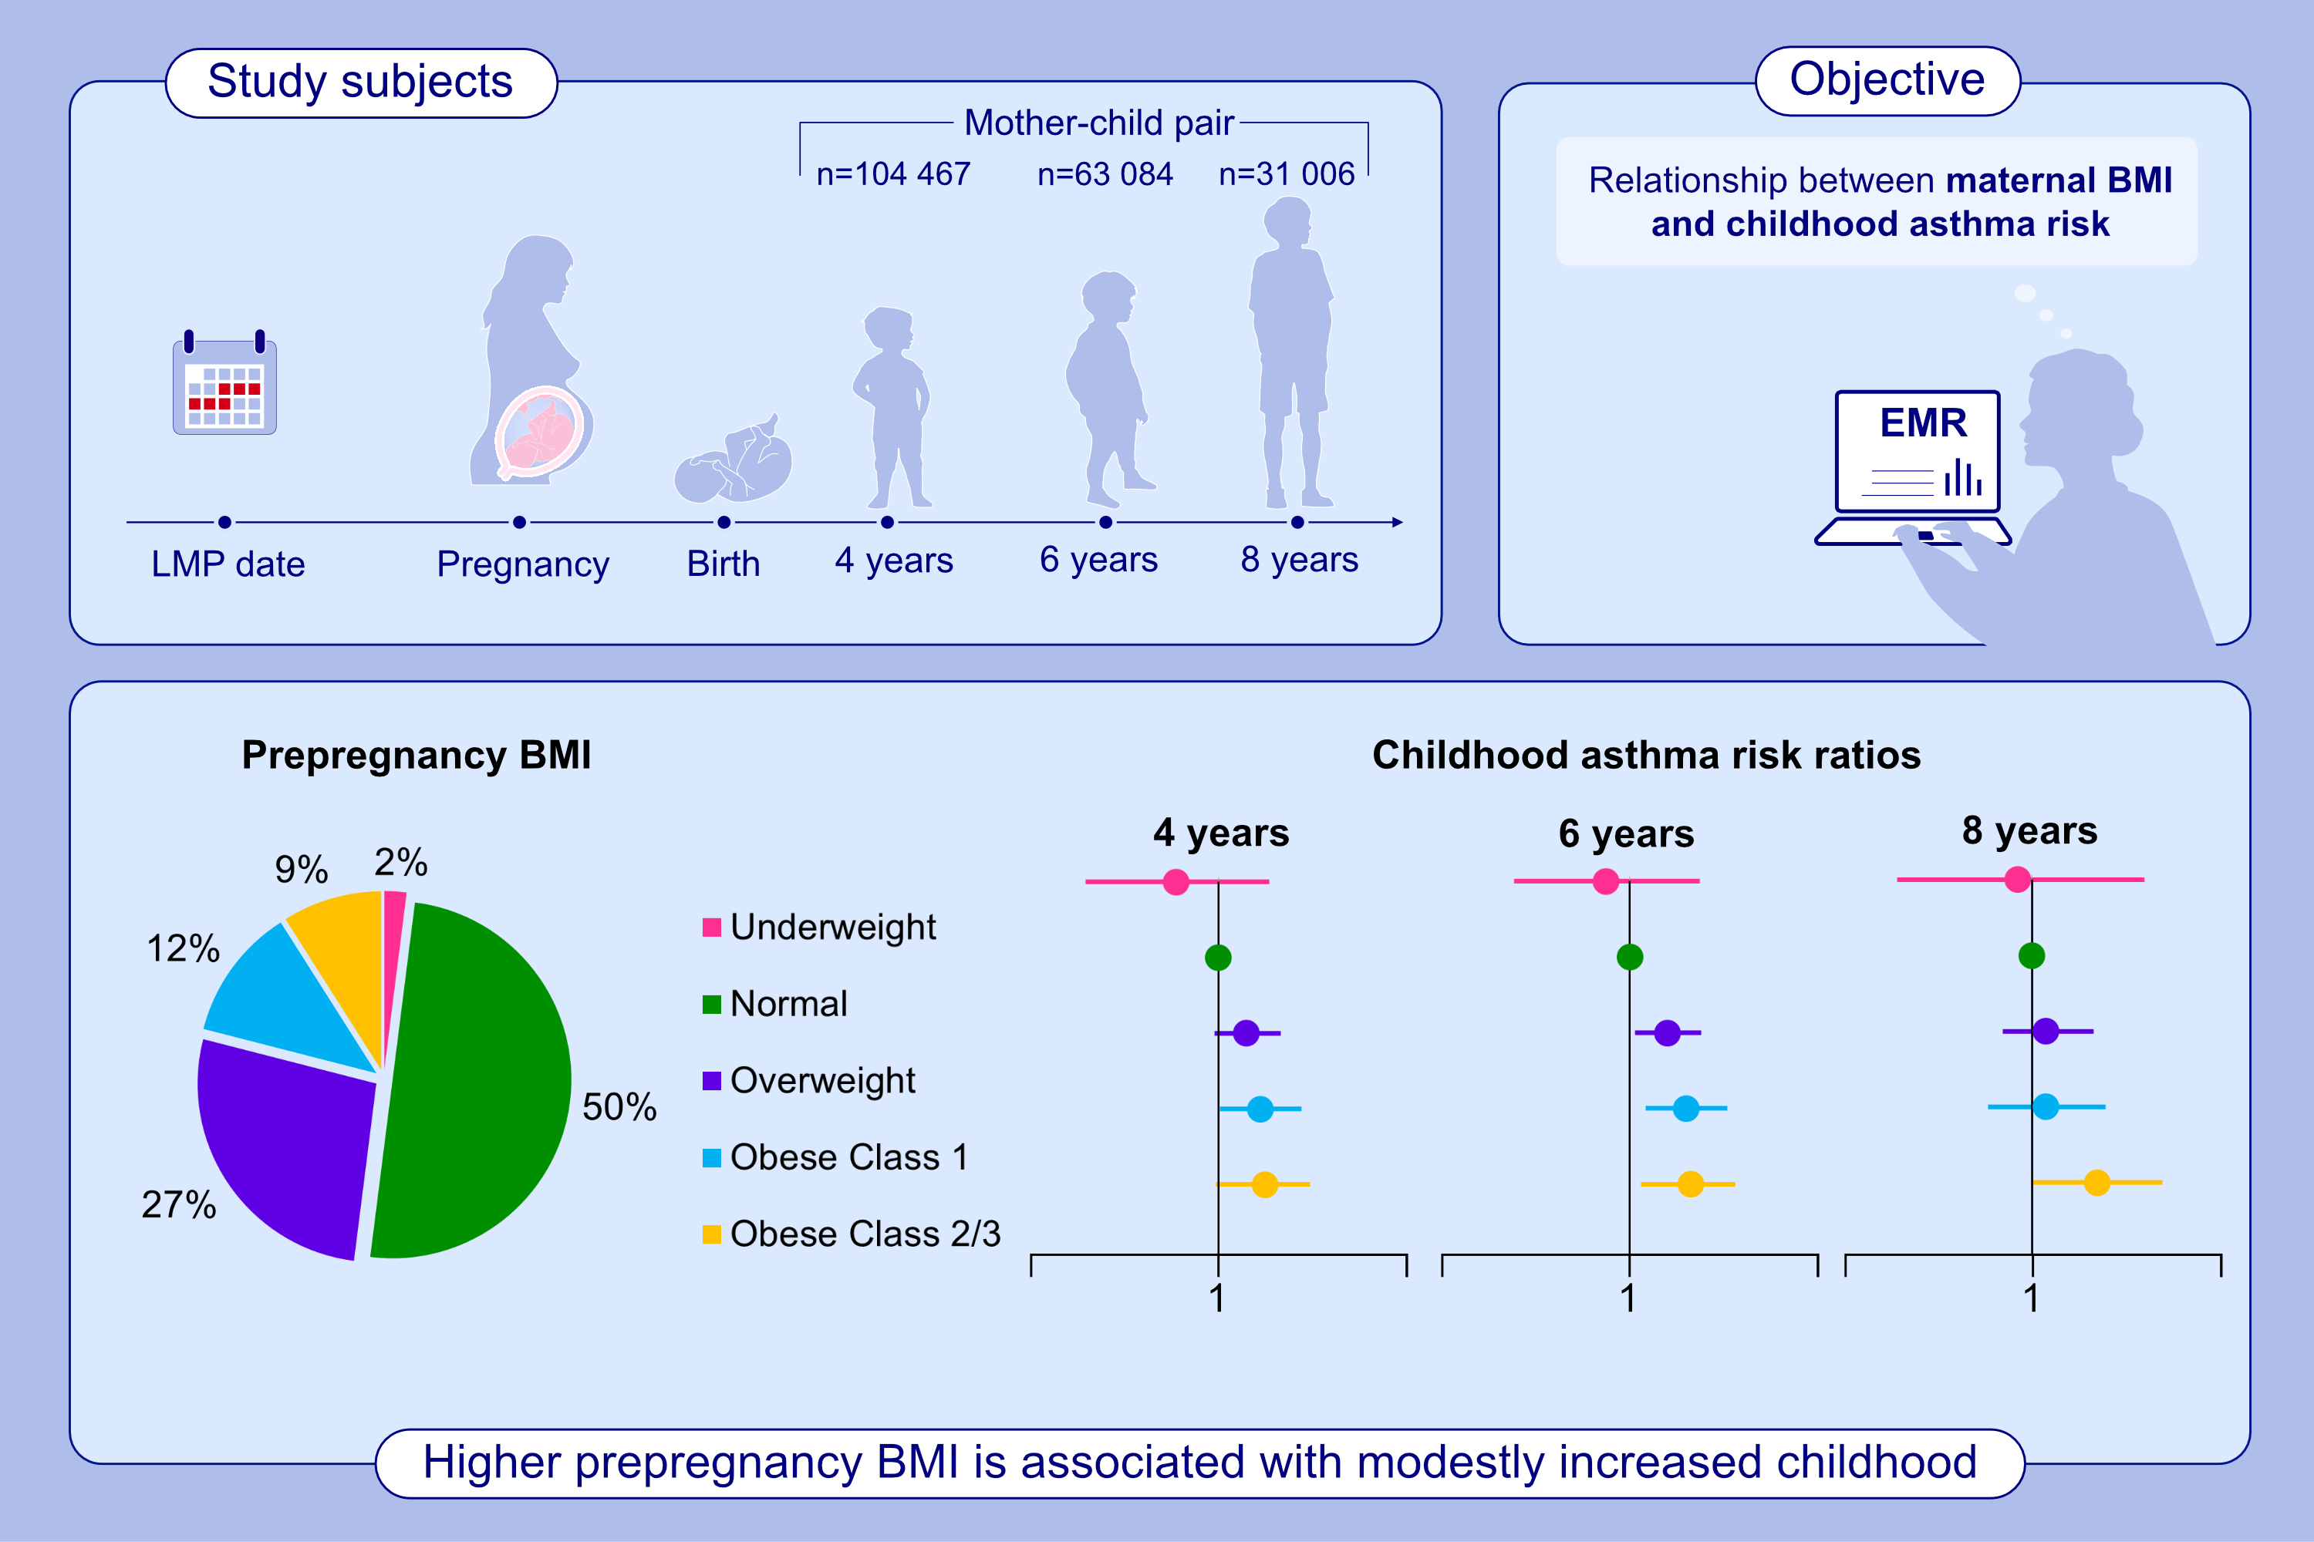
Prepregnancy Body Mass Index and Risk of Childhood Asthma
Natalie A. Rosenquist, Megan Richards, Jeannette R. Ferber, De-Kun Li, So Young Ryu, Heather Burkin, Matthew J. Strickland, Lyndsey A. Darrow, et al.
Allergy. 2023; pages:1234-1244
https://doi.org/10.1111/all.15598
© 2019 EAACI and John Wiley and Sons A/S. Published by John Wiley and Sons Ltd.
Notes:
HIGHLIGHTS
This study investigated relationship between maternal prepregnancy BMI and childhood asthma risk.
Mothers were followed throughout their pregnancy and children were followed up to age 4, 6, or 8 years using electronic medical records. Asthma was assessed at each follow-up age.
Higher prepregnancy BMI was associated with a modest increase in childhood asthma risk.
Abbreviations: BMI, body mass index; EMR, electronic medical records; LMP, last menstrual period.

