Slide 1
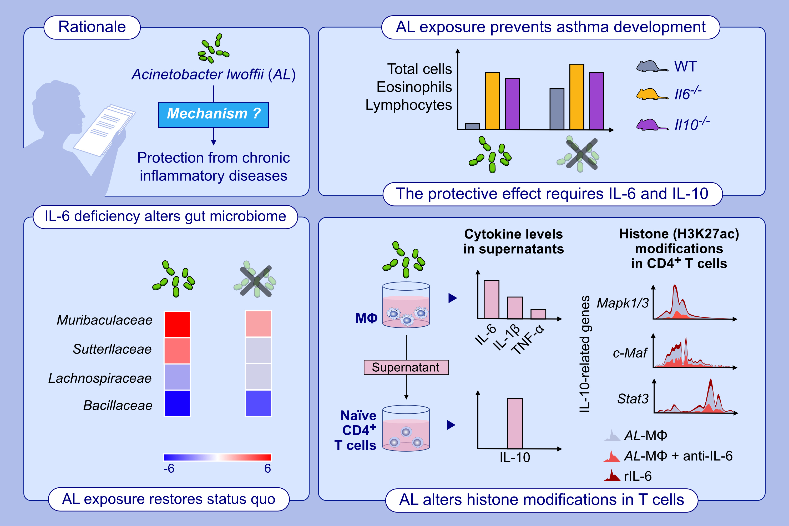
Intranasal administration of Acinetobacter lwoffii in a murine model of asthma induces IL-6-mediated protection associated with caecal microbiota changes
Bilal Alashkar Alhamwe, Zhan Gao, Fahd Alhamdan, Hani Harb, Matthieu Pichene, et al.
Allergy. 2023; pages:1245-1257
https://doi.org/10.1111/all.15606
© 2019 EAACI and John Wiley and Sons A/S. Published by John Wiley and Sons Ltd.
Notes:
HIGHLIGHTS
This study confirms that IL-6-deficient mice are resistant to asthma-protective effect driven by Acinetobacter lwoffii (AL). Downstream of IL-6, the asthma-blocking properties is mediated by IL-10, but not IL-17.
In IL-6-deficient mice, exposure to AL increases Muribaculaceae and Sutterellaceae, and decreases Lachnospiraceae and Bacillaceae, compared to the unexposed mice, restoring the status quo observed in the wild-type littermates mice.
In vitro experiments demonstrate modulations in the epigenetic landscape of histone mark H3K27ac at the promotor regions of the Il10 pathway-related genes (Mapk1/3, Stat3 and c-MAF) in the CD4⁺ T-cells cultured with AL-conditioned macrophage supernatant (AL-Mφ). These changes were reversed by anti-IL-6 treatment (AL-Mφ + anti-IL-6) and phenocopy by adding rIL-6 alone.
Abbreviations: AL, Acinetobacter lwoffii; AL-Mφ, AL-conditioned macrophage; c-Maf, c-musculoaponeurotic fibrosarcoma transcription factor; IL, interleukin; Il6^{−/−}, Il6 knockout; Il10^{−/−}, Il10 knockout; Mφ, macrophages; Mapk1/3, mitogen-activated protein kinase 1/3; rIL-6, recombinant IL-6; Stat3, signal transducer and activator of transcription 3; TNF, tumor necrosis factor; WT, wild-type.

