Slide 1
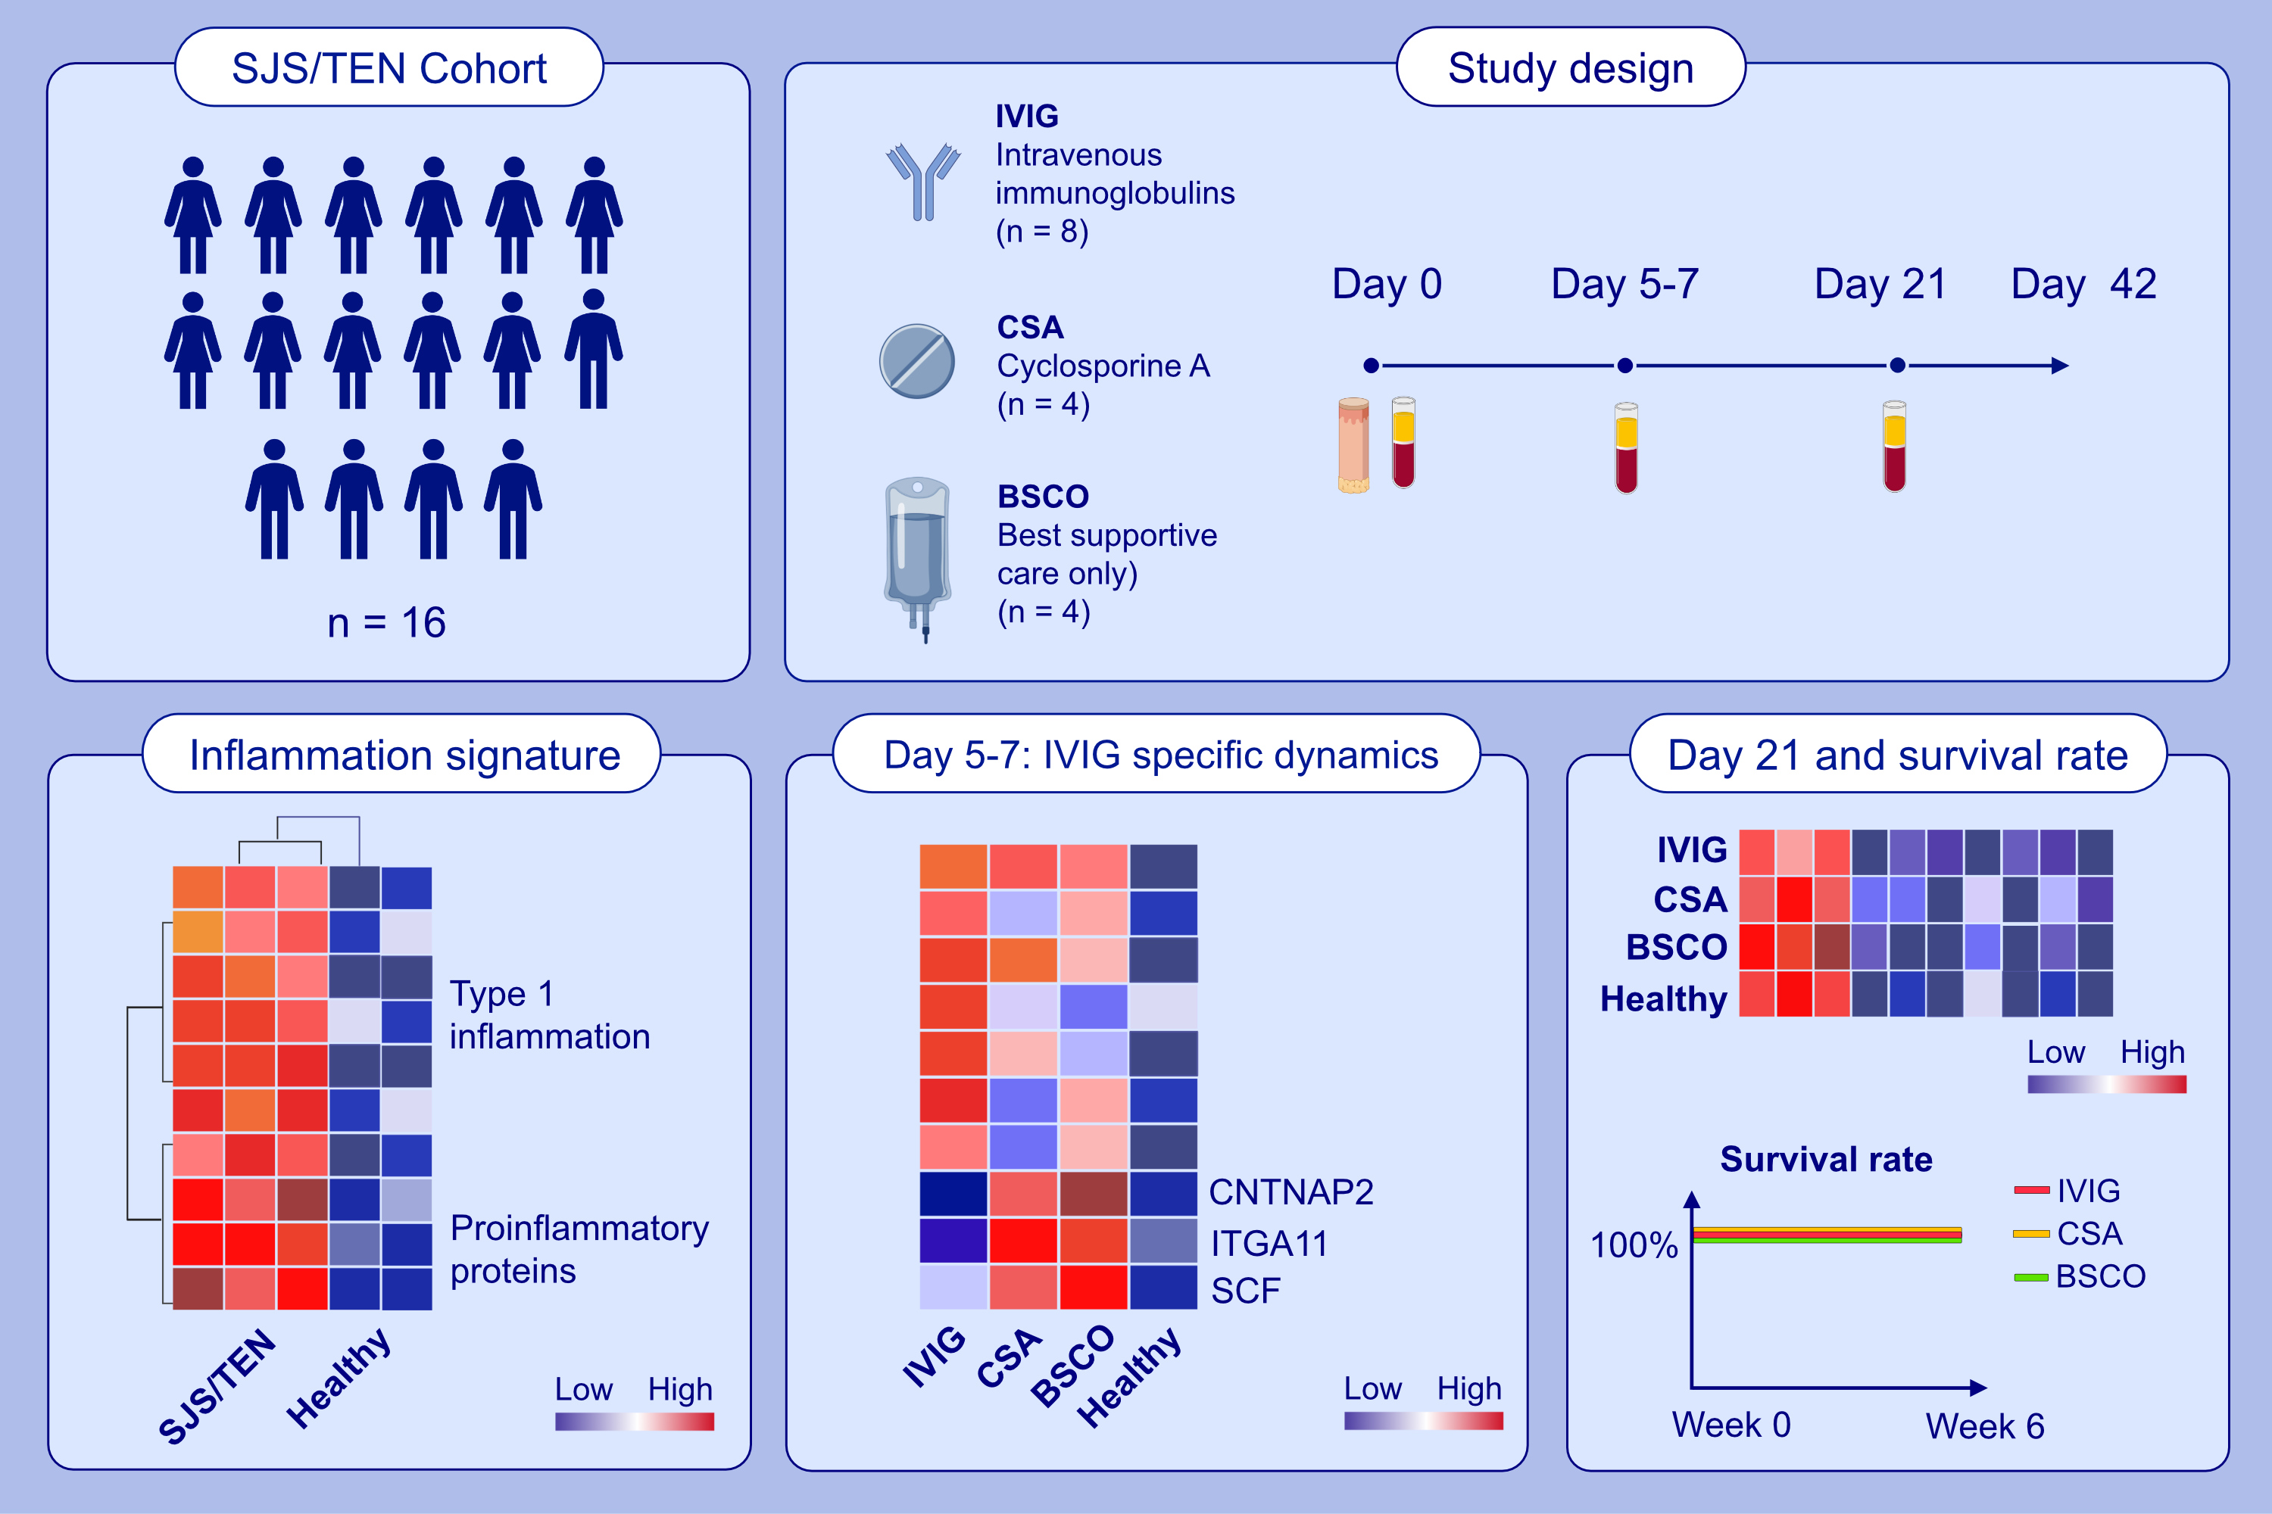
­­­Intravenous immunoglobulins, cyclosporine and best supportive care
in Epidermal Necrolysis: Diverse effects on systemic inflammation
Veronika Schmidt, Sophie Lalevée, Stephan Traidl, Milad Ameri, Reihane Ziadlou, et al.
Allergy. 2023; pages:1280-1291
https://doi.org/10.1111/all.15608
© 2019 EAACI and John Wiley and Sons A/S. Published by John Wiley and Sons Ltd.
Notes:
HIGHLIGHTS
This study characterizes molecular effects of best supportive care only (BSCO) or in combination with intravenous immunoglobulins (IVIG) or cyclosporine A (CSA) in the acute phase of Stevens-Johnson-Syndrome/toxic epidermal necrolysis (SJS/TEN).
Serum inflammatory profiles show massive upregulation of type 1 immune response and proinflammatory markers.
IVIG-treated patients present different dynamics and most significant proteomic changes in an early phase (day 5-7). In all treatment groups, type 1-/inflammatory response markers are dampened at day 21.
Abbreviations: BSCO, best supportive care only; CNTNAP2, contactin associated protein 2; CSA, cyclosporine A; IVIG, intravenous immunoglobulins; ITGA11, integrin subunit alpha 11; SCF, stem cell factor; SJS, Stevens-Johnson-Syndrome; TEN, toxic epidermal necrolysis.

