Slide 1
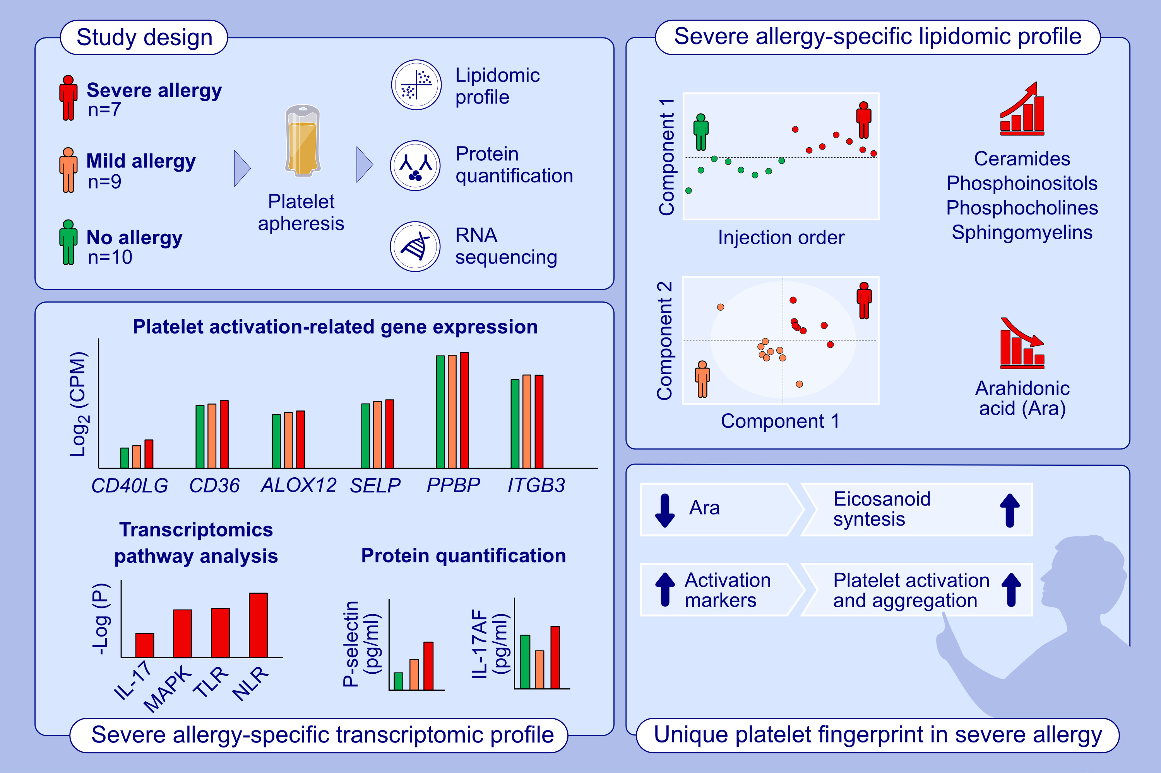
Deciphering the role of platelets in severe allergy by an integrative omics approach
Carmela Pablo-Torres, Elena Izquierdo, Tiak Ju Tan, David Obeso, Janice A. Layhadi, et al.
Allergy. 2023; pages:1319-1332
https://doi.org/10.1111/all.15621
© 2019 EAACI and John Wiley and Sons A/S. Published by John Wiley and Sons Ltd.
Notes:
HIGHLIGHTS
This study analyzes the lipidomic and transcriptomic profile of platelets in patients with mild and severe allergy.
The lipidomic profile of platelets form severe allergic patients shows high levels of ceramides, phosphoinositols, phosphocholines and sphingomyelins, and low levels of arachidonic acid.
Transcriptomics reveales a higher expression of platelet activation genes and the alteration of IL-17, MAPK, TLR and NLR pathways in the severe phenotype, which was validated by P-Selectin and IL-17 AF protein quantification.
Abbreviations: ALOX12, arachidonate 12-lipoxygenase; CD40L, CD40 ligand; CPM, counts per millon; IL, interleukin; ITGB3, integrin subunit beta 3; -Log(P), -Logarithm in base 10 of P value; MAPK, mitogen-activated protein kinase; NLR, NOD-like receptor; PPBP, pro-platelet basic protein; SELP, selectin P; TLR, Toll-like receptor

