Slide 1
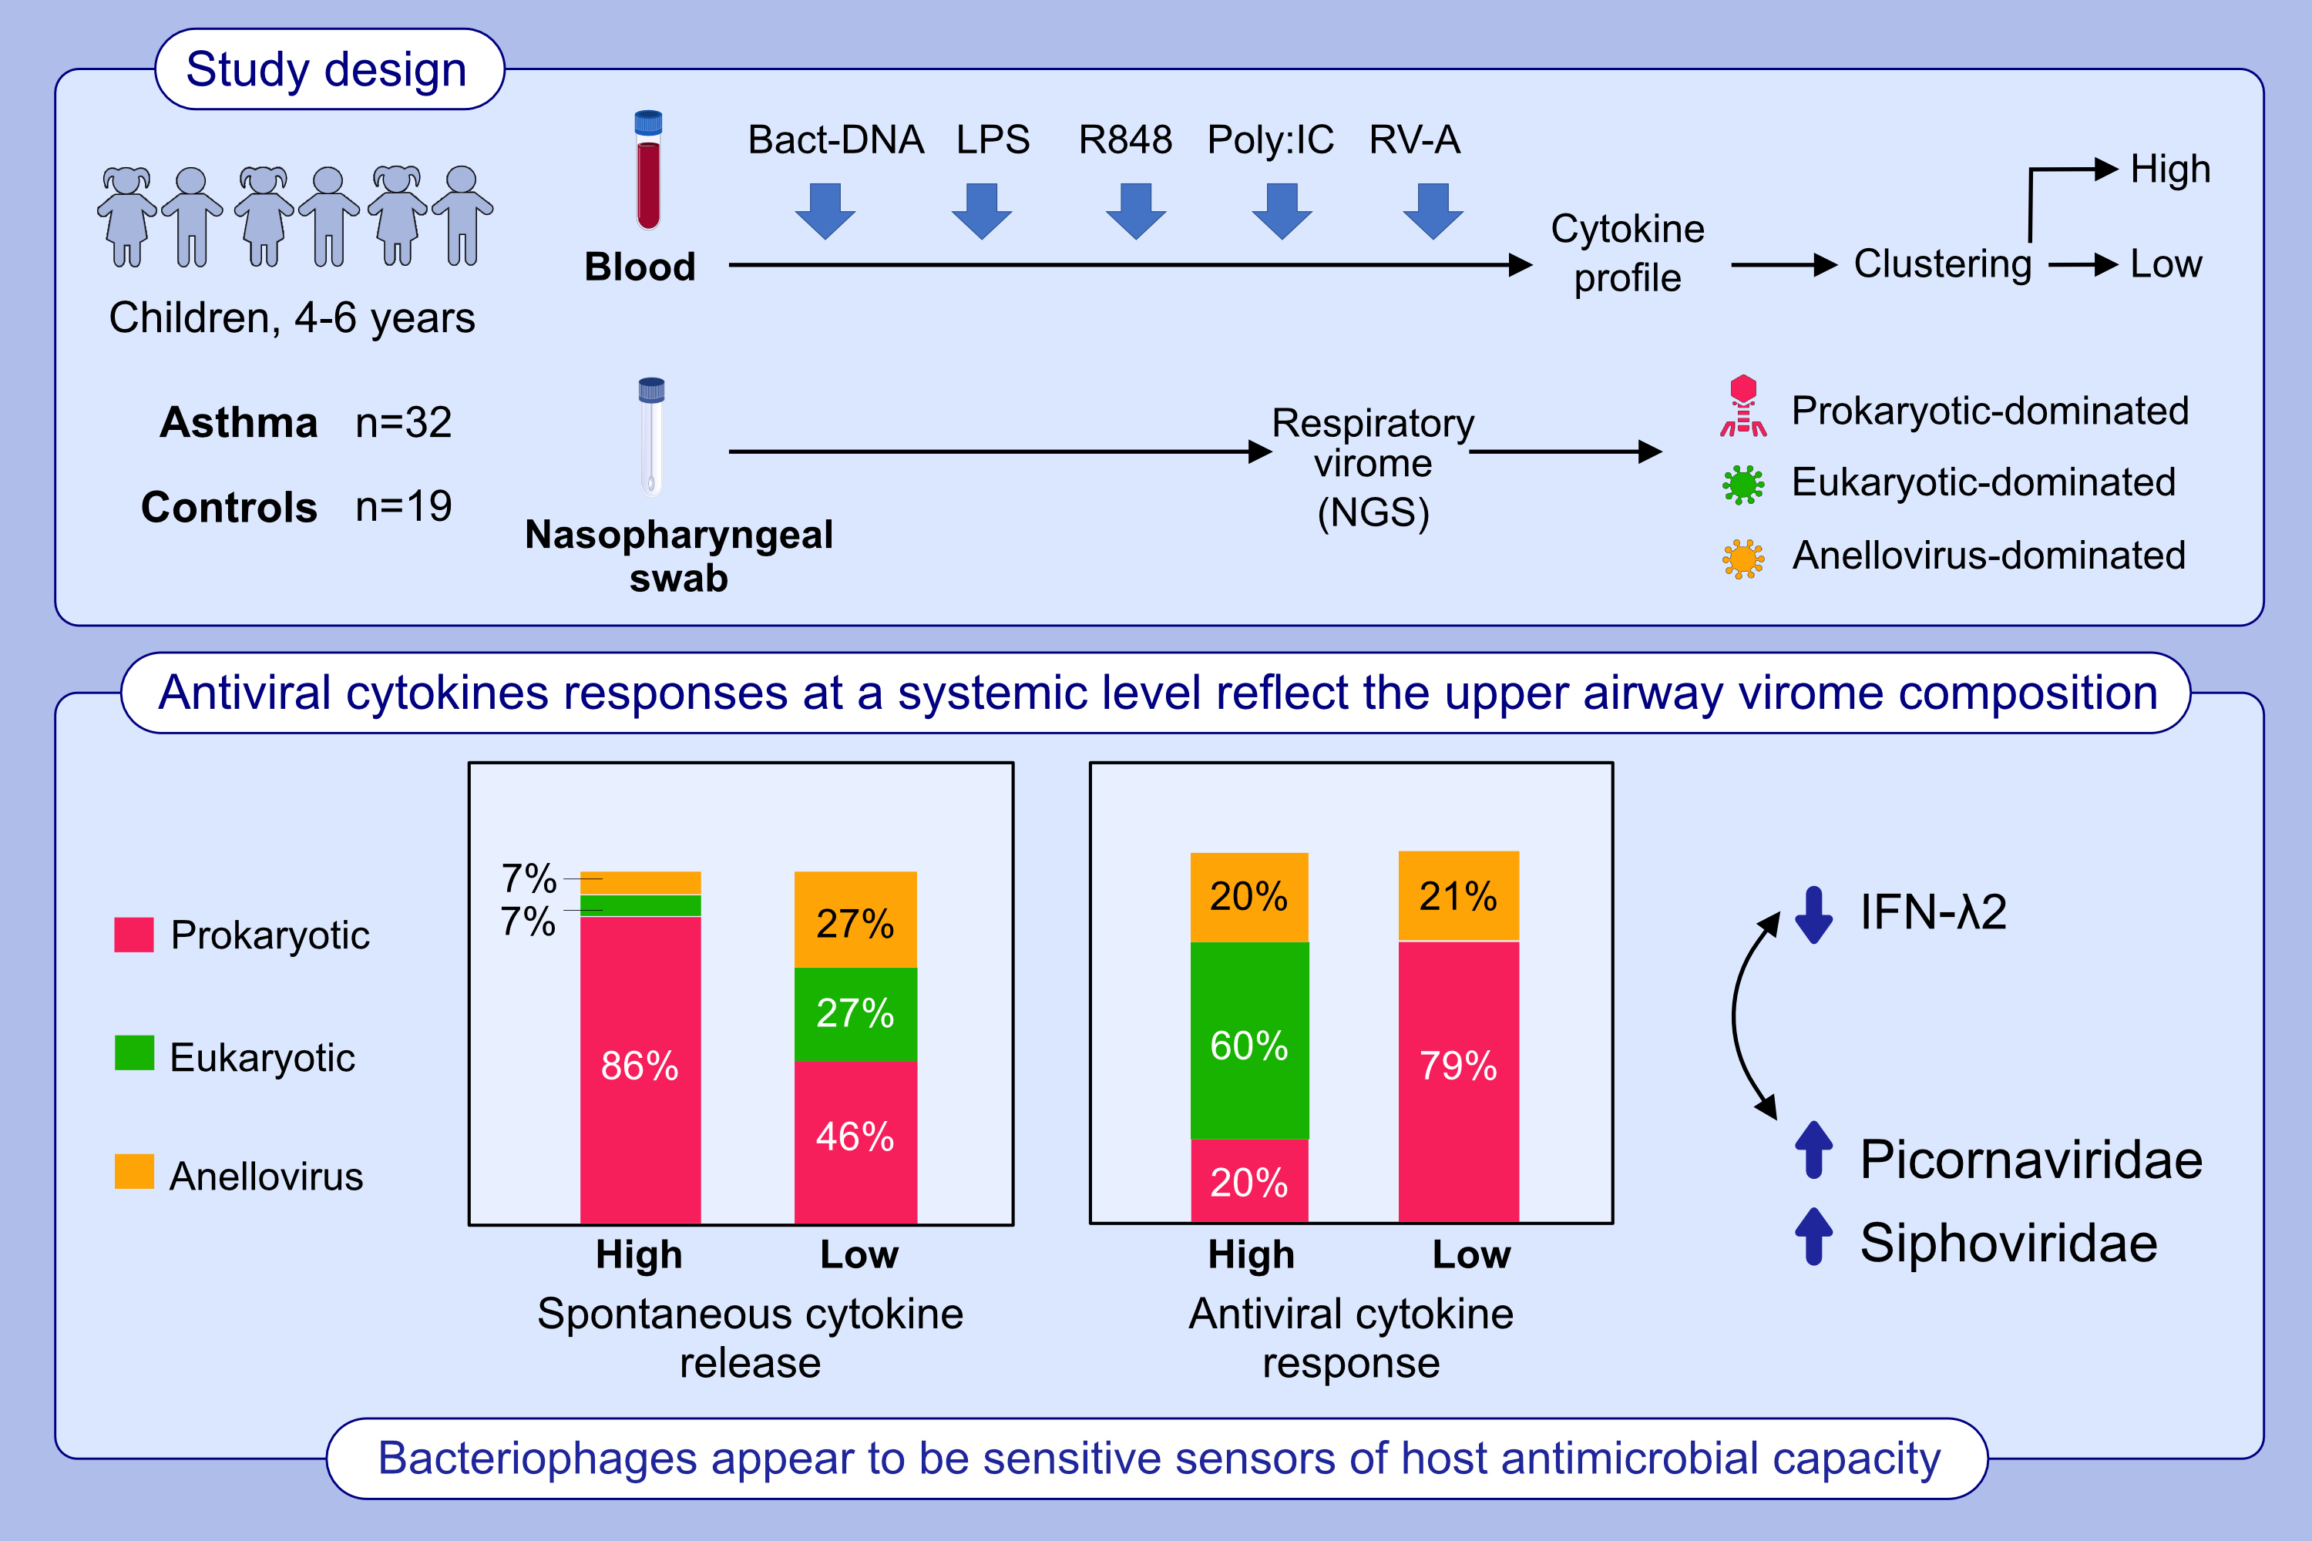
Respiratory virome profiles reflect antiviral immune responses
Judit Rovira Rubió, Spyridon Megremis, Maria Pasioti, John Lakoumentas, Bede Constantinides, et al.
Allergy. 2022; pages:1258-1268
https://doi.org/10.1111/all.15634
© 2019 EAACI and John Wiley and Sons A/S. Published by John Wiley and Sons Ltd.
Notes:
HIGHLIGHTS
Respiratory virome profiles of preschool children was associated with spontaneous cytokine release and stimulated antiviral responses from PBMCs, independent of asthma/allergy status.
Prokaryotic (bacteriophage)-type viromes dominated the high spontaneous cytokine release responder cluster.
High antiviral responders included more eukaryotic-dominated profiles, while low interferon lambda release correlated with increased presence of Picornaviridae and Siphoviridae.
Abbreviations: Bact-DNA, endotoxin-free bacterial DNA; LPS, lipopolysaccharides from E. coli 0111:B4; NGS, next generation sequencing; PBMCs, peripheral blood mononuclear cells: Poly I:C, polyinosinic–polycytidylic acid potassium salt; R848, resiquimod; RV-A, rhinovirus A.

