Slide 1
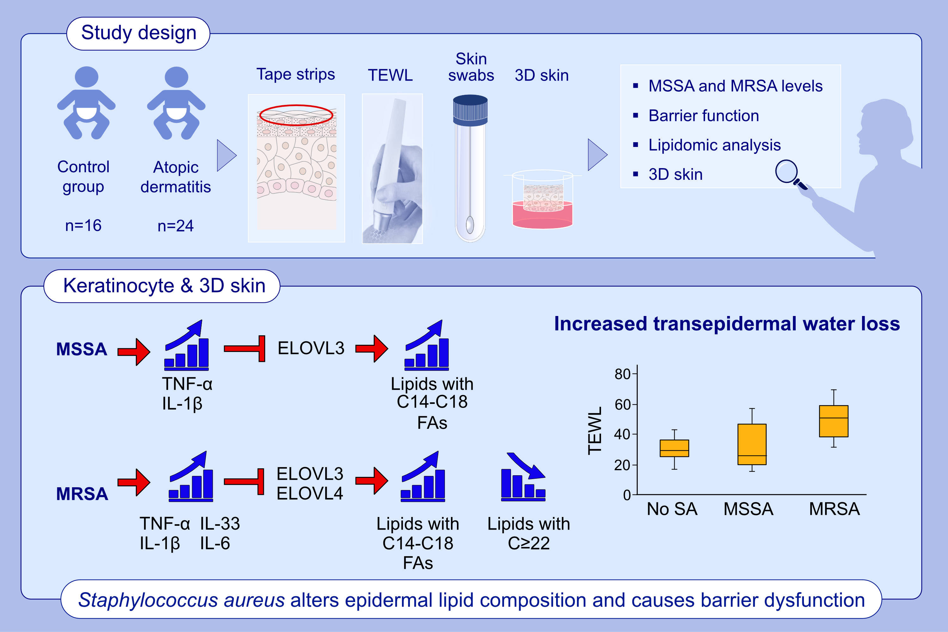
Staphylococcus aureus causes aberrant epidermal lipid composition and skin barrier dysfunction
Jihyun Kim, Byung Eui Kim, Evgeny Berdyshev, Irina Bronova, Lianghua Bin et al.
Allergy. 2022; pages: 1292-1306
https://doi.org/10.1111/all.15640
© 2019 EAACI and John Wiley and Sons A/S. Published by John Wiley and Sons Ltd.
Notes:
HIGHLIGHTS
MRSA induces a broad range of cytokines, while MSSA induces IL-1β and TNF-α.
S. aureus-induced IL-1β, TNF-α, and IL-6 inhibit ELOVL3, resulting in accumulation of lipids with C14-C18 FAs, while MRSA-induced IL-33 inhibits both ELOVL3 and ELOVL4, concomitantly increasing lipids with C14-C18 FAs and decreasing lipids with FAs≥22.
S. aureus-mediated aberrant lipid profiles cause increased TEWL and skin barrier dysfunction.
Abbreviations: 3D skin, organotypic skin; ELOVL, fatty acid elongase; FA, fatty acid; IL, interleukin; MRSA, methicillin-resistant Staphylococcus aureus; MSSA, methicillin-sensitive Staphylococcus aureus; SA, Staphylococcus aureus; TEWL, transepidermal water loss; TNF, tissue necrosis factor

