Slide 1
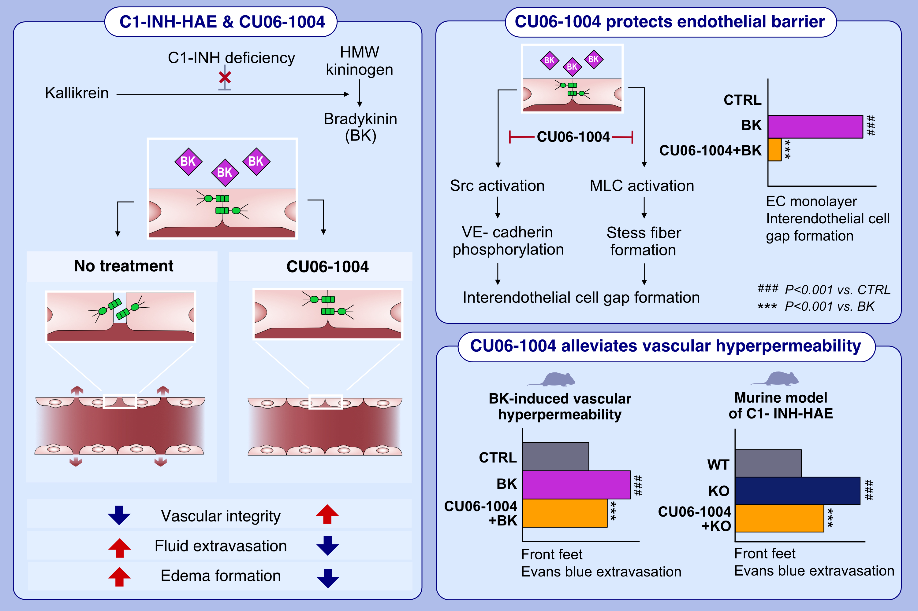
CU06-1004 alleviates vascular hyperpermeability in a murine model of hereditary angioedema by protecting the endothelium
Sunghye Lee, Yeomyeong Kim, Ye-Seul Kim, Haiying Zhang, Minyoung Noh, Young-Guen Kwon
Allergy. 2023; pages:1333-1346
https://doi.org/10.1111/all.15674
© 2019 EAACI and John Wiley and Sons A/S. Published by John Wiley and Sons Ltd.
Notes:
HIGHLIGHTS
Increased vascular permeability due to BK is the leading cause of the C1-INH-HAE.
CU06-1004 protects the endothelial barrier from BK-induced interendothelial cell gap formation by inhibiting VE-cadherin phosphorylation and F-actin formation.
CU06-1004 oral administration alleviates vascular hyperpermeability in C1-INH-HAE murine in vivo model by protecting vascular integrity.
Abbreviation: BK, bradykinin; C1-INH, C1 esterase inhibitor; C1-INH-HAE, hereditary angioedema caused by C1 esterase inhibitor deficiency; CTRL, control; CU06-1004, endothelial dysfunction blocker; EC, endothelial cell; F-actin, filamentous actin; HMW kininogen, high-molecular-weight kininogen; KO, knock-out; MLC, myosin light chain; Src, non-receptor tyrosine kinase; VE-cadherin, vascular endothelial cadherin; WT, wild type

