Slide 1
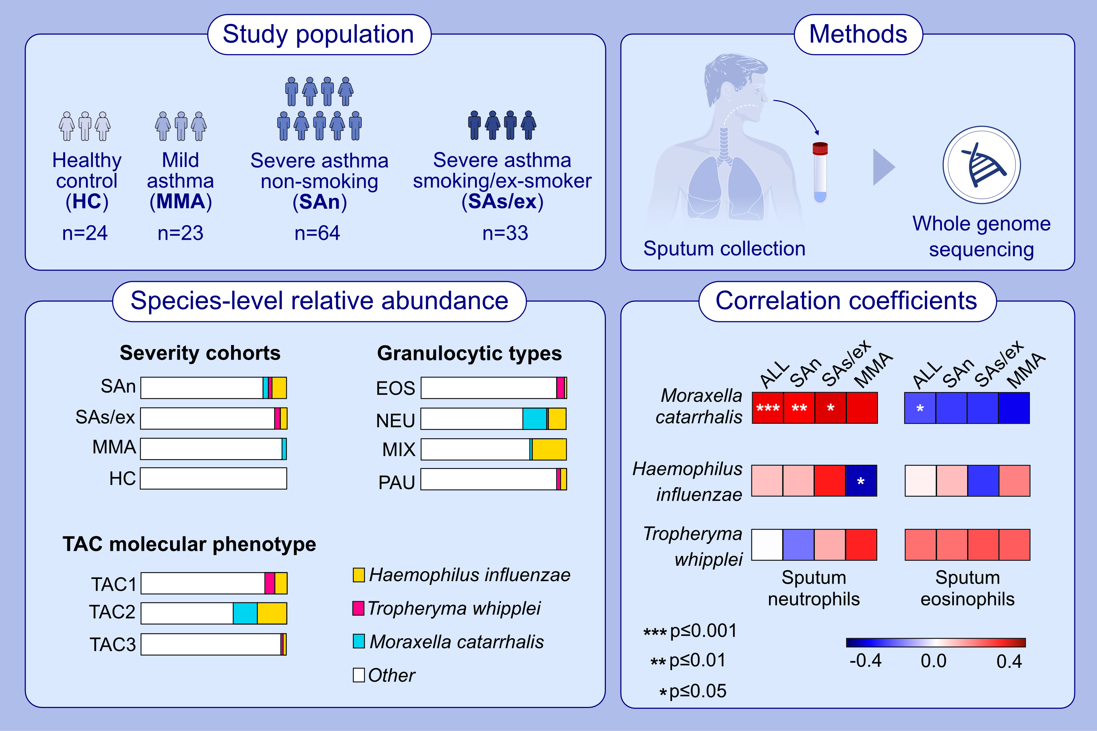
H influenzae & M catarrhalis in sputum of severe asthma with inflammasome and neutrophil activation
Ali Versi, Fransiskus Xaverius Ivan, Mahmoud I. Abdel-Aziz, Stewart Bates, John Riley, et al.
Allergy. 2023; pages:
https://doi.org/10.1111/all.15776
© 2019 EAACI and John Wiley and Sons A/S. Published by John Wiley and Sons Ltd.
Notes:
HIGHLIGHTS
This study analyses the bacterial species in sputum of patients with asthma. Haemophilus influenzae and Moraxella catarrhalis are in highest abundance in non-smoking severe asthma, neutrophilic asthma and TAC2 molecular phenotype linked to inflammasome and neutrophil activation compared to healthy controls.
Haemophilus influenzae and Tropheryma whipplei are more expressed in smoking/ex-smoking severe asthma and TAC1 molecular phenotype characterized by the expression of TSLP and IL-33 receptors, and type 2 inflammation.
Only Moraxella catarrhalis positively correlates with sputum neutrophilia.
Abbreviations: EOS, eosinophilic; IL-33, interleukin 33; MIX, mixed granulocytic; NEU, neutrophilic; PAU, paucigranulocytic; TAC, transcriptomic-associated cluster; TSLP, thymic stromal lymphopoietin.

