Slide 1
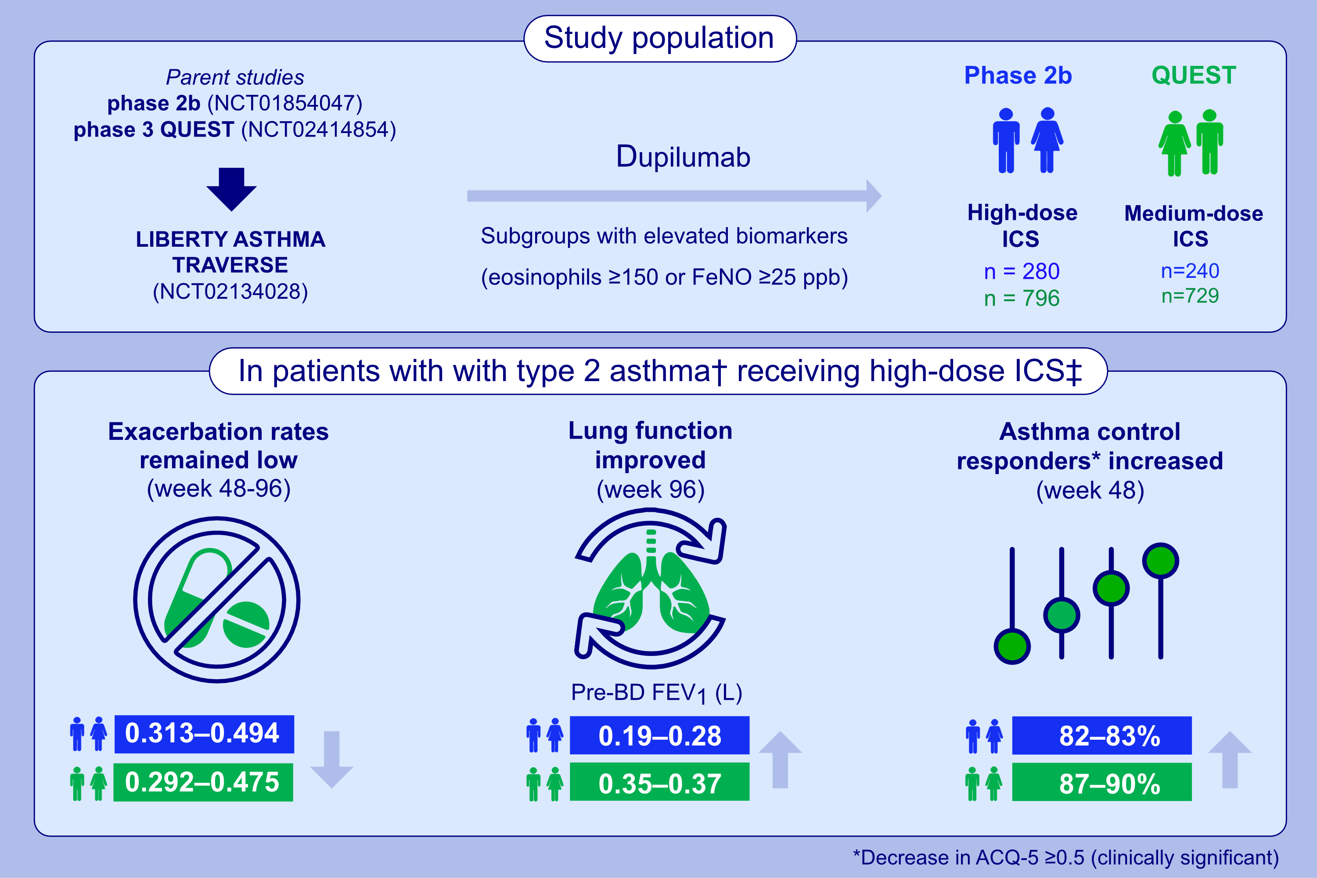
Dupilumab sustains efficacy in patients with moderate-to-severe type 2 asthma regardless of ICS dose
Ian D. Pavord, Arnaud Bourdin, Alberto Papi, Christian Domingo, Jonathan Corren, et al.
Allergy. 2023; pages: 2921-2932
https://doi.org/10.1111/all.15792
© 2019 EAACI and John Wiley and Sons A/S. Published by John Wiley and Sons Ltd.
Notes:
HIGHLIGHTS
Dupilumab sustained long-term efficacy in patients with type 2 asthma regardless of inhaled corticosteroid (ICS) dose at parent study baseline (PSBL).
Similar results were observed in subgroups of patients with elevated type 2 inflammatory biomarkers across ICS dose levels at PSBL.
These findings support the long-term use of dupilumab in patients with uncontrolled moderate-to-severe asthma on high- or medium-dose ICS.
Abbreviations: ACQ-5, 5-item asthma control questionnaire; BD, bronchodilator; FeNO, exhaled nitric oxide; FEV₁, forced expiratory volume in 1 second; ICS, inhaled corticosteroids; ppb, parts per billion; NCT, national clinical trial; PSBL, parent study baseline; q2w, every 2 weeks.
†Type 2 asthma is defined as blood eosinophils ≥150 cells/µL or FeNO ≥25 ppb. ‡Similar results were observed in patients receiving medium-dose ICS at PSBL and across the remaining subgroups analyzed

