Slide 1
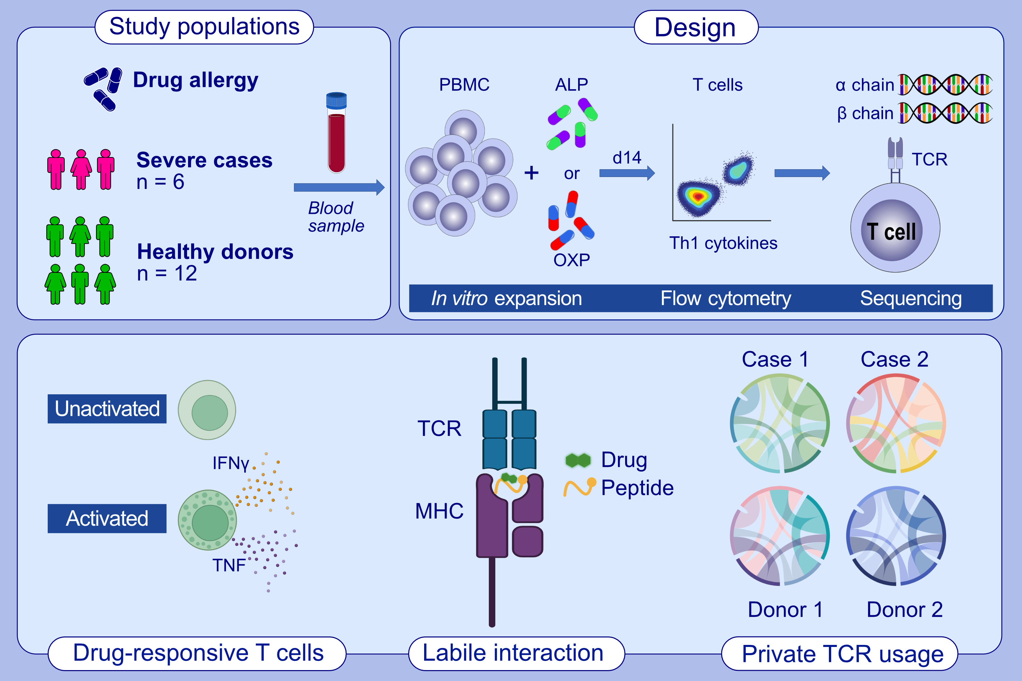
The allopurinol metabolite, oxypurinol, drives oligoclonal expansions of drug-reactive T cells in resolved hypersensitivity cases and drug-naïve healthy donors
Nicole A. Mifsud, Patricia T. Illing, Rebecca Ho, Johanna E. Tuomisto, Heidi Fettke, et al.
Allergy. 2023; pages:2980-2993
https://doi.org/10.1111/all.15814
© 2019 EAACI and John Wiley and Sons A/S. Published by John Wiley and Sons Ltd.
Notes:
HIGHLIGHTS
T cells from healthy drug-naïve donors and patients with resolved ALP-induced hypersensitivity reactions were exposed to ALP and OXP to expand drug-responsive T cells.
Activated and cytokine-producing drug-responsive T cells were single-cell sorted and sequenced to determine their TCR repertoire clonotypes.
We demonstrated that OXP is the driver of CD8 + T cell-mediated responses and that drug-exposed memory T cells can exhibit a proinflammatory immunophenotype similar to T cells described during active disease.
Abbreviations: ALP, allopurinol; IFNγ, interferon gamma; MHC, major histocompatibility complex; OXP, oxypurinol; PBMC, peripheral blood mononuclear cells; TCR, T cell receptor; Th, T helper; TNF, tumour necrosis factor.

