Slide 1
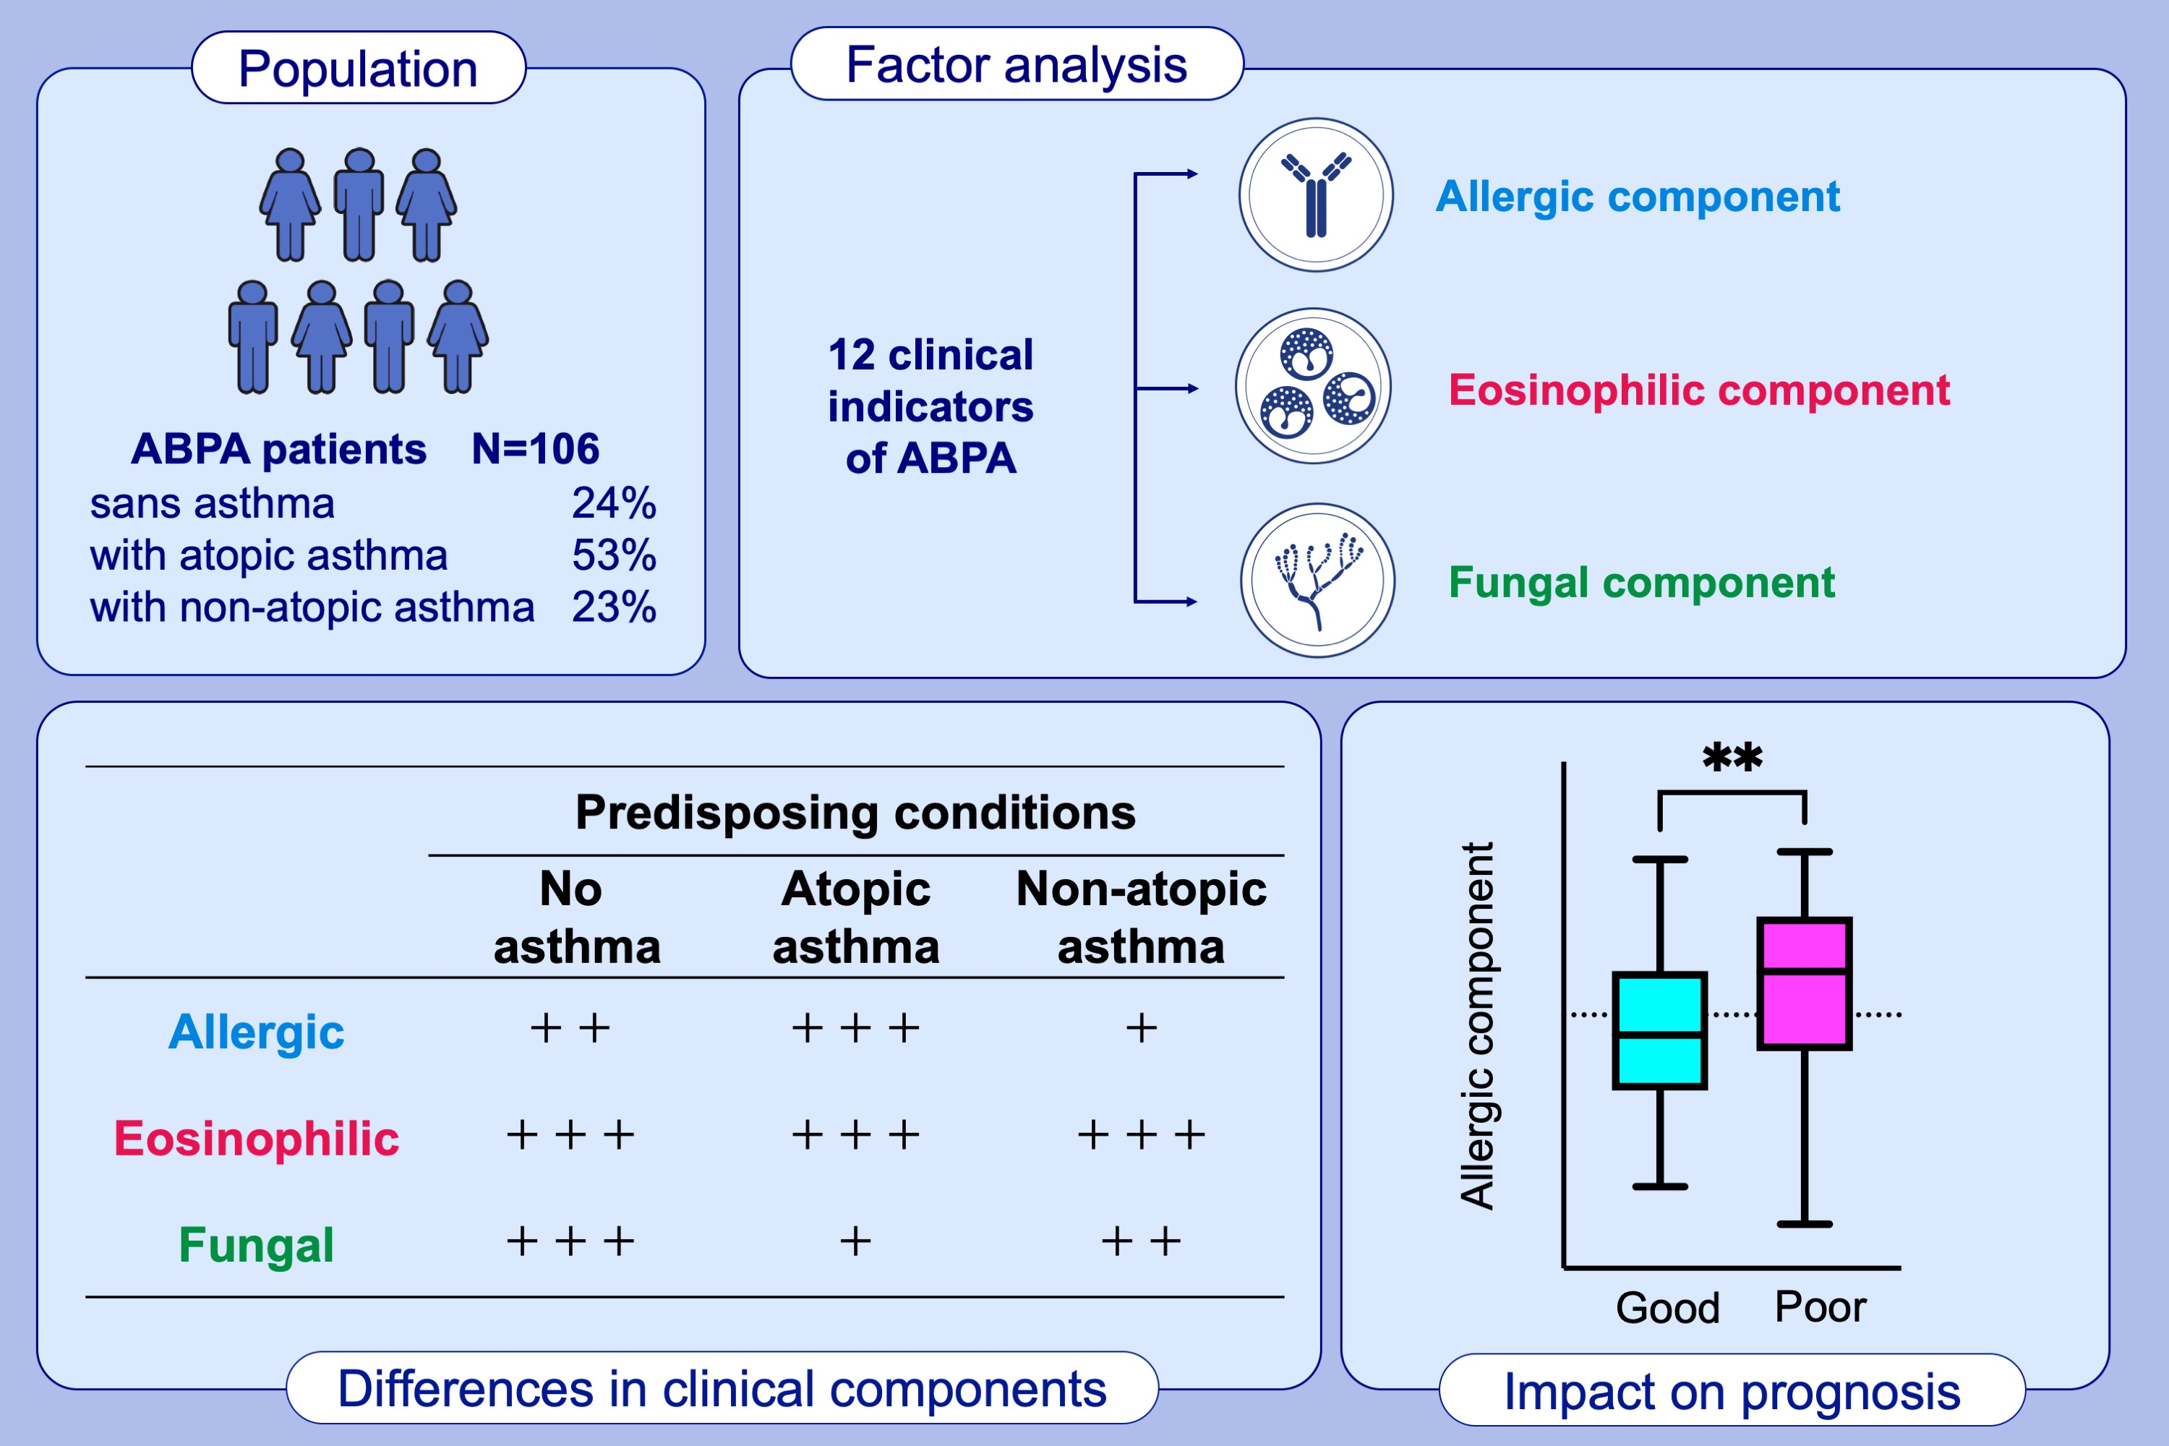
Allergic bronchopulmonary aspergillosis with atopic, non-atopic, and sans asthma – factor analysis
Naoki Okada, Yoshiro Yamamoto, Tsuyoshi Oguma, Jun Tanaka, Katsuyoshi Tomomatsu, et al.
Allergy. 2023; pages: 2933-2943
https://doi.org/10.1111/all.15820
© 2019 EAACI and John Wiley and Sons A/S. Published by John Wiley and Sons Ltd.
Notes:
HIGHLIGHTS
Japanese patients with ABPA were categorized into three groups according to the predisposing conditions: ABPA sans asthma (no preceding asthma or cystic fibrosis), ABPA with atopic asthma, and ABPA with non-atopic asthma.
Exploratory and confirmatory factor analyses identified allergic, eosinophilic, and fungal components.
Eosinophil component remains consistent regardless of the preceding asthma or atopic status, suggesting that it is the cardinal feature of ABPA. On the other hand, allergic component is related with prognosis of ABPA.
Abbreviations: ABPA, allergic bronchopulmonary aspergillosis.
** P = 0.01

