Slide 1
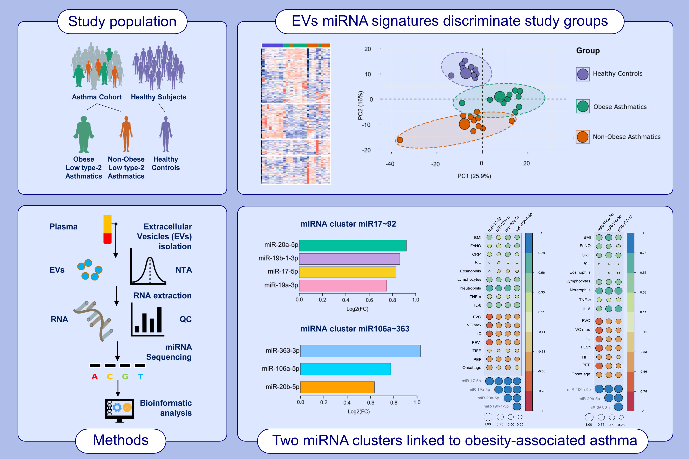
Identification of extracellular vesicle microRNA signatures specifically linked to inflammatory and metabolic mechanisms in obesity-associated low type-2 asthma
Fahd Alhamdan, Timm Greulich, Christian Daviaud, Leigh M. Marsh, Frauke Pedersen, et al.
Allergy. 2023; pages:2944-2958
https://doi.org/10.1111/all.15824
© 2019 EAACI and John Wiley and Sons A/S. Published by John Wiley and Sons Ltd.
Notes:
HIGHLIGHTS
This study utilizes extracellular vesicle (EV) miRNA signatures to gain new insights into underlying molecular mechanisms of obesity-associated low type-2 asthma. EV miRNA expression profiles allowed distinction between the three study groups.
Integrative pathway analysis of potential target genes of the differentially expressed miRNAs revealed inflammatory cytokines and metabolic factors signaling pathways to be specifically linked to obesity-associated low type-2 asthma.
In particular, in plasma EV microRNA signatures we identified two miRNA clusters, miR-17~92 and -106a~363, to be associated with specific inflammatory and metabolic mechanisms of the obesity-associated low type-2 asthma phenotype.
Abbreviations: BMI, body mass index; CRP, C-reactive protein; EV, extracellular vesicles; FC, fold change; FeNO, fractional exhaled nitric oxide; FEV1, forced expiratory volume in the first second; FVC, forced vital capacity; IC, inspiratory capacity; miR, microRNA; NTA, nanoparticle tracking analysis; PC, principal component; PEF, peak expiratory flow; QC, quality control; TIFF, Tiffeneau-Pinelli index (FEV1/FVC); VC, vital capacity

