Slide 1
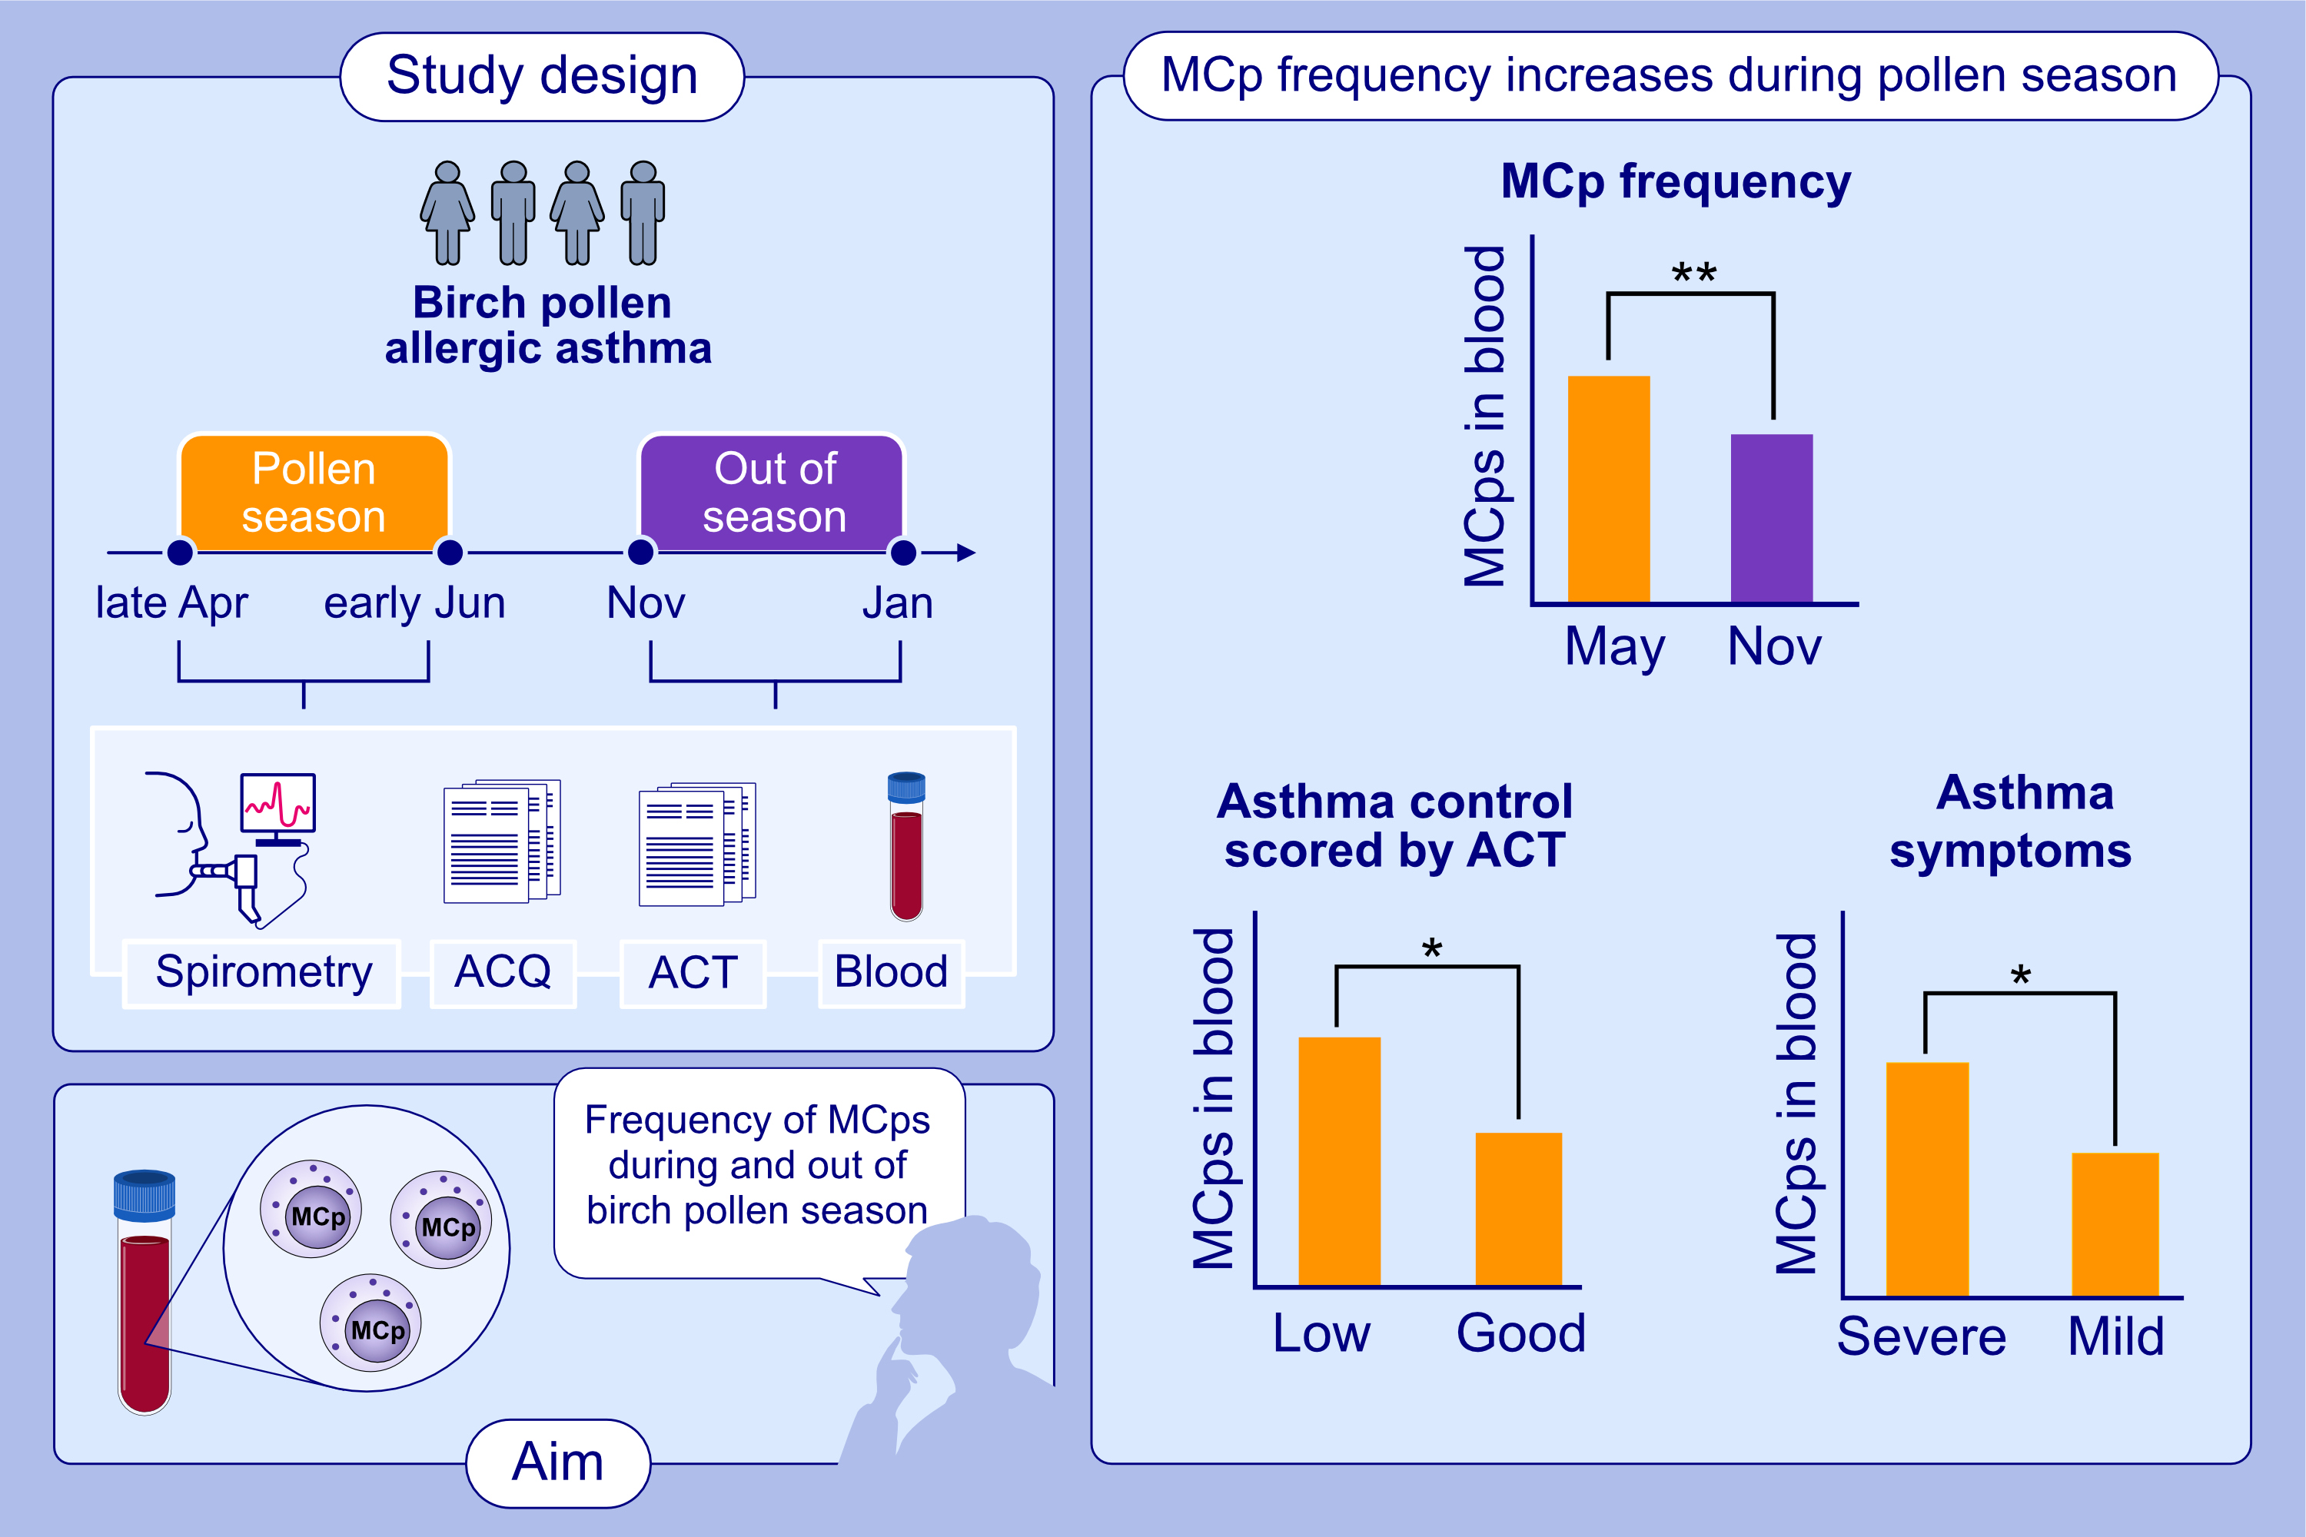
Circulating mast cell progenitors increase during natural birch pollen exposure in allergic asthma patients
P. Abigail Alvarado-Vazquez, Erika Mendez-Enriquez, Maya Salomonsson, Ida Waern, Christer Janson,, et al.
Allergy. 2023; pages:2959-2968
https://doi.org/10.1111/all.15860
© 2019 EAACI and John Wiley and Sons A/S. Published by John Wiley and Sons Ltd.
Notes:
HIGHLIGHTS
The frequency of blood circulating MCps was investigated in birch-pollen sensitized asthma patients during birch pollen season and out of the pollen season.
The MCp frequency was higher in pollen season than out of season.
In pollen season, the patients with more asthma symptoms, and reduced asthma control had more circulating MCps.
Abbreviations: ACQ, asthma control questionnaire; ACT, asthma control test; MCp, mast cell progenitor.

