Slide 1
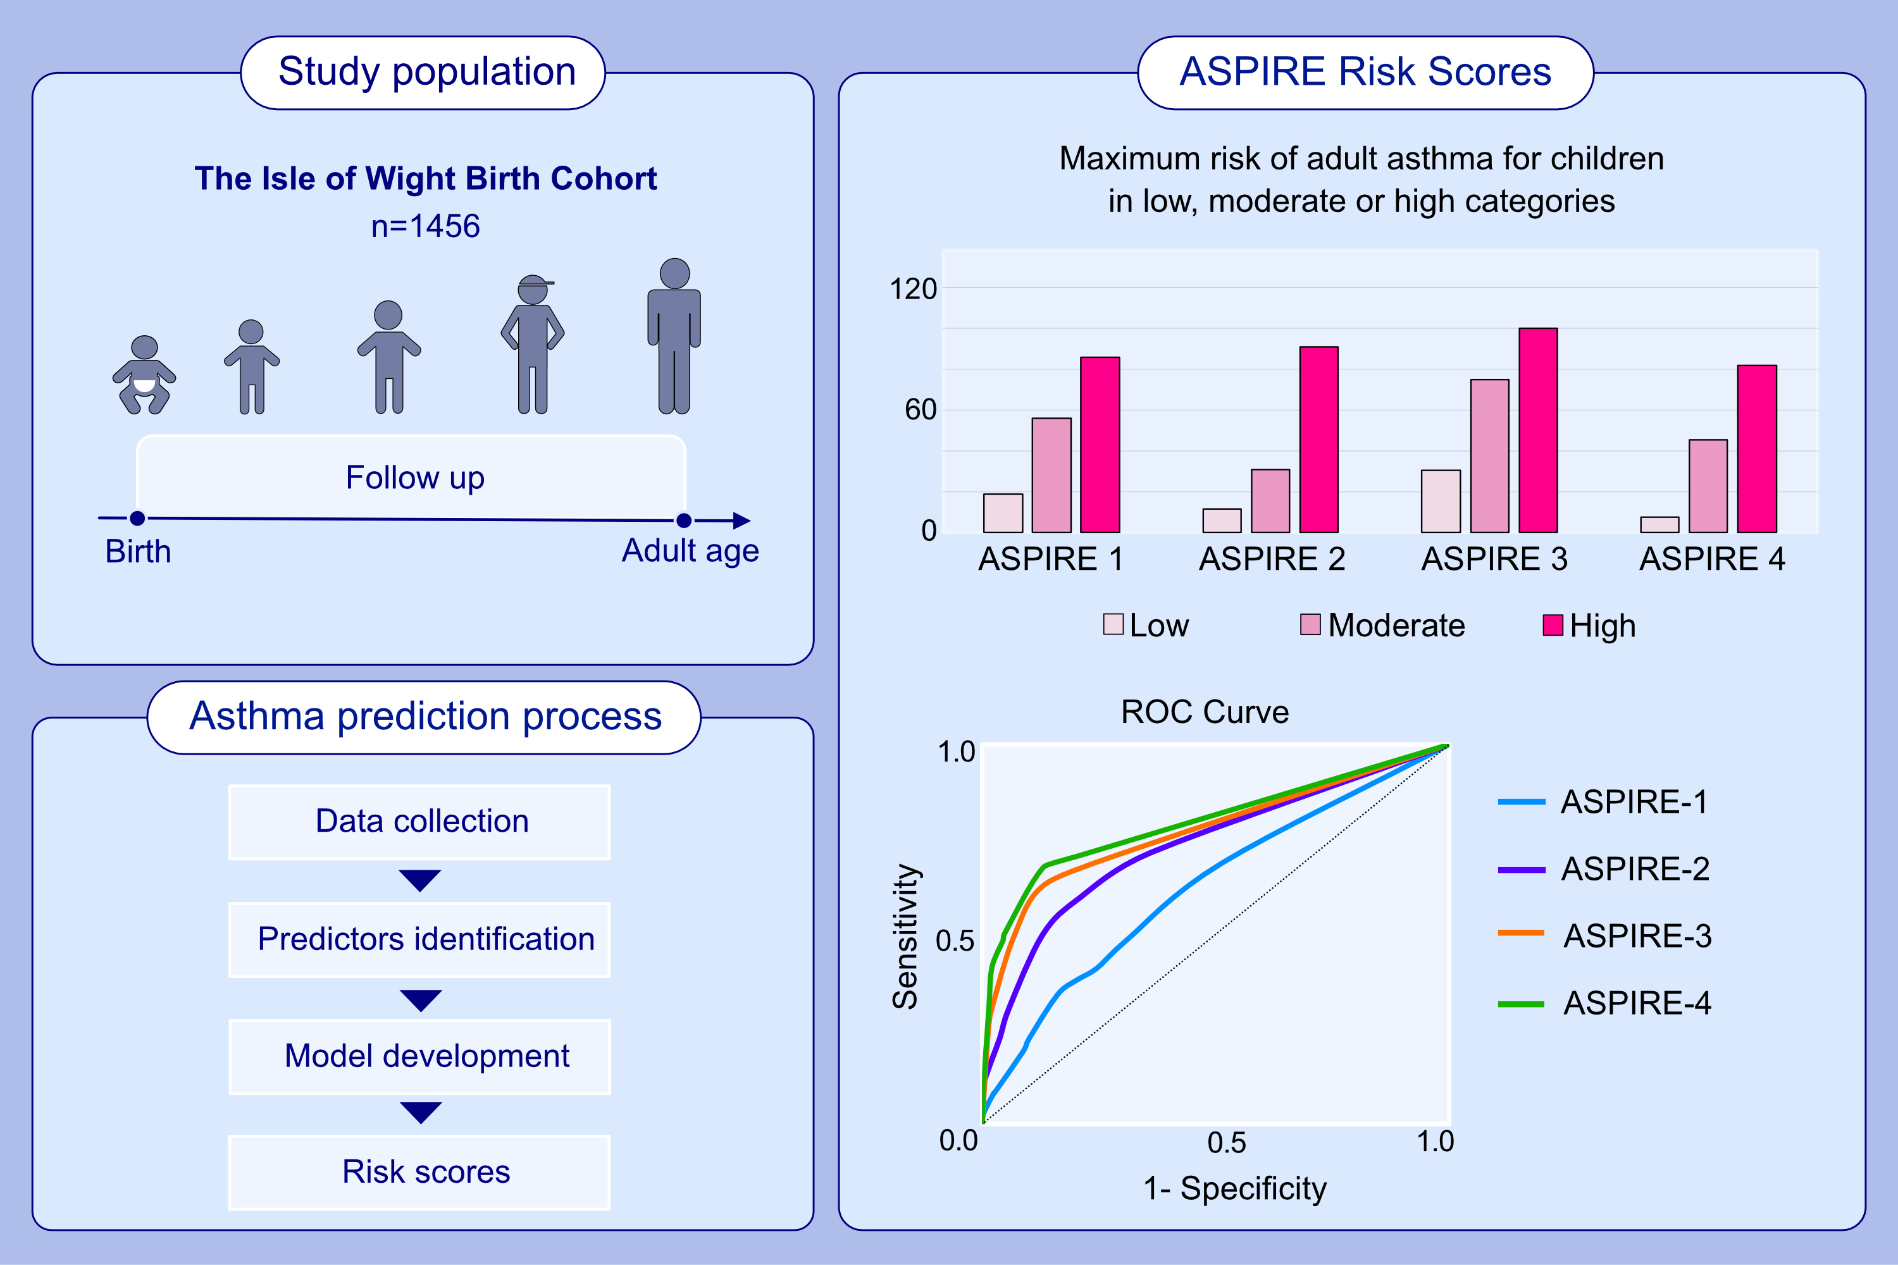
Prediction of Adult Asthma-risk in early childhood using novel adult asthma predictive risk scores
Abdal J. Farhan, Dilini M. Kothalawala, Ramesh J. Kurukulaaratchy, Raquel Granell, Angela Simpson et al.
Allergy. 2023; pages:2969-2979
https://doi.org/10.1111/all.15876
© 2019 EAACI and John Wiley and Sons A/S. Published by John Wiley and Sons Ltd.
Notes:
HIGHLIGHTS
We aimed to create childhood risk scores for adult asthma prediction.
Four ASPIRE models were developed in the Isle of Wight cohort that has been followed to young adult life and validated internally and externally.
In the high-risk score category, the maximum risk of adult asthma ranged from 80 to 100%. The predictive accuracy was highest for persistent adult asthma.
Abbreviations: ASPIRE, Adult Asthma Predictive Risk Scores; ROC, receiver operating characteristic

