Slide 1
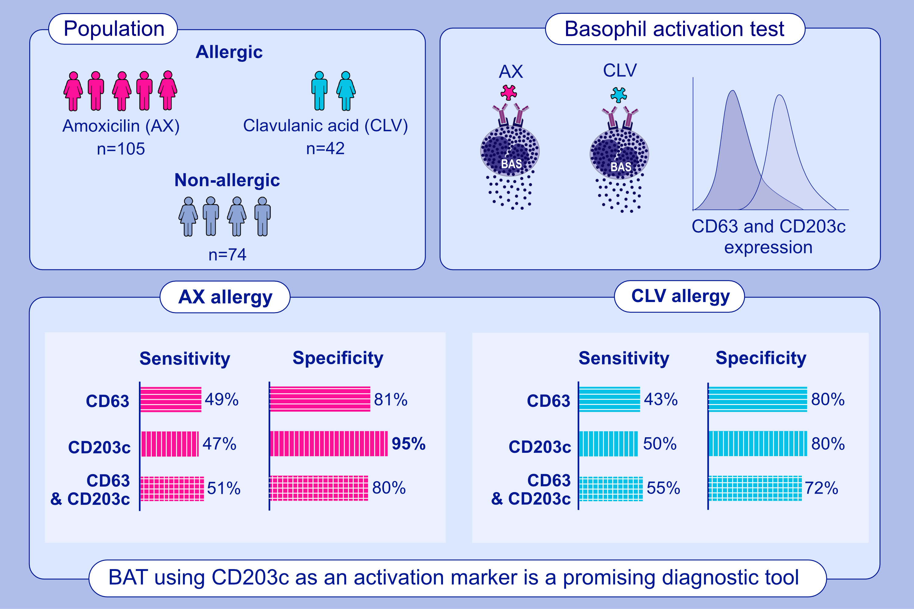
Diagnosis of immediate reactions to amoxicillin: Comparison of basophil activation markers CD63 and CD203c in a prospective study
Jose A. Céspedes, Rubén Fernández-Santamaría, Adriana Ariza, Gador Bogas, Inmaculada Doña, et al.
Allergy. 2023; pages: 2745-2755
https://doi.org/10.1111/all.15610
© 2019 EAACI and John Wiley and Sons A/S. Published by John Wiley and Sons Ltd.
Notes:
HIGHLIGHTS
Patients suffering from an immediate reaction after AX or AX-CLV intake have been prospectively recruited. BAT with CD63 and CD203c was performed.
BAT using CD203c in IRs to AX has shown high specificity and good confirmatory power.
BAT to AX with CD203c as first step in the diagnostic algorithm could avoid the performance of in vivo tests in some patients.
Abbreviations: AX, amoxicillin; BAT, basophil activation test; CLV, clavulanic acid; IRs, immediate reactions

