Slide 1
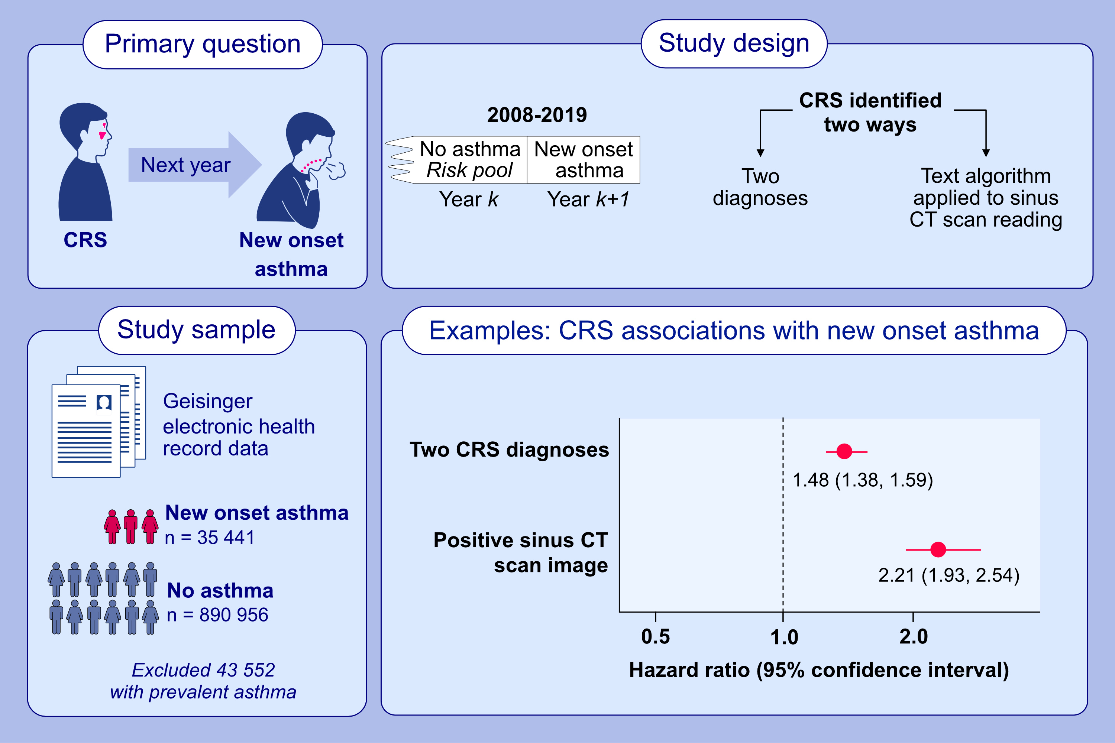
Sinus inflammation and chronic rhinosinusitis are associated with a diagnosis of new onset asthma in the following year
Brian S. Schwartz, Jonathan S. Pollak, Karen Bandeen-Roche, Annemarie G. Hirsch, Ashton E. Lehmann, ,et al.
Allergy. 2023; pages: 2659-2668
https://doi.org/10.1111/all.15771
© 2019 EAACI and John Wiley and Sons A/S. Published by John Wiley and Sons Ltd.
Notes:
HIGHLIGHTS
CRS and asthma commonly co-occur, but no studies have leveraged the very large sample sizes needed to address whether preexisting CRS is associated with new onset asthma over time.
In a longitudinal study of over 900,000 persons from 2008–2019, prevalent CRS (identified with sinus CT scan or diagnoses) was associated with 1.5-2.2-fold increased risk of the diagnosis of new onset asthma in the following year.
The findings may have implications for the prevention of adult-onset asthma.
Abbreviations: CRS, chronic rhinosinusitis; CT, computerized tomography.

