Slide 1
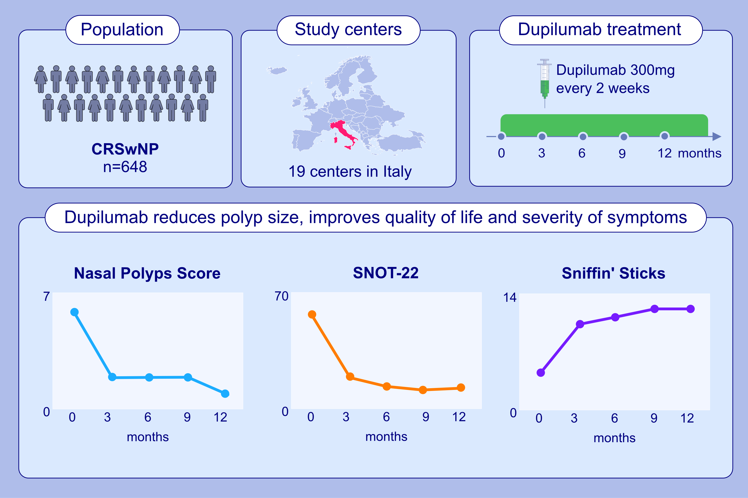
Dupilumab in the treatment of severe uncontrolled CRSwNP: a multicentric observational phase 4 real-life study (DUPIREAL)
Eugenio De Corso, Ernesto Pasquini, Matteo Trimarchi, Ignazio La Mantia, Fabio Pagella , et al.
Allergy. 2023; pages: 2669-2683
https://doi.org/10.1111/all.15772
© 2019 EAACI and John Wiley and Sons A/S. Published by John Wiley and Sons Ltd.
Notes:
HIGHLIGHTS
This study assessed the effectiveness and safety of dupilumab in severe uncontrolled CRSwNP.
In the first 12-months, dupilumab significantly decreased NPS and SNOT-22 and improved smell function; an excellent-moderate response was observed in 96.9% of patients.
At study end, only 6 patients had discontinued dupilumab due to a major adverse event.
Abbreviations: CRSwNP, chronic rhinosinusitis with nasal polyps; NPS, nasal polyp score; SNOT-22, sino-nasal outcomes test-22

