Slide 1
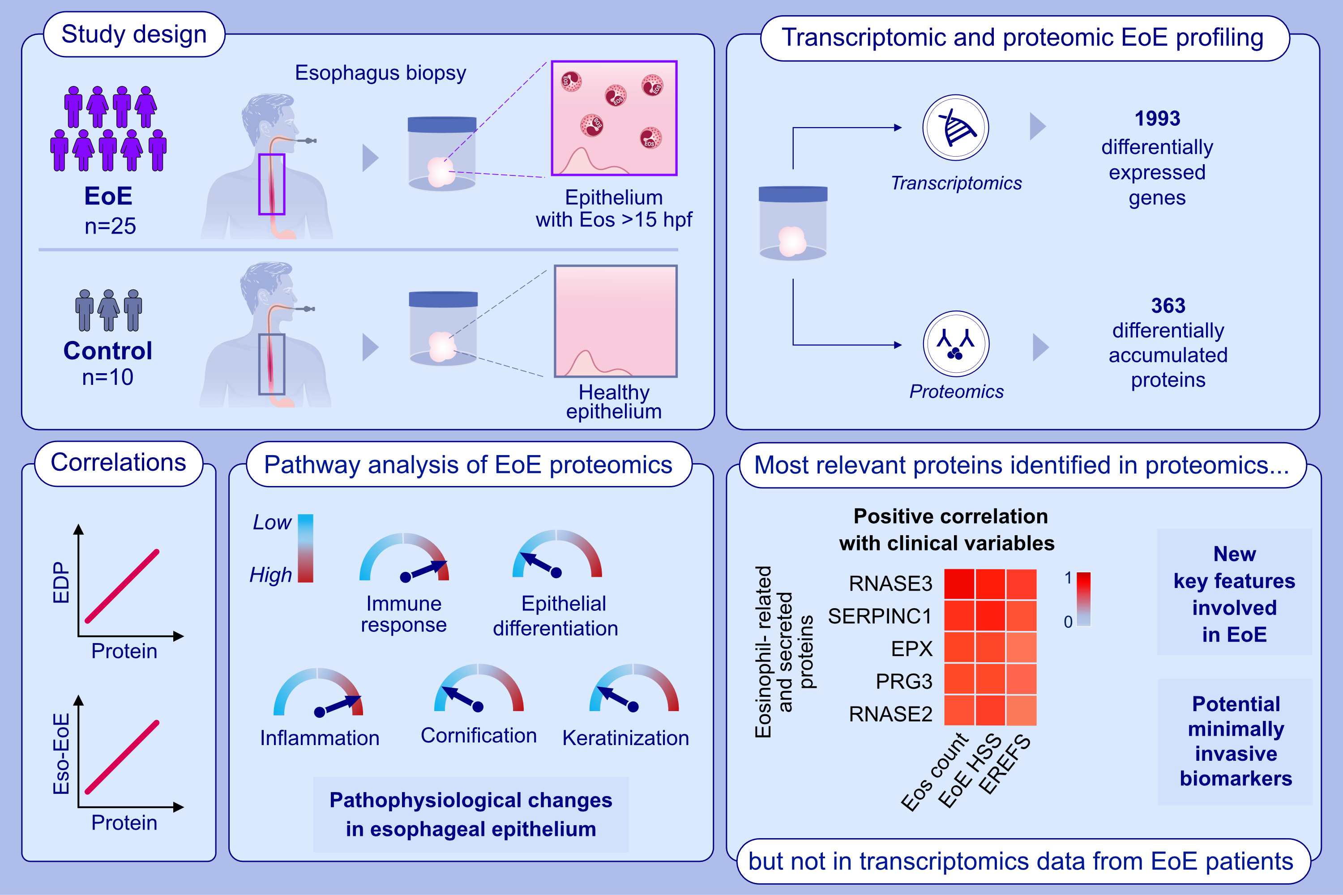
Proteomic Analysis Reveals Key Features of Eosinophilic Esophagitis Pathophysiology
Francisca Molina-Jiménez, Lola Ugalde-Triviño, Laura Arias-González, Carlos Relaño-Rupérez, Sergio Casabona, María Teresa Pérez-Fernández, et al.
Allergy. 2023; pages:
https://doi.org/10.1111/all.15779
© 2019 EAACI and John Wiley and Sons A/S. Published by John Wiley and Sons Ltd.
Notes:
HIGHLIGHTS
This study employed unbiased proteomics approach and RNAseq to investigate pathophysiological changes in esophageal epithelium.
Protein expression positively correlated with EDP and Eso-EoE, and corresponded with the most abundant proteins of the human esophageal proteome. Pathway analysis in EoE showed alterations in immune and inflammatory responses, epithelial differentiation, cornification and keratinization.
A set of differentially accumulated proteins, including eosinophil-related and secreted proteins, was not detected at mRNA level.
Abbreviations: EDP, EoE diagnostic panel; EoE, eosinophilic esophagitis; EPX, eosinophil peroxidase; Eos, eosinophil; EREFS, EoE endoscopic reference score; Eso-EoE, esophageal biopsy from EoE patient; hpf, high-power field; HSS, histologic scoring system; PRG3, proteoglycan 3; RNASE, ribonuclease A family member; RNAseq, RNA sequencing; SERPINC1, serpin family C member 1

