Slide 1
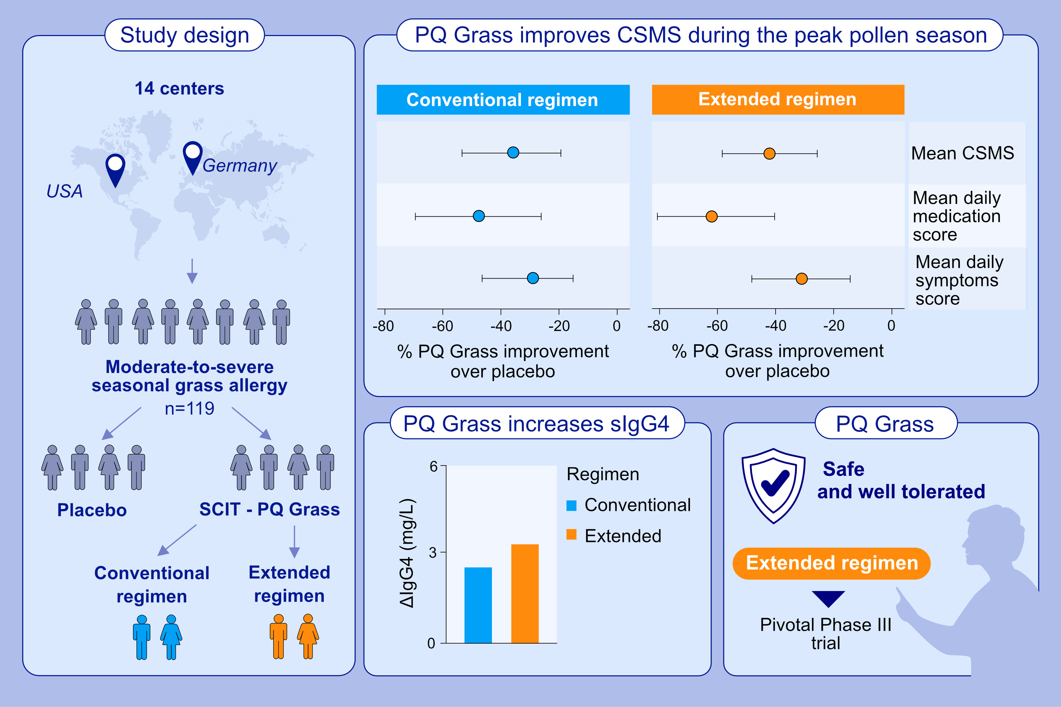
Short-course subcutaneous treatment with PQ Grass strongly improves symptom
and medication scores in grass allergy
P. J. de Kam, S. Zielen, J. A. Bernstein, U. Berger, M. Berger, M. Cuevas, D. Cypcar, , et al.
Allergy. 2023; pages: 2756-2766
https://doi.org/10.1111/all.15788
© 2019 EAACI and John Wiley and Sons A/S. Published by John Wiley and Sons Ltd.
Notes:
HIGHLIGHTS
PQ Grass or placebo were administered in a double-blind fashion to 119 adult subjects with moderate-to-severe seasonal grass allergy.
The primary CSMS showed a clinically relevant and statistically significant improvement after PQ Grass compared to placebo for both regimens: 39.5% [p=0.0112; 80% CI: -54.7% to -24.4%] and 33.1% [p=0.0325; 80% CI: -48.8% to -17.4%] for the extended and conventional regimen, respectively.
An increase in IgG4 was shown for both extended and conventional regimen (p<0.01). Both regimens were well-tolerated. Based on enhanced efficacy profile extended regime will be progressed to the pivotal Phase III trial.
Abbreviations: CI, confidence interval; CSMS, combined symptom and medication score;
PQ Grass, a modified grass allergen subcutaneous immunotherapy product with MicroCrystalline Tyrosine and Monophosphoryl Lipid-A as an adjuvant system

